Slide 1
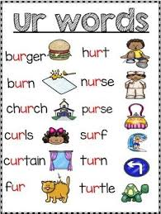

ur

Slide 2

burn

Slide 3
hurt

Slide 4
church

Slide 5

turn

Slide 6

burger

Slide 7

curl

Slide 8

turkey

Slide 9
burst

Slide 10

ir, er, ur

Slide 11
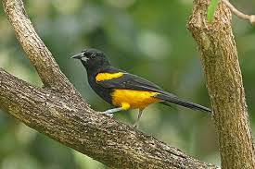



Slide 12
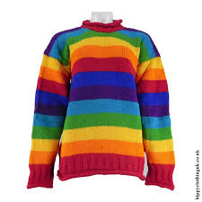
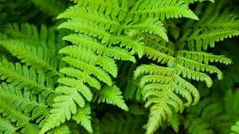


Slide 13
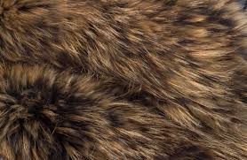
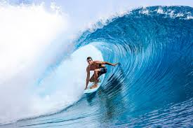


Slide 14


Guess the split digraph!
?
h - v -

Slide 15
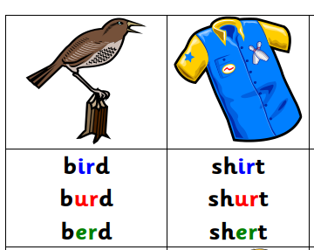
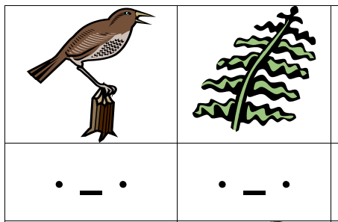
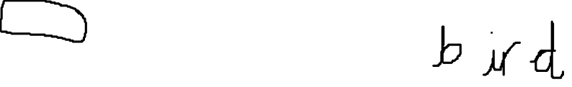
1 Star
2 Star
Circle the correct spelling.
Write the correct word.

