Slide 1





Chalfont St Peter Infant School
Year R Presentation
Tuesday 30th September 2025

Slide 2



Communication and Language
The children will be learning to:
  talk confidently and clearly
  have conversations back and forth
  show awareness of the listener
  enjoy listening to stories, songs, poems; showing good attention
  follow instructions
  answer questions about stories
  use new vocabulary
  talk in sentences using different tenses

Slide 3

Personal, Social and Emotional Development
The children will be learning to:
  become self-confident
  have awareness of their own feelings and those of others
  use the Zones of Regualtion
  build relationships with peers and staff
  become independent
  share and take turns
  have focussed attention and respond appropriately

Slide 4
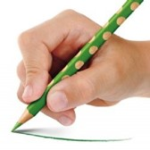
Physical Development
The children will be learning to:
  move confidently
  negotiate space
  control their body
  handle equipment such as pencils, scissors, cutlery
  use a tripod grip

Slide 5

Literacy
The children will be learning to:
  retell stories
  make marks and give meanings to those marks
  read sounds, words and sentences
  form letters correctly
  spell and write words and sentences which can be read by others
  read and write tricky words

Slide 6
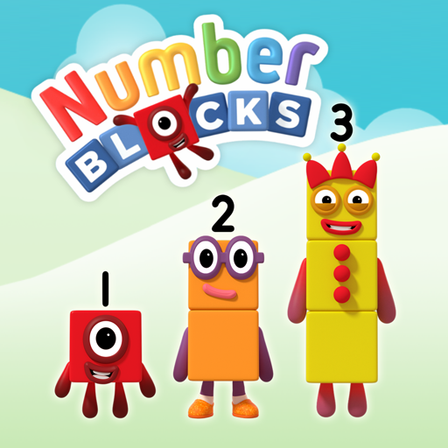
Mathematics
The children will be learning to:
  recognise numbers to 10+
  explore the composition of numbers
  subitise to 5
  recall number bonds to 5
  count beyond 20
  compare quantities
  recognise patterns in numbers (doubles, odd, evens)
  recognise and name 2D and 3D shapes
  explore weight, capacity, length and height

Slide 7

Understanding the World
The children will:
  explore and find out about the world around them
  find out about past events in their live and their families
  talk about the lives of people around them
  know similarities and differences between cultures and communities
  compare life in this country with another country
  talk about changes through the seasons

Slide 8

Expressive Art and Design
The children will:
  use a variety of materials
  share their creations and talk about the process
  use props to enhance their role play
  sing a range of songs
  explore colour mixing and different types of paint

Slide 9




Phonics

Slide 10


Phonics is...
"making connections between the sounds of our spoken words and the letters that are used to write them down."

Slide 11



How do we teach phonics?
Teach and Practise
Revisit and Review
New phoneme (sound) and grapheme (written sound), orally blend new words, read new words, learn new tricky words
Practise and Apply
Recap previously taught sounds, decodable words and tricky words
Oral blending games, read sentence, write words and tricky words, write a sentence

Slide 12

Reading Practice Sessions
Children take part in reading practice sessions three times a week and they read the same book all week.
Session 1: Decoding- Developing fluency
Session 2: Prosody- Reading with expression
Session 3: Comprehension- Reading with expression, fluency and answering questions about what they have read

Slide 13

Tricky Words
These are words that can not be read using phonics. The children are taught the tricky part of each word.

Slide 14

Spelling
Say the word.
Segment the sounds.
Count the sounds.
Write them down.

Slide 15
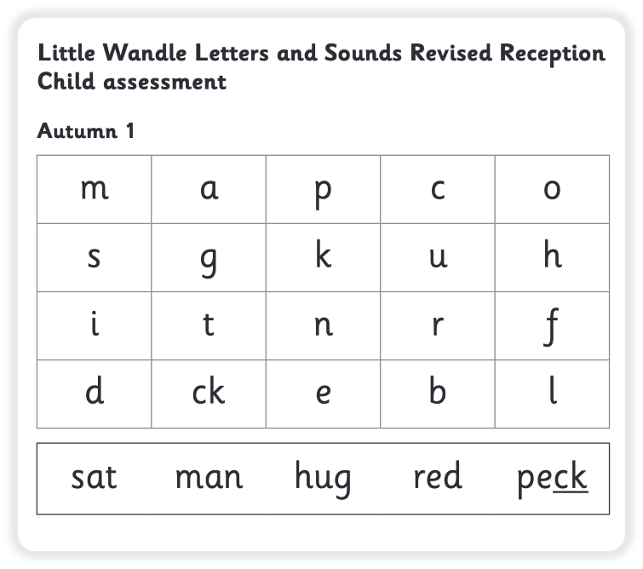
Assessment
Every six weeks we will assess the children on the sounds and words they have been taught. We will use these assessments to choose the right reading level that matches their phonetic knowledge.

Slide 16


Reading Books
Decodable Book
Sharing Books
This book is matched to the child’s phonic stage that they can read independently.
This is a book that your child can talk about and enjoy with you.

Slide 17
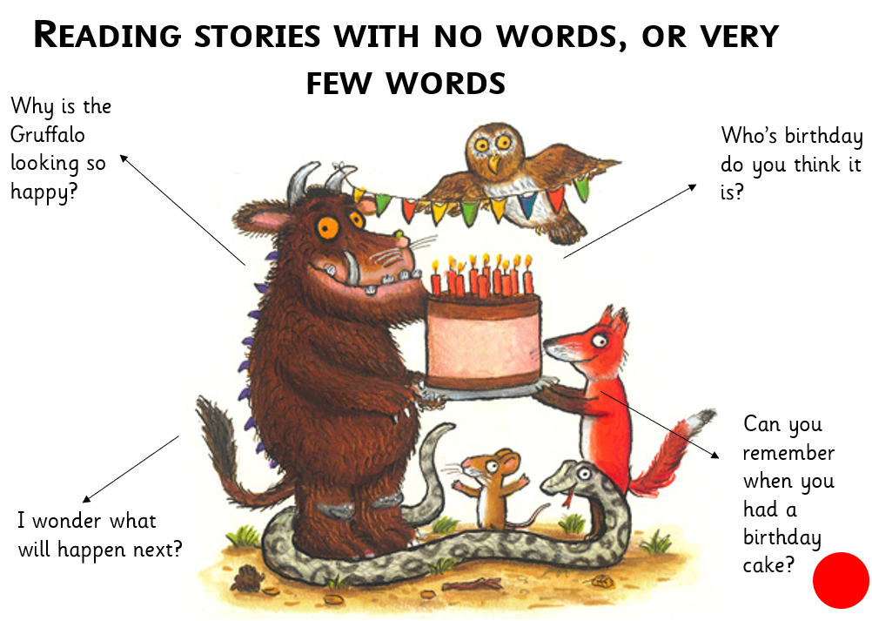
Wordless Books
During the first few weeks most children will have books without, or with very few, words.
This encourages children to understand the patterns of stories.
Encourage your child to create a story. Question your child about the pictures. Play I spy for oral blending.
e.g. I spy with my little eye a c-a-t

Slide 18
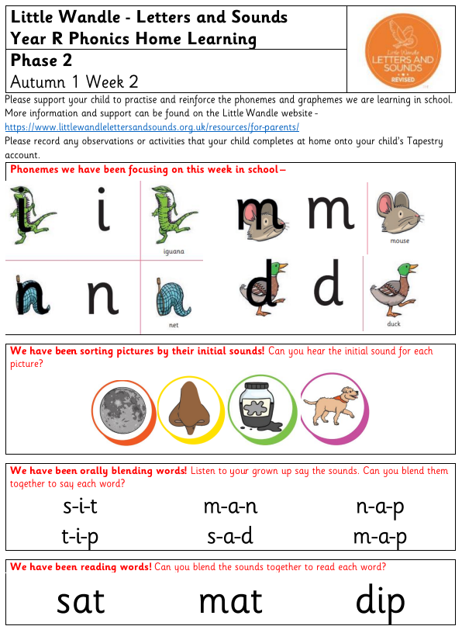
Phonics Home Learning
Every Friday a sheet will be added to your child's book
Phonemes- Say sound and mnemonic e.g i i iguana, i
Initial Sounds- Say each word, can your child say the first sound
Oral Blending- Say each sound, can your child repeat them and blend them together to say the word
Reading- Can your child say each sound and blend them together.

Slide 19
Phonics Home Learning
You can adapt each activity for example writing sounds with paint or in shaving foam.
Hide sounds/words around the room, can your child find the sound or word
If your child does want to practise writing, please write on a separate piece of paper. If you wish to share with use please upload to Tapestry and we will celebrate their learning in class.

Slide 20

Sharing Books
Sharing books makes a big difference to your child’s education.
When you read to your child you are making a positive impact on your child’s reading ability and their love of reading.
Reading books your child has chosen to read for pleasure is one of the best things you can do to help them succeed at school.
A love of reading is the biggest indicator of future academic success!

Slide 21

Literacy

Slide 22
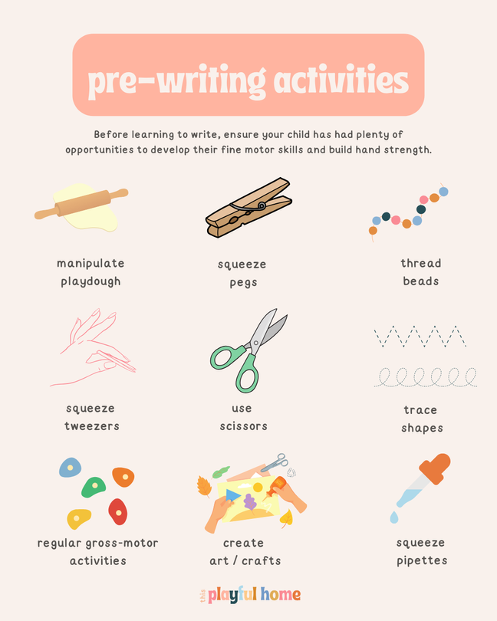
Prewriting
Prewriting can be split roughly into four key areas:
• Finger / Hand exercises to strengthen and improve manipulative ability to develop the correct grip on a pencil.
• Developing the correct pressure for using a pencil.
• Understanding that writing goes from left to right.
• Developing good pencil control by practising continuous movement when holding a pencil.

Slide 23
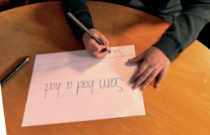
The Process of Writing
To be a successful writer children will be introduced to the key rationale of writing:
• That print carries meaning.
• Writing goes from left to right.
• Writing is a sequence of words that are separated by spaces.
• Words are made from a set of phonemes.
• Letters need to be formed correctly. This is our main focus of the Autumn term. We are tracing our names, copying our names using a starting dot and will begin to copy words and captions we can read.

Slide 24
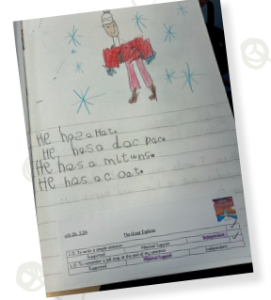
Literacy Lessons
Happens 4 times a week
We delve into a book each week and introduce new vocabulary.
Lesson 1 is handwriting- working on forming letters correctly
Lesson 2 and 3 is demonstrating a new skills and the children applying the skills in focus writing sessions.
Lesson 4- Interventions- Children work 1:1 with the class teacher to practise any skills they needed support in.

Slide 25
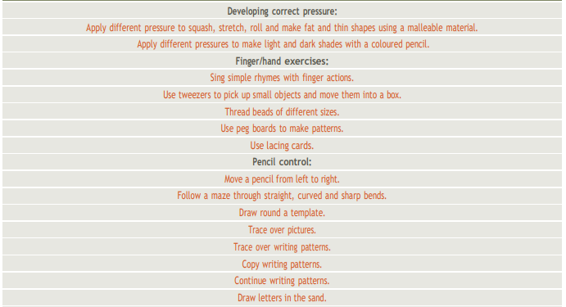
Prewriting Skills Ladder

Slide 26
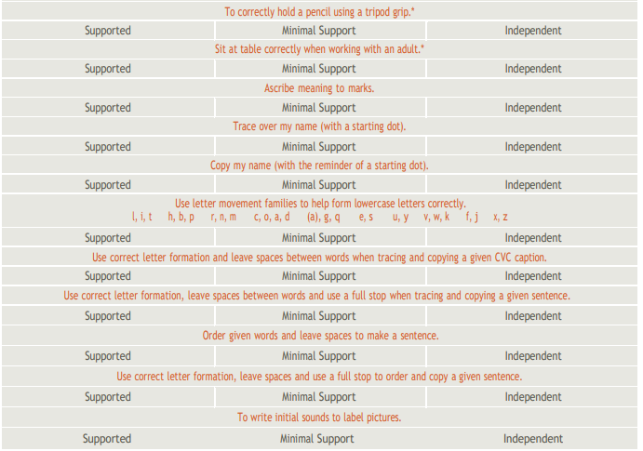
Autumn Term Writing Ladder

Slide 27
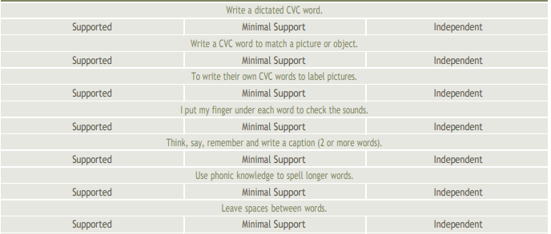
Spring Term Writing Ladder

Slide 28
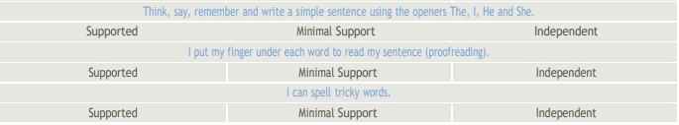
Summer Term Writing Ladder

Slide 29


Slide 30
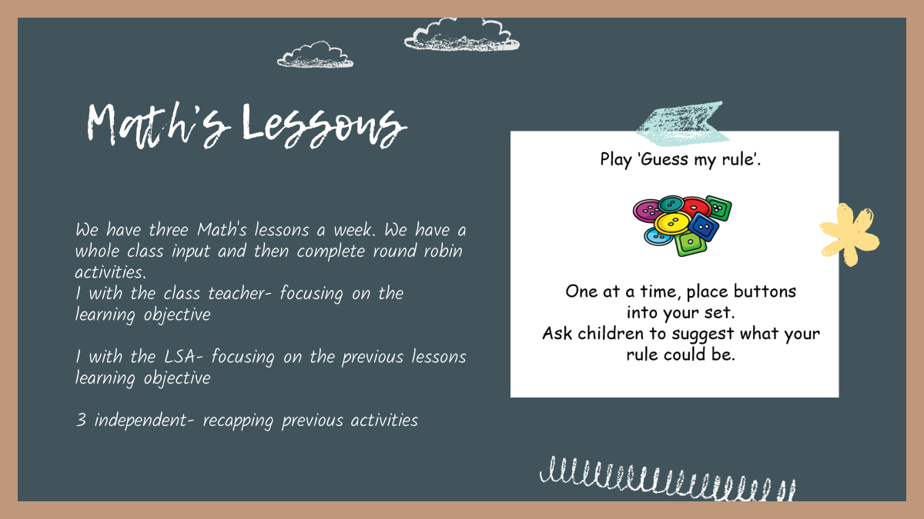

Slide 31
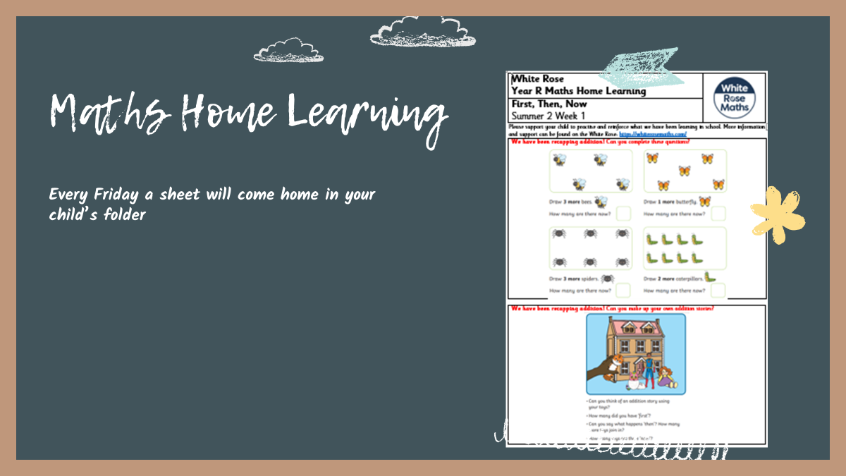

Slide 32



How to help at home
Mark Make
Encourage your child to mark-make using various different media.
Listen to your child read
Listen to your child read daily and record in reading record.
READ
Phonics Home Learning
PLAY
Support your child in practising their phonics at home.
EXPLORE
Support with Maths
Practise counting, recognise numbers in the environment, play board games, sing number songs, explore different shapes
TALK

Slide 33

https://www.chalfontstpeterinfantschool.co.uk/curriculum-1/
Useful Links
https://www.littlewandlelettersandsounds.org.uk/resources/for-parents/
https://www.bbc.co.uk/iplayer/episodes/b08bzfnh/numberblocks

Slide 34
Please make sure your child has a water bottle, folder, school bag and a coat every day
Reminders
Wellies and tracksuit bottoms to be kept in school
Please write any going home messages in the front of your child's reading record
Please check all uniform is clearly labelled including shoes, hats, gloves etc

Slide 35
Thank you!
Any Questions?

