Slide 1
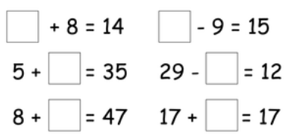
LO: To solve addition and subtraction missing number problems.

Slide 2
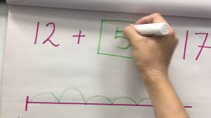
What do we know about missing number sentences?

Slide 3
- 4 = 9
When the first number is missing in a subtraction sum use the inverse, change the number sentence to an addition.
4 + 9 = or 9 + 4 =

Slide 4
10 - = 3
When the second number is missing you can just subtract the answer.
10 - 3 =

Slide 5
+ 4 = 9
To solve missing number additions use the inverse, change the number sentence to a subtraction.
9 - 4 =

Slide 6
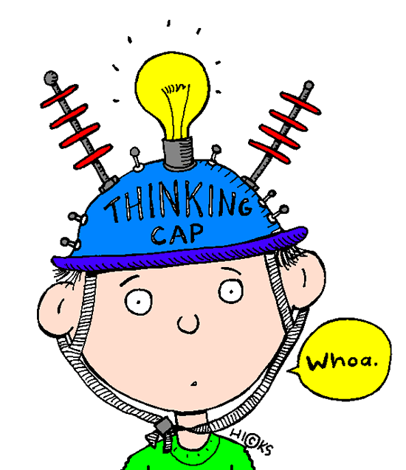
Have a go!
7 + = 13

Slide 7
Have a go!
- 4 = 10

Slide 8
Have a go!
+ 8 = 12

Slide 9
Have a go!
11 - = 9

Slide 10
5 + ? = 7
? - 4 = 9
? + 3 = 11
6 - ? = 2
? - 5 = 15
8 + ? = 12
? + 4 = 17
20 - ? = 14
9 + ? = 11
? - 6 = 14
? + 7 = 16
13 - ? = 5
? - 8 = 13
8 + ? = 12
? + 4 = 17
20 - ? = 14
10 + ? = 23
? - 16 = 27
? + 14 = 26
22 - ? = 9
? - 11 = 30
19 + ? = 33
? + 17 = 37
40 - ? = 18
29 + ? = 36
? - 21 = 40
? + 27 = 45
48 - ? = 15
? - 22 = 16
28 + ? = 42
? + 30 = 57
63 - ? = 24

