Slide 1

Thursday
11th February 2021

Slide 2
L.O: To tell the time to quarter to the hour.

Slide 3

Starter
https://www.youtube.com/watch?v=zaOc-4TA4lk

Slide 4
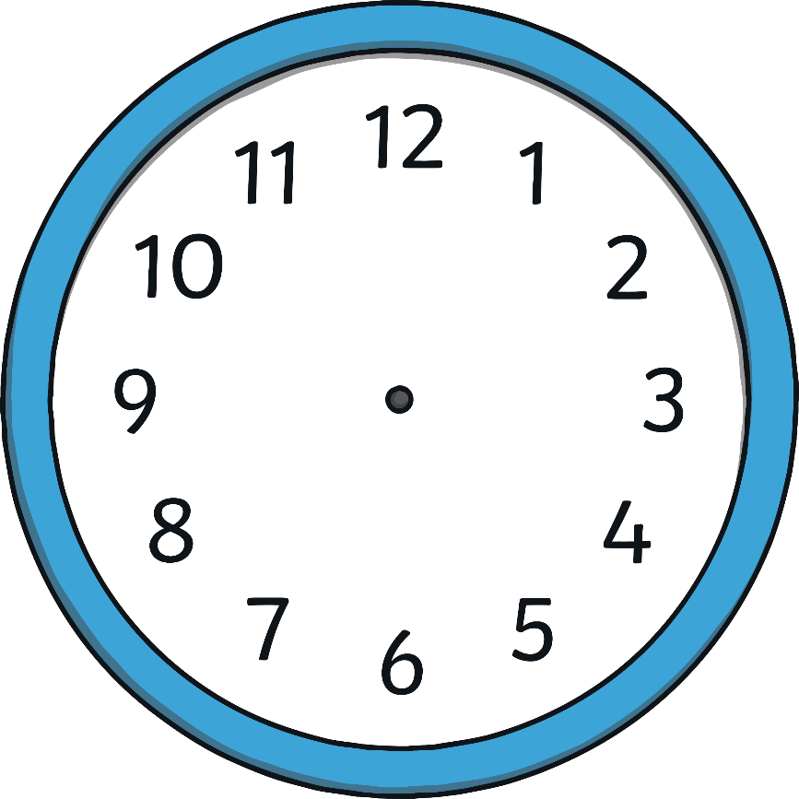
What Time Is It?
6 o’clock.

Slide 5
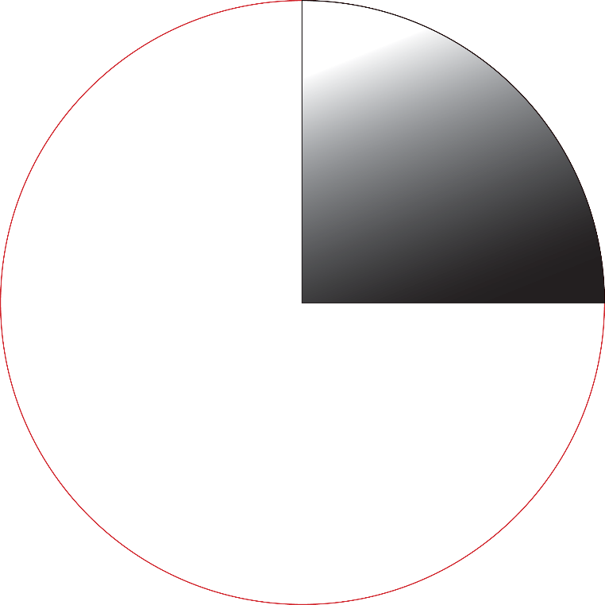
What Time Is It?
Quarter past 6

Slide 6
What Time Is It?
Half past 5

Slide 8
What Time Is It?

Slide 9

What Time Is It?
Quarter to 7

Slide 10
What Time Is It?
Quarter to 8

Slide 11
What Time Is It?
Quarter to 2

Slide 12
Does this say quarter to 12?
No!

Slide 13
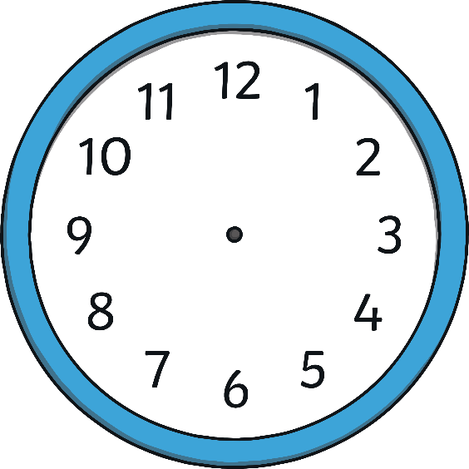


What Time Is It?
Which clock shows quarter to 2

Slide 14
What Time Is It?
Which clock shows quarter to 4?

Slide 15
What Time Is It?
Which clock shows quarter to 11?

Slide 16
Task:
2

Slide 17
Task:

Slide 18
Task:
Quarter to 11

