Slide 1
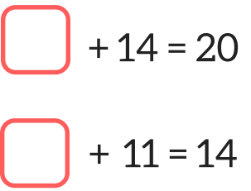
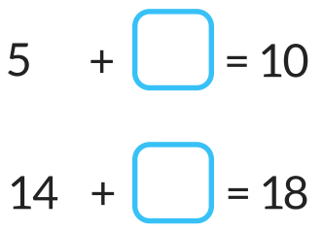
LO: To solve missing
number additions.

Slide 2
+ 4 = 9
To solve missing number additions you use the inverse, change the number sentence to a subtraction.
9 - 4 =

Slide 3
10 + = 17
It doesn't matter where the missing number is!
17 - 10 =

Slide 4
Solve these missing number sentences by using the inverse. Change these missing number additions into subtraction sentences.
+ 7 = 11
+ 3 = 8
+ 4 = 12
+ 5 = 15
+ 6 = 20
+ 5 = 25

Slide 5
Solve these problems by using the inverse.
15 + = 21
20 + = 26
17 + = 25
8 + = 13
22 + = 32
39 + = 45

Slide 6
12 + ? = 15
9 + ? = 13
? + 5 = 11
? + 7 = 16
13 + ? = 19
? + 4 = 15
18 + ? = 21
? + 3 = 22
15 + ? = 19
7 + ? = 15
? + 5 = 14
? + 7 = 23
23 + ? = 29
? + 18 = 26
37 + ? = 45
? + 17 = 35
19 + ? = 24
14 + ? = 25
? + 20 = 32
? + 12 = 23
41 + ? = 52
? + 25 = 32
59 + ? = 66
? + 36 = 48
51 + ? = 62
29 + ? = 36
? + 30 = 41
? + 42 = 56
64 + ? = 73
? + 33 = 42
72 + ? = 89
? + 47 = 59

