Slide 1
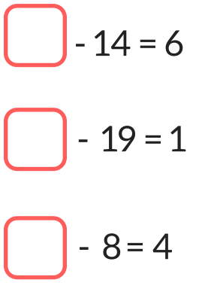
LO: To solve missing number subtractions and know when to use the inverse.

Slide 2
- 4 = 9
When the first number is missing you use the inverse and change the number sentence to an addition:
4 + 9 = or 9 + 4 =

Slide 3
Change these missing number subtractions into addition sentences.
7 = 11
3 = 8
- 12 = 4
5 = 20
16 = 2
- 25 = 25

Slide 4
10 - = 3
When the second number is missing you don't need to use the inverse, you just subtract the answer.
10 - 3 =

Slide 5
Solve these problems by subtracting the answer.
15 - = 6
20 - = 10
17 - = 6
8 - = 3
22 - = 14
39 - = 25

Slide 6
Think carefully about where the missing number is within each number sentence. Only use the inverse if the first number is missing.
12 - ? = 10
9 - ? = 3
? - 5 = 11
? - 7 = 16
13 - ? = 9
? - 4 = 15
18 - ? = 8
? - 3 = 22
15 - ? = 8
7 - ? = 2
? - 5 = 14
? - 7 = 23
23 - ? = 10
? - 18 = 26
37 - ? = 19
? - 17 = 35
19 - ? = 11
14 - ? = 5
? - 20 = 13
? - 12 = 23
41 - ? = 26
? - 25 = 9
59 - ? = 19
? - 36 = 17
51 - ? = 25
29 - ? = 16
? - 30 = 17
? - 42 = 13
64 - ? = 28
? - 33 = 7
72 - ? = 19
? - 47 = 34

