Slide 1


Year 2 – Summer Block 1 – Position and Direction
Step 1: Describing Movement
© Classroom Secrets Limited 2019

Slide 2
Introduction
Follow the instructions below.
Why have your answers changed?
Stand so that you are facing the computer screen.
What’s to your left? What’s to your right?
What’s in front of you? What’s behind you?
Now turn so that you are facing the door.
What’s to your left? What’s to your right?
What’s in front of you? What’s behind you?
© Classroom Secrets Limited 2019

Slide 3
Introduction
Follow the instructions below.
Why have your answers changed?
The answers have changed because the direction you are facing has changed.
Stand so that you are facing the computer screen.
What’s to your left? What’s to your right?
What’s in front of you? What’s behind you?
Now turn so that you are facing the door.
What’s to your left? What’s to your right?
What’s in front of you? What’s behind you?
© Classroom Secrets Limited 2019

Slide 4
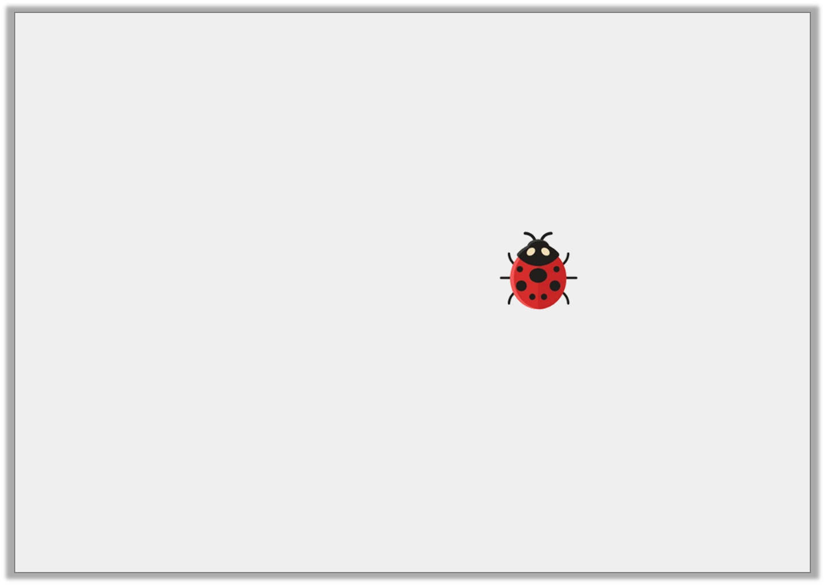
Varied Fluency 1
In which direction is the ladybird moving?
© Classroom Secrets Limited 2019

Slide 5
Varied Fluency 1
In which direction is the ladybird moving?
The ladybird is moving to the left.
© Classroom Secrets Limited 2019

Slide 6
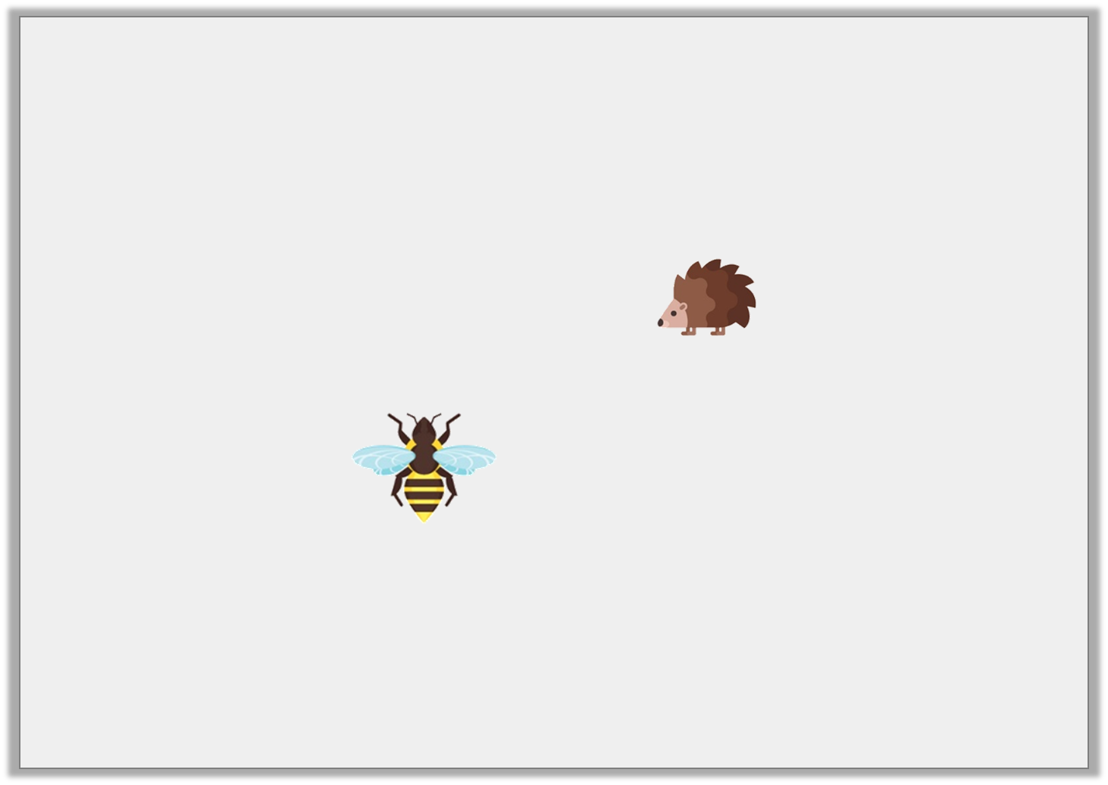
Varied Fluency 2
In which direction is each creature moving?
© Classroom Secrets Limited 2019

Slide 7
Varied Fluency 2
In which direction is each creature moving?
The wasp is moving forwards, the hedgehog is moving to the left.
© Classroom Secrets Limited 2019

Slide 8
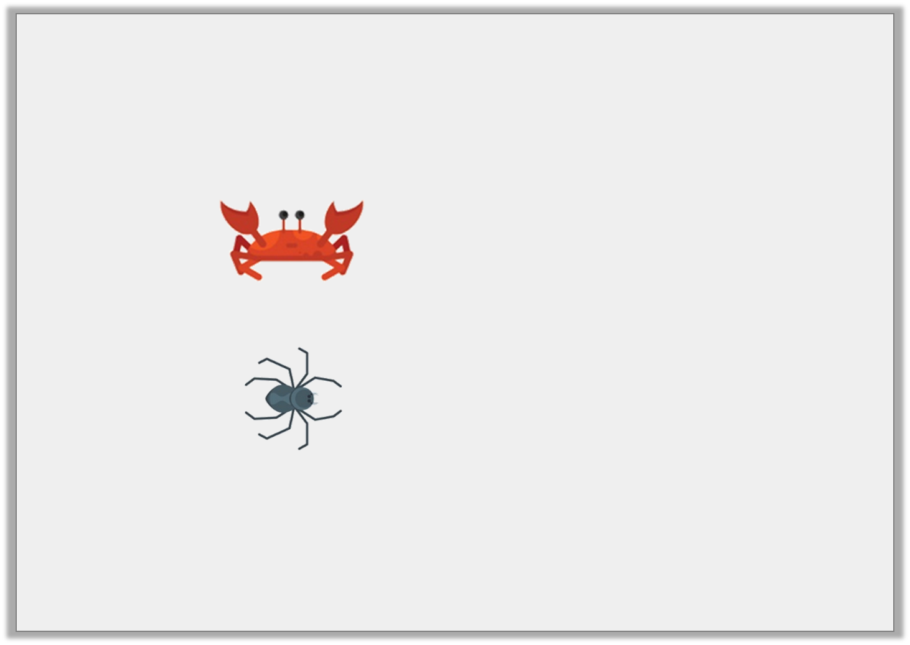
Varied Fluency 3
Circle the creature which is moving to the left.
© Classroom Secrets Limited 2019

Slide 9
Varied Fluency 3
Circle the creature which is moving to the left.
The crab (the spider is moving forwards).
© Classroom Secrets Limited 2019

Slide 10
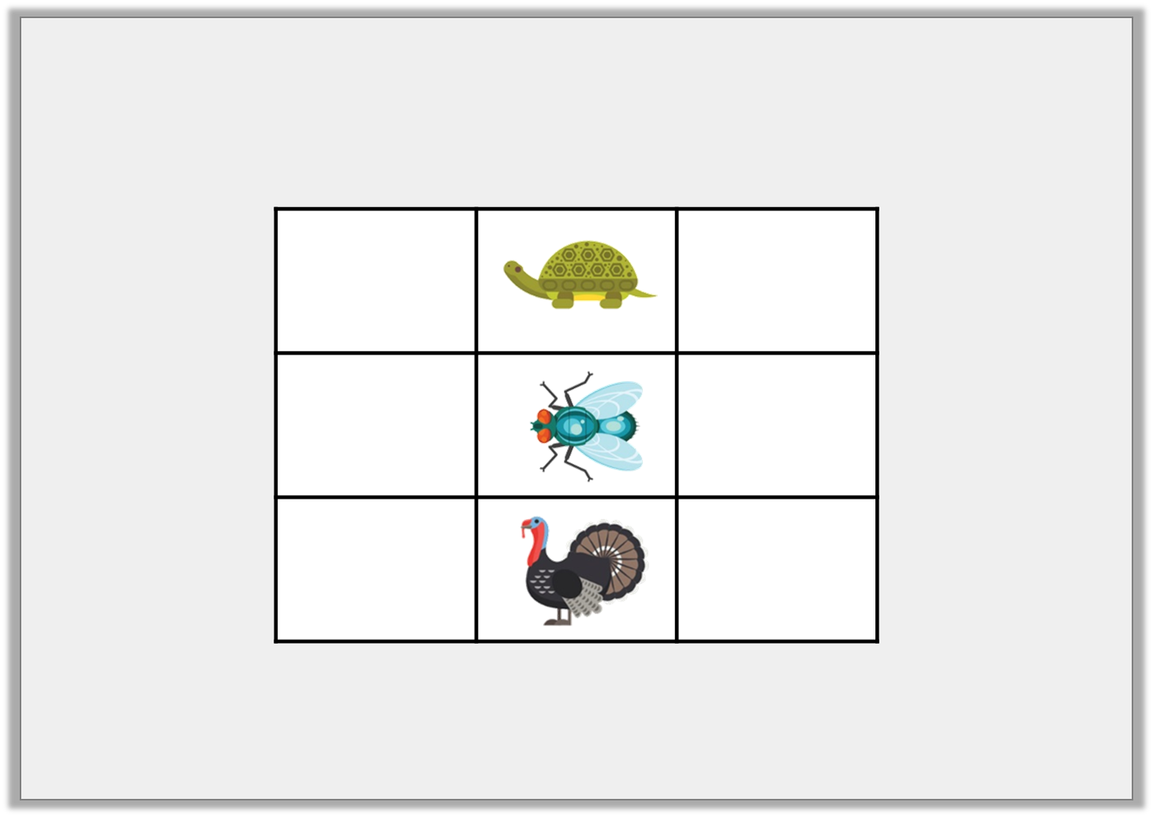
Varied Fluency 4
True or false? The bug is to the right of the turkey.
© Classroom Secrets Limited 2019

Slide 11
Varied Fluency 4
True or false? The bug is to the right of the turkey.
True
© Classroom Secrets Limited 2019

Slide 12
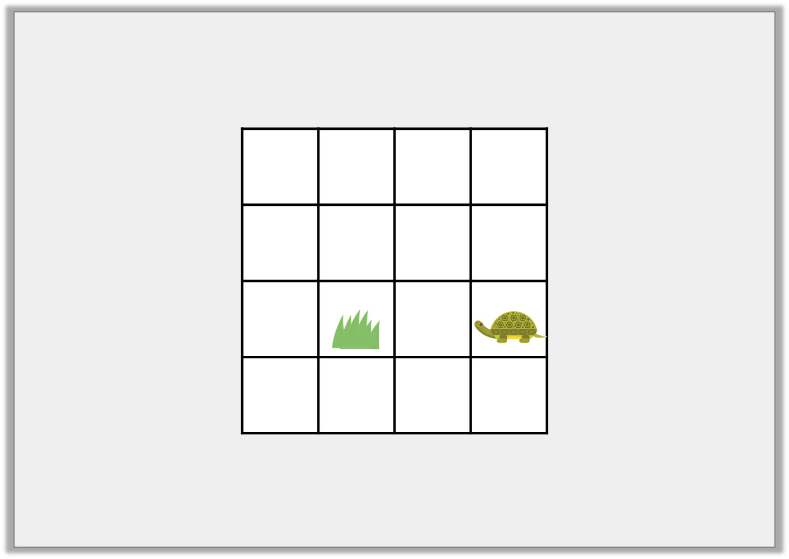
Reasoning 1
Ria thinks that if the turtle moves 2 squares to the left, it will find the grass.
Is she correct? Explain how you know.
© Classroom Secrets Limited 2019

Slide 13
Reasoning 1
Ria thinks that if the turtle moves 2 squares to the left, it will find the grass.
Is she correct? Explain how you know.
Ria is not correct because…
© Classroom Secrets Limited 2019

Slide 14
Reasoning 1
Ria thinks that if the turtle moves 2 squares to the left, it will find the grass.
Is she correct? Explain how you know.
Ria is not correct because the turtle must move two squares forwards.
© Classroom Secrets Limited 2019

Slide 15
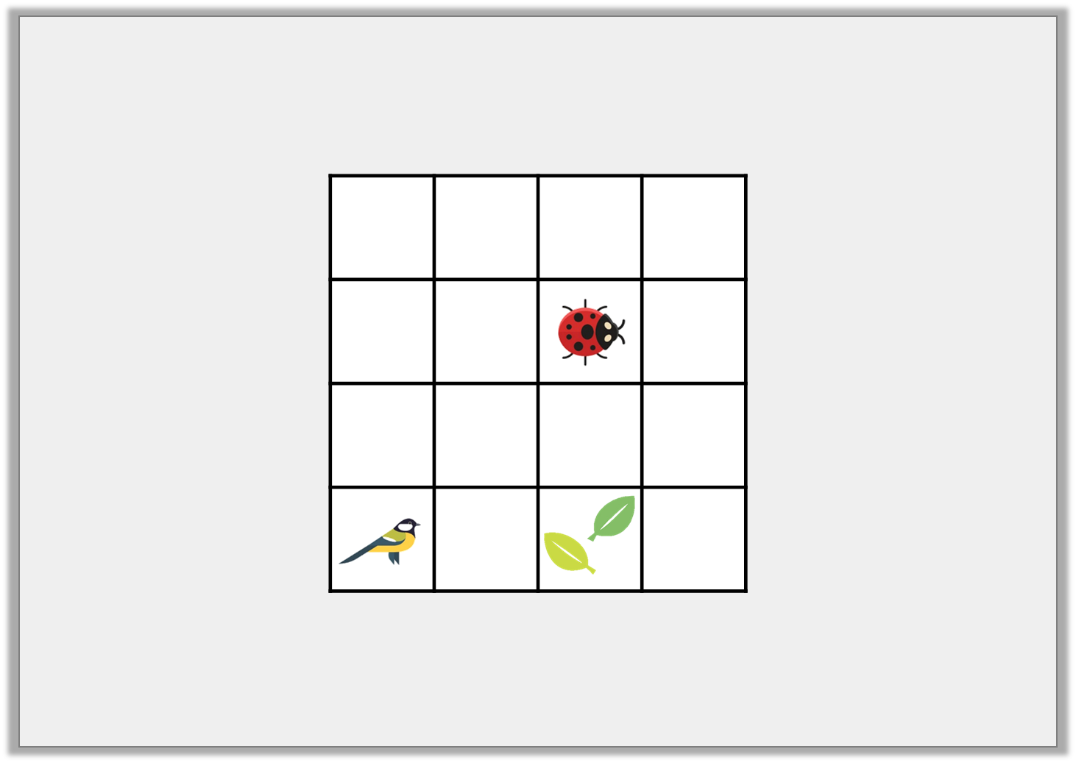
Problem Solving 1
Write statements using forwards, backwards, left and right to describe how each creature can get to the leaves.
© Classroom Secrets Limited 2019

Slide 16
Problem Solving 1
Write statements using forwards, backwards, left and right to describe how each creature can get to the leaves.
Various possible answers, for example:
The ladybird moves two squares to the right and the bird moves two squares forwards.
© Classroom Secrets Limited 2019

Slide 17
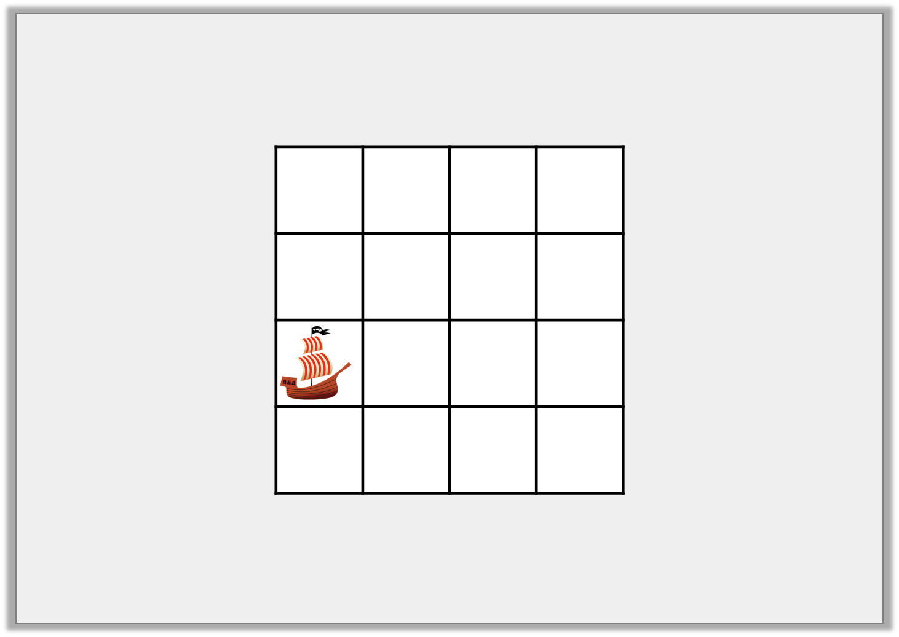
Problem Solving 2
The treasure is buried 2 squares left of the ship.
Where is the treasure buried?
© Classroom Secrets Limited 2019

Slide 18
Problem Solving 2
The treasure is buried 2 squares left of the ship.
Where is the treasure buried?
© Classroom Secrets Limited 2019

