Slide 1
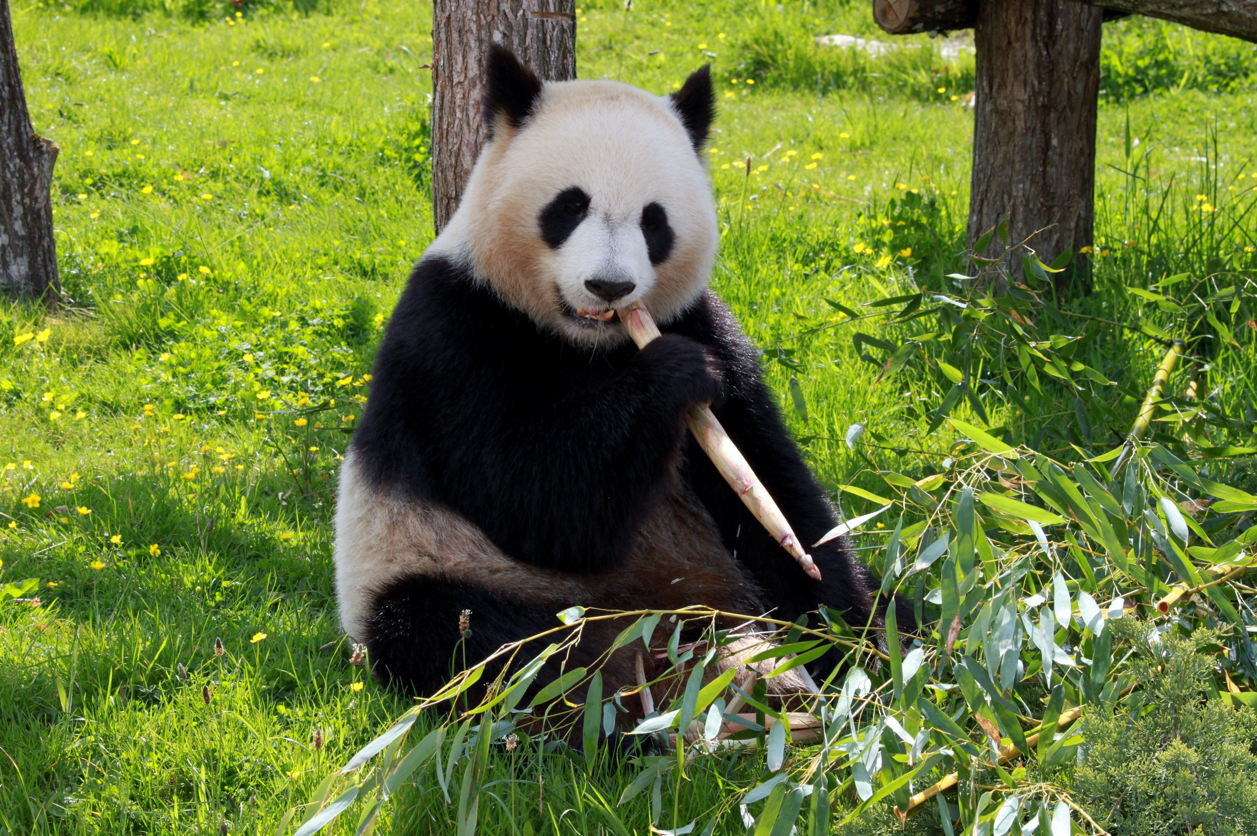

English

Slide 2
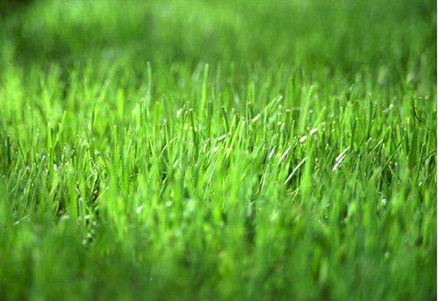
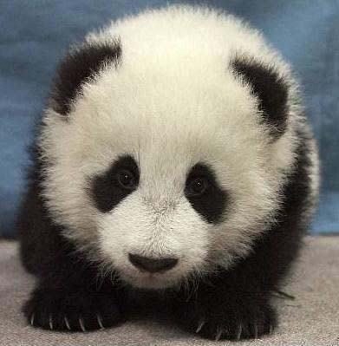
Learning Objective:
To write non-fiction facts.
This Photo by Unknown Author is licensed under CC BY-NC-ND

Slide 3
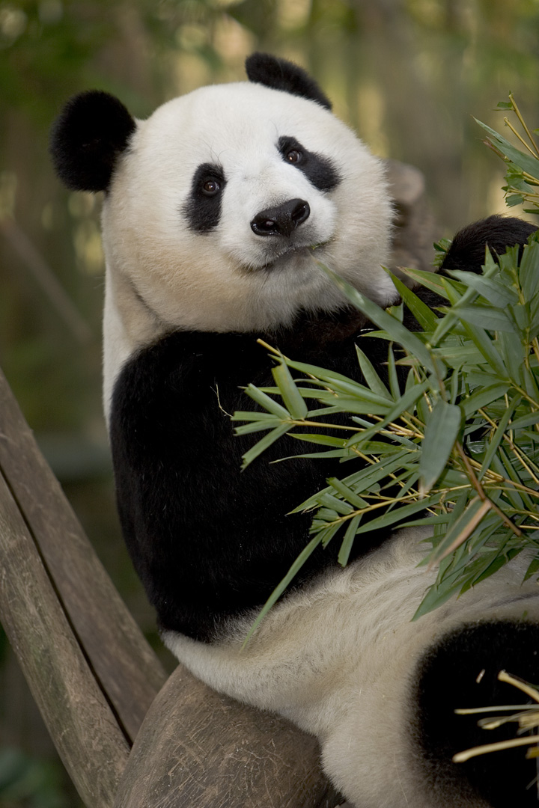
What do you know about giant pandas?
Giant pandas are mammals.
A mammal is an animal that gives birth to live young and they feed their babies with milk.
This Photo by Unknown Author is licensed under CC BY

Slide 4
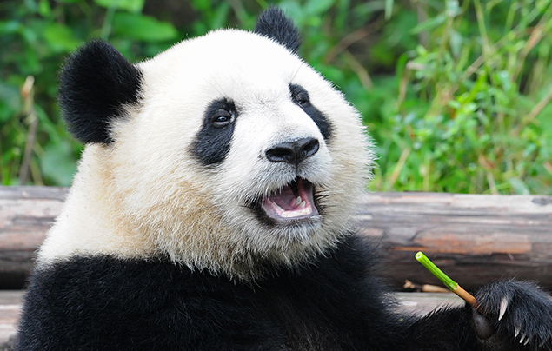
What do you know about giant pandas?
Giant pandas are omnivores.
An omnivore is an animal that eats plants and meat in their daily diet. Pandas eat mainly bamboo shoots. Sometimes they eat small rodents.

Slide 5
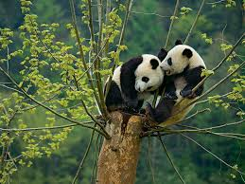
Giant pandas live in China. They have been endangered but now there are about 1864 giant pandas living in the wild. They are now known as ‘at risk’.

Slide 6
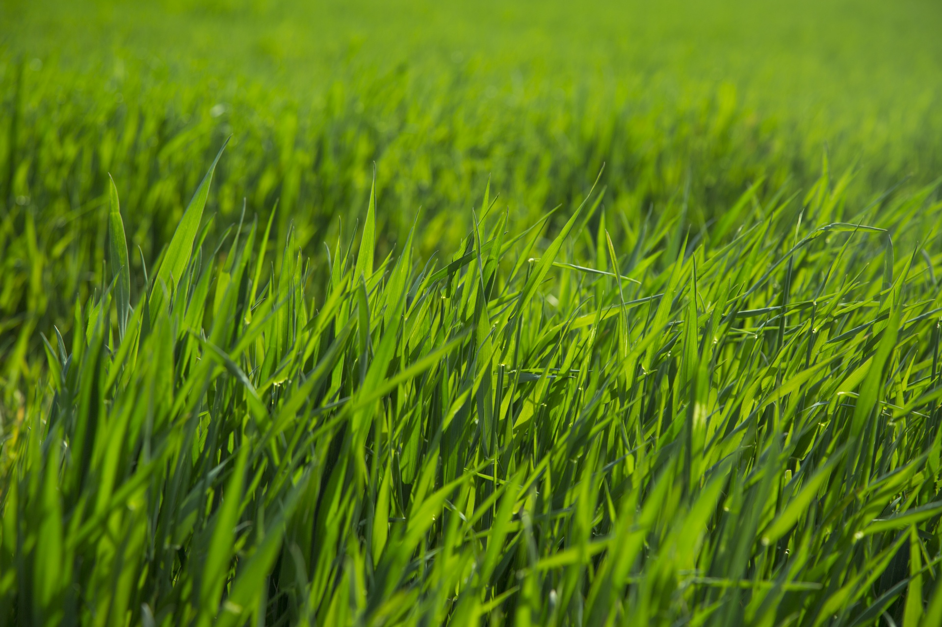
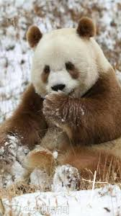
Did you know…
There is only one kind of Giant panda but although these animals are black and white, there is a rare giant panda that is brown and white.

Slide 7
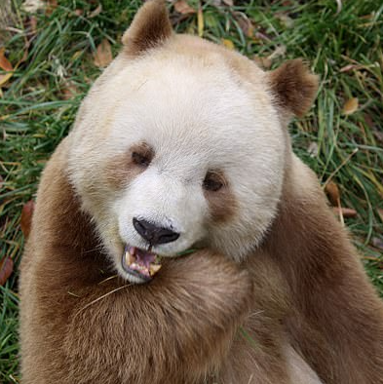
The Brown Panda
This is Qizai. He is 11 years old and he is the only brown and white giant panda in captivity.

Slide 8
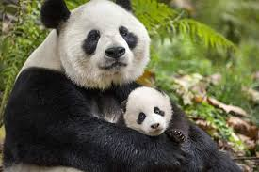
More facts…
Giant pandas usually give birth to one cub but if they do have two cubs, sadly one usually dies. This is because the giant panda only chooses to look after one of her babies.

Slide 9
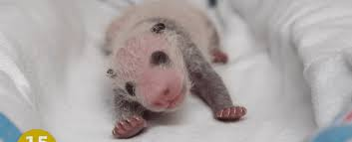
More facts…
Although a giant panda is a huge animal, the baby is tiny! In fact it is minute!

Slide 10
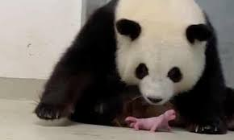
Giant Panda Cubs
Look at the size of the baby to the mother giant panda!

Slide 11
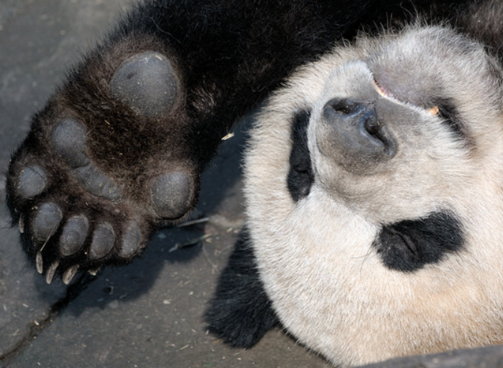
More facts…
Giant pandas have a long wrist bone that is like a thumb so that they can hold their bamboo shoots!

Slide 12
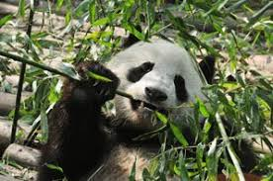
More facts…
Giant pandas eat for 12 hours every day. They fill their tummy with 12kg of bamboo shoots!

Slide 13

Read the information again.
Write some non-fiction facts.
Remember the sentence rules.
Draw a giant panda!

