Slide 1




English

Slide 2

Learning Objective:
To design an advertisement.

Slide 3



What is an advertisement?
An advert is something that encourages you to buy something or maybe go to an event like a celebration.
It is a like a poster.

Slide 4
What information should you include?
The event Chinese New Year
The animal The Year of the Ox
The year 2021

Slide 5
What information should you include?
The colours Red and Gold
Pictures The Ox
Chinese decorations Lanterns and Dragons

Slide 6

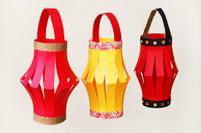
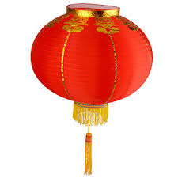
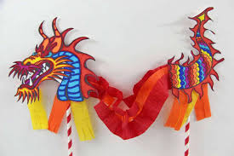
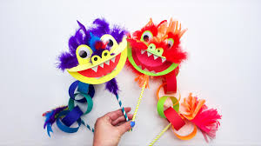

Chinese decorations

Slide 7
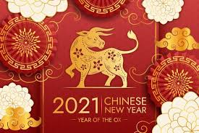
Look at these designs advertising Chinese New Year…

Slide 8
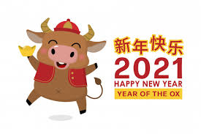
Look at these designs advertising Chinese New Year…

Slide 9
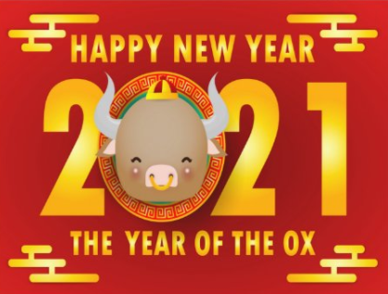
Look at these designs advertising Chinese New Year…

Slide 10

Look at these designs advertising Chinese New Year…

Slide 11
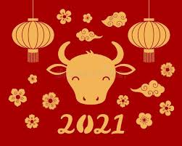
Look at these designs advertising Chinese New Year…

Slide 12
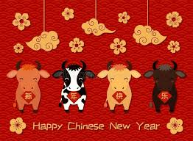
Look at these designs advertising Chinese New Year…

Slide 13

Look at these designs advertising Chinese New Year…

Slide 14
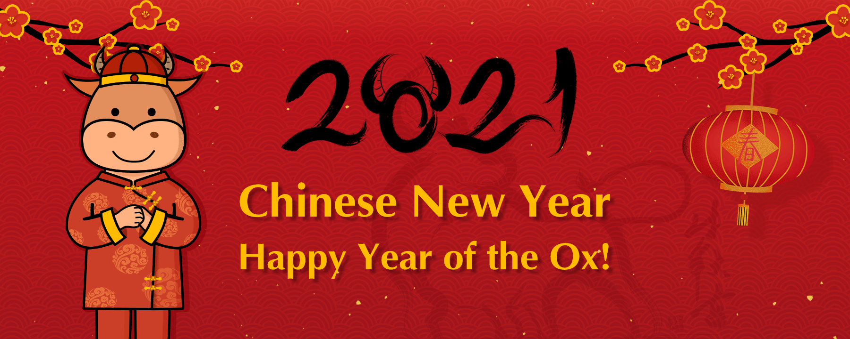

Slide 15
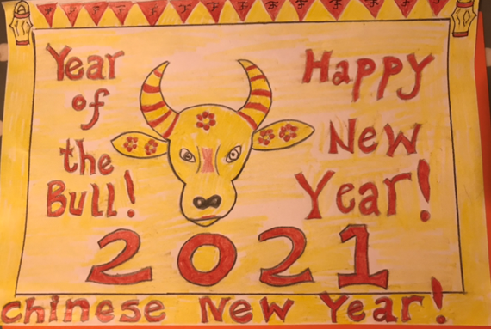
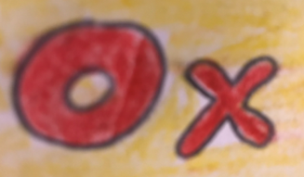














This is my design.

Slide 16

Use this bordered paper to create you design or place it in your yellow book.
Your Chinese New Year Design will go on the website to be shared with all your friends.

