Slide 1

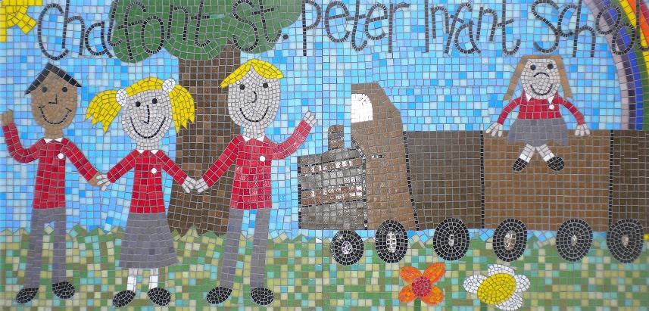

Welcome
Phonics Screening Presentation

Slide 2

What is Phonics ?
Phonics is a way of teaching children to read and write skilfully. Children are taught to recognise and read phonemes (sounds) that each letter makes and then identify the sounds that different combinations of letters make (graphemes). Eg. ‘ck’, ‘oo’, ‘igh’, ‘ng’

Slide 3
Letters and Sounds
Daily, all children are taught 30 minutes of Phonics following ‘Little Wandle Letters and Sounds Revised’.
Lessons are taught in the same way each day where your children are taught to ‘segment’ and ‘blend’ sounds together in order to read and write words.

Slide 4
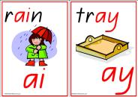
Terminology
Digraph – 2 letters that make one sound – cow
Trigraph – 3 letters that make one sound – night
Split digraph – 2 vowels with a consonant in between – spine
GPC – Grapheme Phoneme Correspondence - Knowing a GPC means being able to match a phoneme (sound) to a grapheme (written representation) and vice versa.

Slide 5
Identifying sounds within words
Activities for identifying and sorting words help children to ‘see’ graphemes within words in order to read and recall choices for writing. (Phonics Homework)
ay | ai | a-e | a | ea
play | train | game | lady | break
day | plain | date | alien | great

Slide 6
Reading
Through regular reading at school and at home,
children refine and apply their phonic knowledge
skills to de-code unfamiliar words.
Jane went to the garden and she stood by the
gate. It was brown and the wood looked old.
While she waited for her sister, she sang a
song very loudly. “What is that noise?”said
Layla.

Slide 7
Reading
Little Wandle Assessments place the children at the correct level according to their knowledge of previously taught phonics.
When your child is able to read at a specific rate of fluency, accuracy and pace, they will move onto the school book bands (Turquoise level and above).

Slide 8
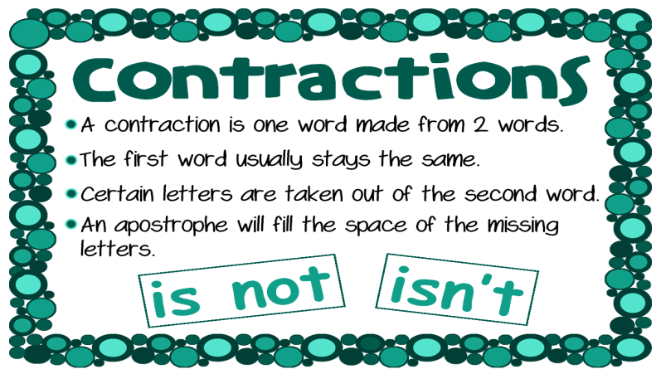
Tricky Words
Daily, children read and write the Little Wandle Tricky Words for Year 1. As we move closer to Year 2, attention is paid to unusual spelling including contractions, suffixes and prefixes.
ed
ing
un

Slide 9
What is the Phonics Screening Check?
During the week beginning 8th June 2026, all Year 1 children will take the Government statutory Phonics Screening Check.
This will be similar to the tasks that the children already complete during Phonics lessons.
The focus of the check is to provide evidence of children’s decoding and blending skills, not to test vocabulary.
Notes:
• Practise chanting the number names. Encourage your child to join in with you. When they are confident, try starting from different numbers - 4, 5, 6, 12
• Sing number rhymes together - there are lots of commercial t apes and CD’s available.
• Give your child the opportunity to count a range of interesting objects (coins, pasta shapes, buttons etc.). Encourage them to touch and move each object as they count.
• Count things you cannot touch or see (more difficult!!). Try lights on the ceiling, window panes, jumps, claps or oranges in a bag.
• Play games that involve counting (e.g. snakes and ladders, dice games, games that involve collecting objects).
•Build a tower
For this game you need a dice
and some building blocks or lego bricks.
♦ Take turns.
♦ Roll the dice.
♦ Collect the number of bricks to build your own tower.
♦ The first to 10 wins!
For a change, start with 10 blocks or bricks each. Take away the
number on the dice. First to exactly zero wins.

Slide 10
What Will the Children Do?
The check takes approximately 4 – 9 minutes to complete.
Children will be asked to read or ‘sound out’ and blend sounds together to read a word. Eg. ‘p-l-ay = play
The check will consist of 20 real words and 20 ‘alien’ words.
Children will be told if the word is a real or an ‘alien’ word.
‘Alien’ words will show a corresponding alien image.
Notes:
• Practise chanting the number names. Encourage your child to join in with you. When they are confident, try starting from different numbers - 4, 5, 6, 12
• Sing number rhymes together - there are lots of commercial t apes and CD’s available.
• Give your child the opportunity to count a range of interesting objects (coins, pasta shapes, buttons etc.). Encourage them to touch and move each object as they count.
• Count things you cannot touch or see (more difficult!!). Try lights on the ceiling, window panes, jumps, claps or oranges in a bag.
• Play games that involve counting (e.g. snakes and ladders, dice games, games that involve collecting objects).
•Build a tower
For this game you need a dice
and some building blocks or lego bricks.
♦ Take turns.
♦ Roll the dice.
♦ Collect the number of bricks to build your own tower.
♦ The first to 10 wins!
For a change, start with 10 blocks or bricks each. Take away the
number on the dice. First to exactly zero wins.

Slide 11
Examples of Real Words
chart
cloaks
soil
strike
shed
tantrum
Notes:
• Practise chanting the number names. Encourage your child to join in with you. When they are confident, try starting from different numbers - 4, 5, 6, 12
• Sing number rhymes together - there are lots of commercial t apes and CD’s available.
• Give your child the opportunity to count a range of interesting objects (coins, pasta shapes, buttons etc.). Encourage them to touch and move each object as they count.
• Count things you cannot touch or see (more difficult!!). Try lights on the ceiling, window panes, jumps, claps or oranges in a bag.
• Play games that involve counting (e.g. snakes and ladders, dice games, games that involve collecting objects).
•Build a tower
For this game you need a dice
and some building blocks or lego bricks.
♦ Take turns.
♦ Roll the dice.
♦ Collect the number of bricks to build your own tower.
♦ The first to 10 wins!
For a change, start with 10 blocks or bricks each. Take away the
number on the dice. First to exactly zero wins.

Slide 12

Here Come the Aliens!
shoig
strow
skarld
Notes:
Look for numerals in the environment. You can spot numerals at home, in the street or when out shopping.
• Cut out numerals from newspapers, magazines or birthday cards. Then help your child to put the numbers in orders.
• Make mistakes when chanting, counting or ordering numbers. Can your child spot what you have done wrong?
• Choose a number of the week e.g. 5. Practise counting to 5 and on from 5. Count out groups of 5 objects (5 dolls, 5 bricks, 5 pens). See how many places you can spot the numeral 5.

Slide 13


Examples of Alien Words
bluns
thobe
scroy
gair
harnd
zale
Notes:
• Practise chanting the number names. Encourage your child to join in with you. When they are confident, try starting from different numbers - 4, 5, 6, 12
• Sing number rhymes together - there are lots of commercial t apes and CD’s available.
• Give your child the opportunity to count a range of interesting objects (coins, pasta shapes, buttons etc.). Encourage them to touch and move each object as they count.
• Count things you cannot touch or see (more difficult!!). Try lights on the ceiling, window panes, jumps, claps or oranges in a bag.
• Play games that involve counting (e.g. snakes and ladders, dice games, games that involve collecting objects).
•Build a tower
For this game you need a dice
and some building blocks or lego bricks.
♦ Take turns.
♦ Roll the dice.
♦ Collect the number of bricks to build your own tower.
♦ The first to 10 wins!
For a change, start with 10 blocks or bricks each. Take away the
number on the dice. First to exactly zero wins.

Slide 14
How Will the Check be Administered?
Mrs Chambers, Mrs West and Mrs Whittall will conduct all of the screening checks with children from their own class.
The children will complete the check on a 1:1 basis in a quiet room away from the classroom.

Slide 15


How Will the Check be Administered?
There is no time limit and it is designed to be fun rather than stressful.
We are not permitted to indicate to the children whether they have read the word correctly. However lots of positive encouragement will be given!

Slide 16
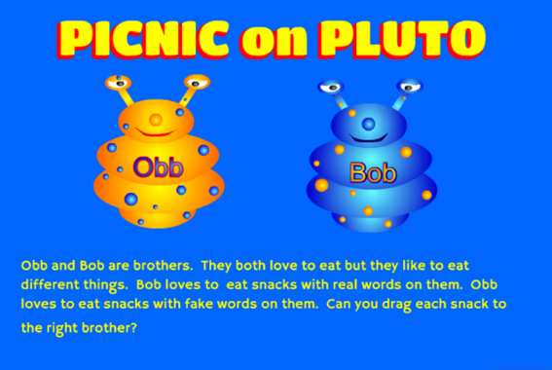
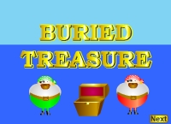
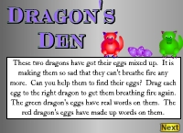
How Can you Help?
When reading, ask your child to identify digraphs and trigraphs within words.
Play the online games at:
www.phonicsplay.co.uk

Slide 17
How Can you Help?
A practise phonics booklet will be sent home each week to help you prepare for the Phonics Screening Check.
These will replace the weekly homework for the next 4 weeks.
The booklets must be returned to school each Tuesday.

Slide 18
The Results
Children will be scored against a national standard. (32/40 previously) but this may change)
The results will be sent to the Local Authority.
In July you will be informed if your child has reached the national standard.
Children who do not reach the required standard will re-take the Phonics Screening Check in Year 2.

Slide 19
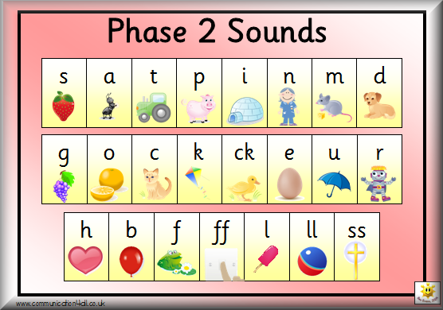
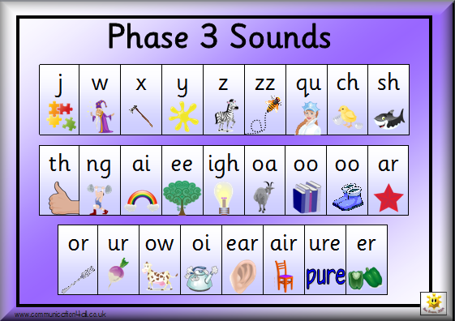
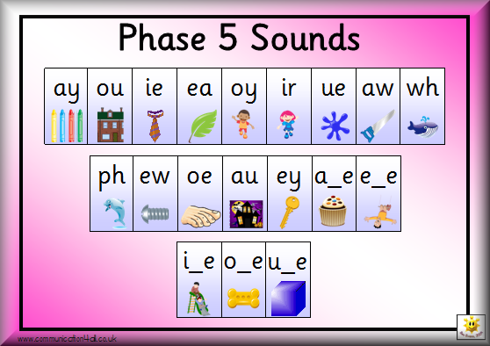
Questions

