Slide 1
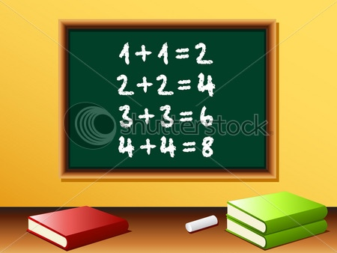

Lo: To solve addition number sentences with missing numbers.

Slide 2
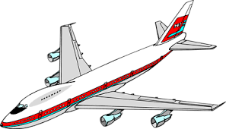
This is your captain speaking. Welcome to Flight 300 to sunny Chalfont. The weather is hot and it looks like a great day. We are almost ready for take off.
Flight attendants are all passengers on board?

Slide 3

The flight attendant's need to finish boarding all the passengers onto the plane. They should have 16 passengers but some are missing.
12 + =16
Your job is to help him find out how many passengers are missing.

Slide 4
Don’t look so worried! I have an idea. We could use a number line.

Slide 5
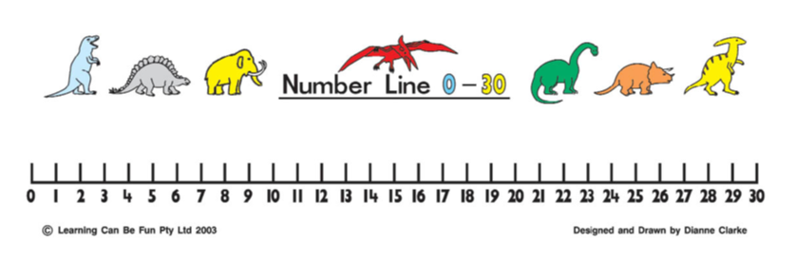
12 + =16
Start at 12 and count on until you get to 16 . How many jumps did you make?
12 +. =
Therefore we need to board 4 more passengers.

Slide 6


It does not matter which way round our numbers are in addition calculations?
12 + =16
+ 12=16

