Slide 1
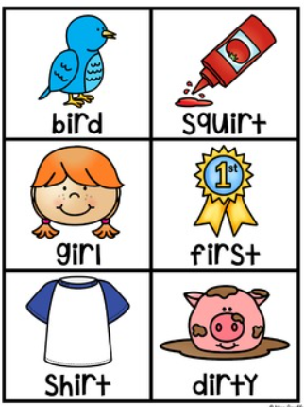


ir

Slide 2

girl

Slide 3

bird

Slide 4

shirt

Slide 5

thirsty

Slide 6

birth

Slide 7

third

Slide 8

first

Slide 9
thirteen

Slide 10

skirt

Slide 11
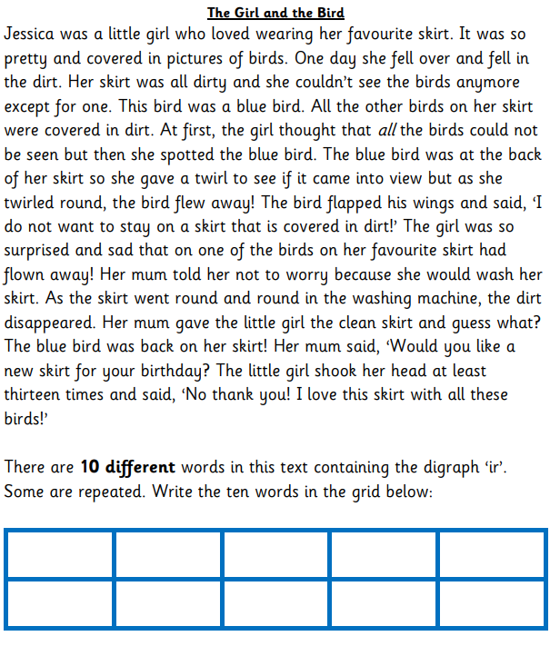
Read the story and circle all the words that contain the ‘ir’ digraph.
Choose ten different circled words and write them in the grid at the bottom of the page.
Choose 3 words and write a sentence for each word.

