Slide 1
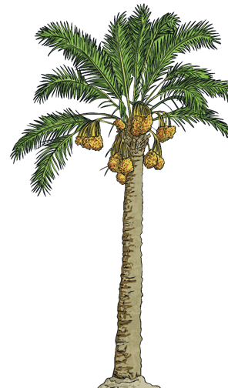

Tuesday
9th January 2021
St Lucia

Slide 2
L.O: To complete a comprehension on
St Lucia

Slide 3
First we are going to do a little quiz.

Slide 4


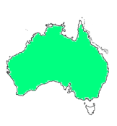
Which map shows St Lucia?
A.
B.
C.
A

Slide 5
What is the capital city of St Lucia?
A. Caribbean
B. Castries
C. Canaries
B

Slide 6
What sea surrounds St Lucia?
A. St Lucia Sea
B. North Sea
C. Caribbean Sea
C

Slide 7



Which is the flag for St Lucia?
A.
B.
C.
C

Slide 8
How can you not travel to St Lucia?
A. Airplane
B. Train
C. Boat or ferry
B

Slide 9
What do they grow the most of in St Lucia?
A. Bananas
B. Mangos
C. Grapes
A

Slide 10
What do the locals call bananas?
A. Green Jewels
B. Golden Fruit
C. Green Gold
C

Slide 11
Why?
A. They are hard like gold.
B. They are green when they are picked.
C. They are gold when they are picked.
B

Slide 12
What is the name of the growing industry in St Lucia beginning with T?
A. Tourist
B. Tourism
C. Turtle tours
          B

Slide 13
Would you like to go on holiday to St Lucia?
A. Yes
B. No
C. Maybe
A

Slide 14
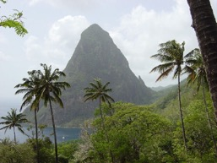
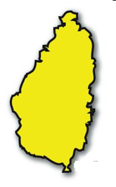
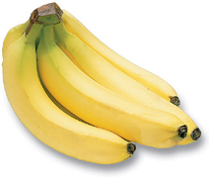
WOW!!!!
You did fantastic!
You are all St Lucia
EXPERTS!!!!

Slide 15
Task:
Reading Comprehension

Slide 16
Task:
Answer the comprehension questions

