Slide 1

Curriculum Presentation
Year 1
Autumn 2025

Slide 2
Oak Class
Elm Class
Mrs Nowell
Mrs Page
Miss Richards
Mrs Chambers
Mrs Skyrme-Davies
Mr Thorne

Slide 3
Classroom Environment
Enhanced learning environment: Providing a range of learning opportunities that are tailored to the needs of the children, allowing them to engage in activities that are meaningful and relevant to their development.
Promotes resilience and independence: Encourages children to take on challenges, think critically and take more responsibility for their learning.
Improves attention span and communication skills: Encouraging children to engage in activities that require collaboration and interaction.
Meets National Curriculum requirements: Aligns with National Curriculum objectives ensuring that children are learning the necessary skills and knowledge to meet educational standards.

Slide 4

English: Writing
Teaching from the New National Curriculum updated 2020, we will be focusing on:
Spelling, punctuation and grammar
Familiar stories with predictable patterns
Traditional tales
Poetry
Non-fiction study
Writing instructions
Drama
Writing Letters

Slide 5



English: Features of Writing
Children are taught the key features of writing to make work more interesting and detailed:
Punctuation for sentence structure

Slide 6


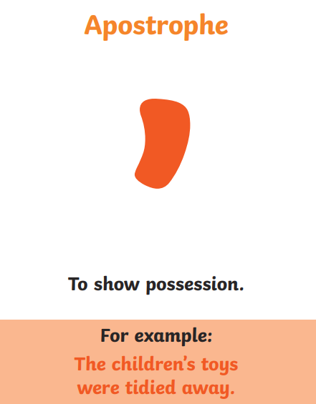
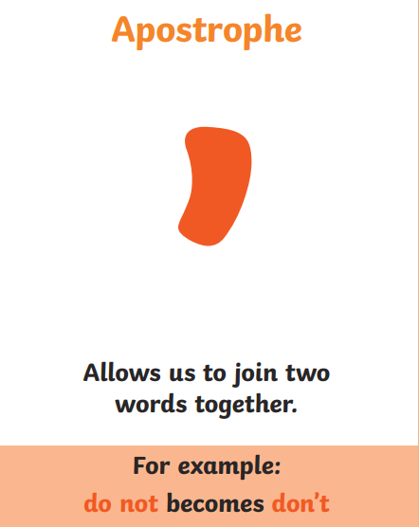
English: Features of Writing
Children are taught the key features of writing to make work more interesting and detailed:
Punctuation for effect

Slide 7


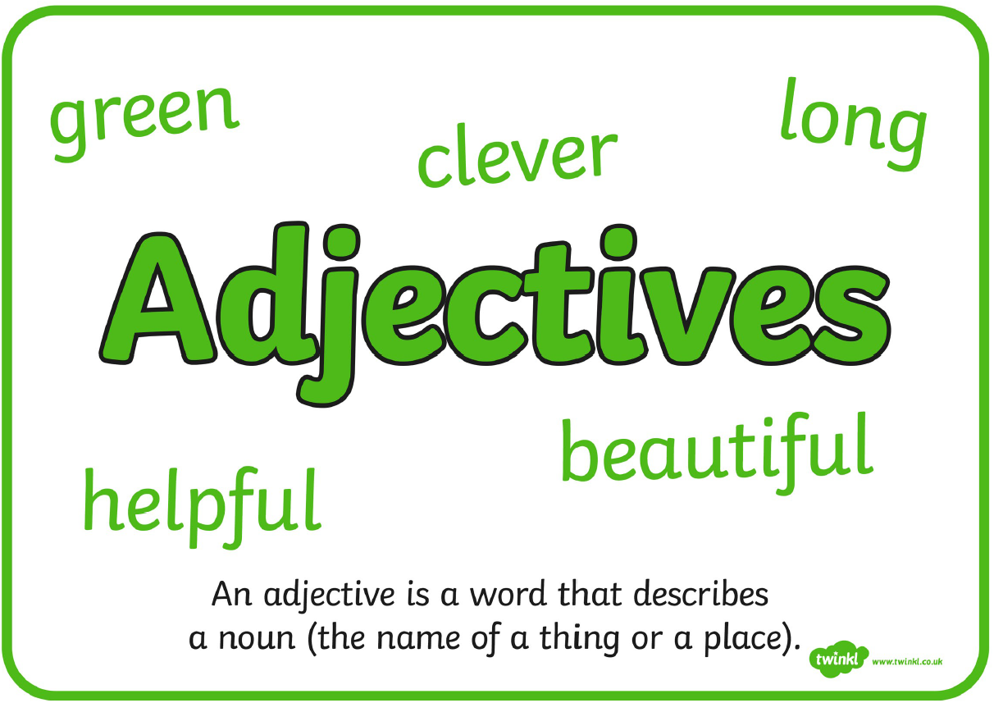
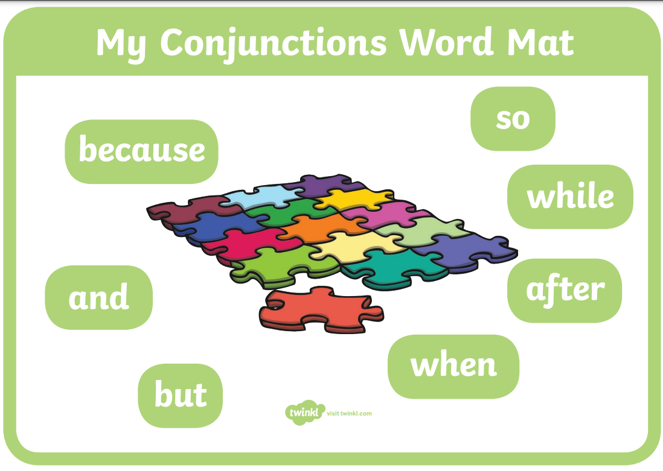


English: Features of Writing
Children are taught the key features of writing to make work more interesting and detailed:
Adjectives – descriptive words
Conjunctions – words that join two sentences
Time connectives –

Slide 8

Handwriting
The children practise letter formation through discrete Handwriting lessons.
Children are taught pre-cursive letter formation from the beginning of Spring term in Year 1. All letters have a ‘lead in’ and a ‘lead out’.
Children are encouraged to join letters as soon as they are able.

Slide 9
English: Reading and Phonics
Daily phonics lessons following the Little Wandle scheme.
Reading takes place throughout the curriculum.
Children participate in small group reading sessions once a week, based at their level.
Additional 1:1 reading with an adult.
Children are assessed formally at the end of each half term to determine if they are ready for the next level of books. The Little Wandle phonics assessments guide our judgements.
Notes:
Essential – particularly for accessing maths and some foundation subjects.
1:1 reading once a week each – sometimes marked in the record (busy times)
Reading at home important to do every day. You must sign the reading record in order to have the book changed. If you've been offered a space at the early morning book club please do take it up.

Slide 10


Mathematics
We use White Rose Maths, which follows the National Curriculum. The scheme uses a mastery approach to teach mathematical concepts so that the children can gain a deeper understanding.
Fluency – where children learn and practise key concepts
Reasoning – children are taught how to explain their thinking which leads them to understand more
Problem solving

Slide 11
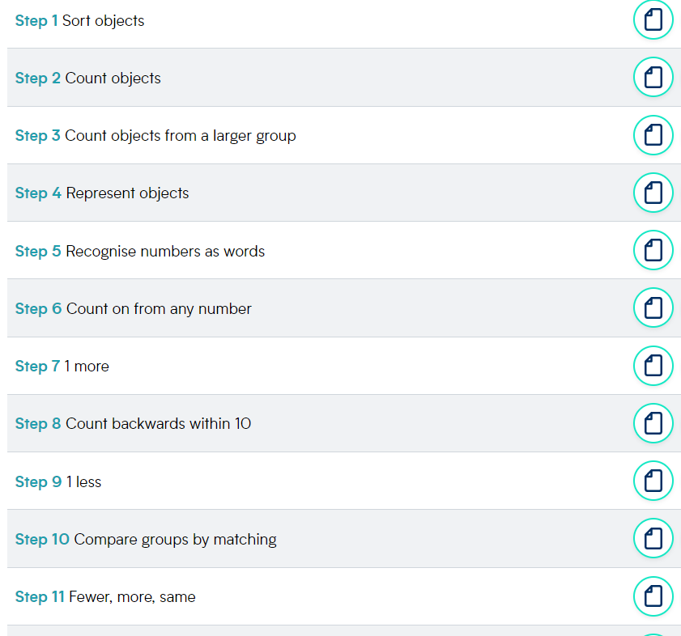
White Rose Maths – small steps
The scheme breaks down key topics (blocks) into small steps in order to ensure the children really understand every part of a whole unit.
Children spend as much or as little time as needed on a particular topic.

Slide 12
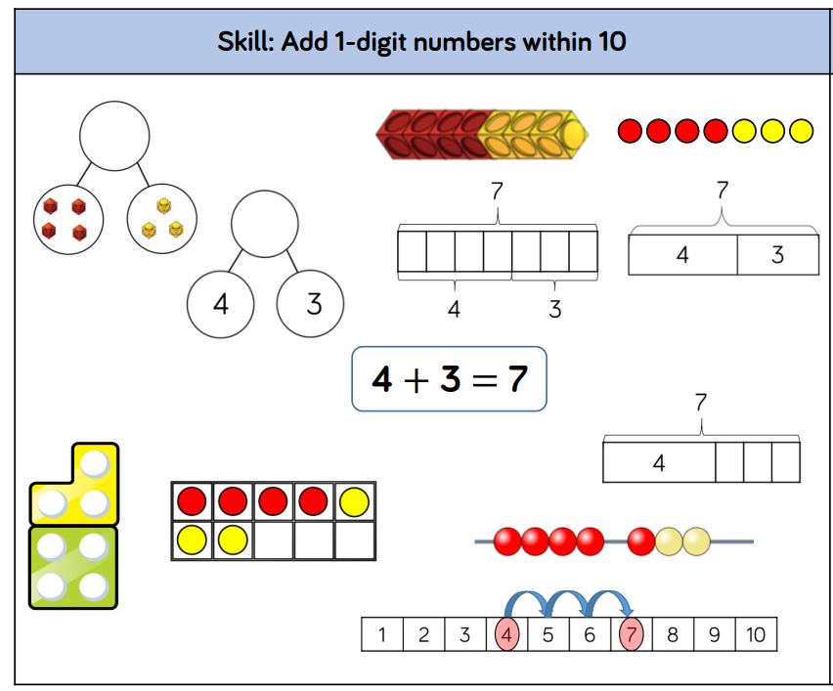
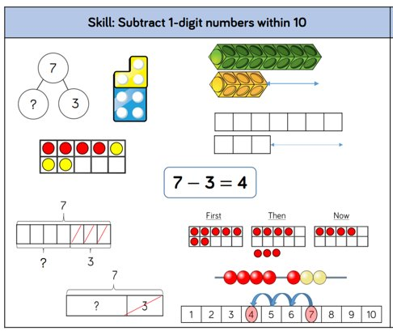
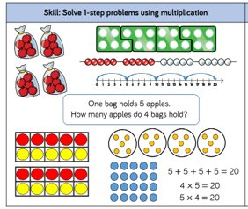
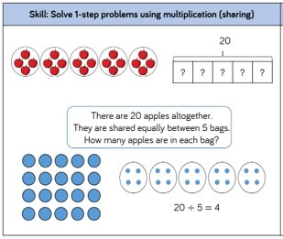
White Rose Maths – Methods

Slide 13
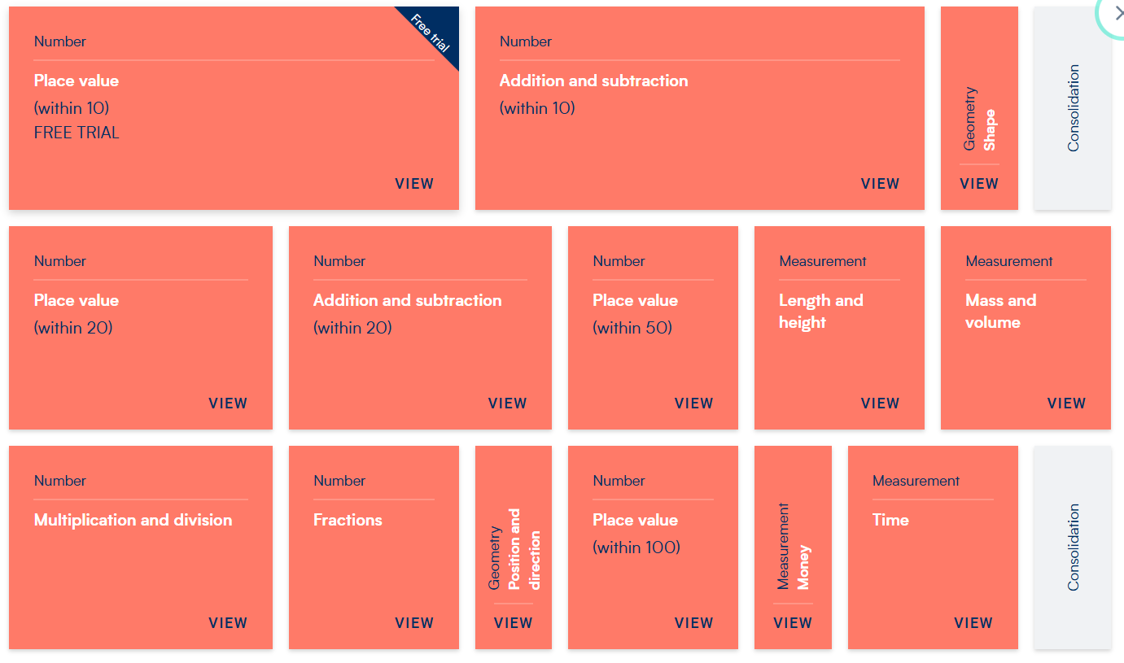
Topics covered

Slide 14

We are Scientists!
This year children will be studying the following topics and trying to become Scientists!
Animals including humans (body parts and senses, animal types and diets, classification)
Plants (deciduous, evergreen, common flowers and plant structures)
Seasons (lessons fit in to the Science curriculum as the season arrives)
Materials (identifying, properties and comparison
Investigations and working scientifically

Slide 15

Computing:
This year we will be covering the following topics:
E -Safety
Algorithms and Debugging using Purple Mash and Bee Bots.
Simple animation
Create, organise, store, manipulate and retrieve digital content

Slide 16
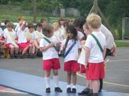
Physical Education
Oak class – Tuesday/Friday
Elm class – Tuesday/Friday
A named P.E kit should be in school at all times. This is sent home during half term and at the end of term.
Children are allowed to wear either black plimsoles or black trainers. (Please only provide trainers with laces if your child can independently tie them.)

Slide 17
Foundation Subjects
Geography – Countries of the UK and capital cities, maps, local area and human and physical features.
History - Great fire of London, Toys, monarchy and local history.
Art - Painting, drawing, sculpture, printing and looking at the work of famous artists.
DT – Planning designing and making, investigating moving parts, fire engines and cooking.
PSHE - Teamwork, being healthy, diversity and self-esteem.

Slide 18

Homework:
Daily reading.
Maths and Phonics Home Learning Resources sent on a Friday. This is for your own use and does not need to be returned.
Spellings will begin after half-term and they are sent home on a Wednesday.
A spelling test is given on the following Wednesday.
The spellings are based on focus graphemes and tricky words that are being taught during the week.

Slide 19
Helping at home
English:
Listen to your child read daily if possible.
Read and recall sounds for digraphs and trigraphs from the Little Wandle Home Learning Resource
Read, write and spell Tricky Words from the Little Wandle Home Learning Resource
Orally create stories using imagination.
Practise writing and structuring a sentence using a capital letter and a full stop.

Slide 20
Helping at home
Mathematics:
Help your child to represent numbers in different ways.
Help your child to add 1 and take away 1 from any given number (more and less)
Understanding about numbers being greater than or less than other numbers.
Counting accurately and being confident with numbers up to 100 and beyond.
Allow your child to work with real money.
Help your child to recognise o’clock and half past.
Refer to the Maths Home Learning Resource.

Slide 21
DArya
Enhancing the Curriculum!
Great Fire Day!
Street Detectives Walk
Pirate Day!
Summer Trip TBC

Slide 22
Thank you
Any questions?

