Slide 2
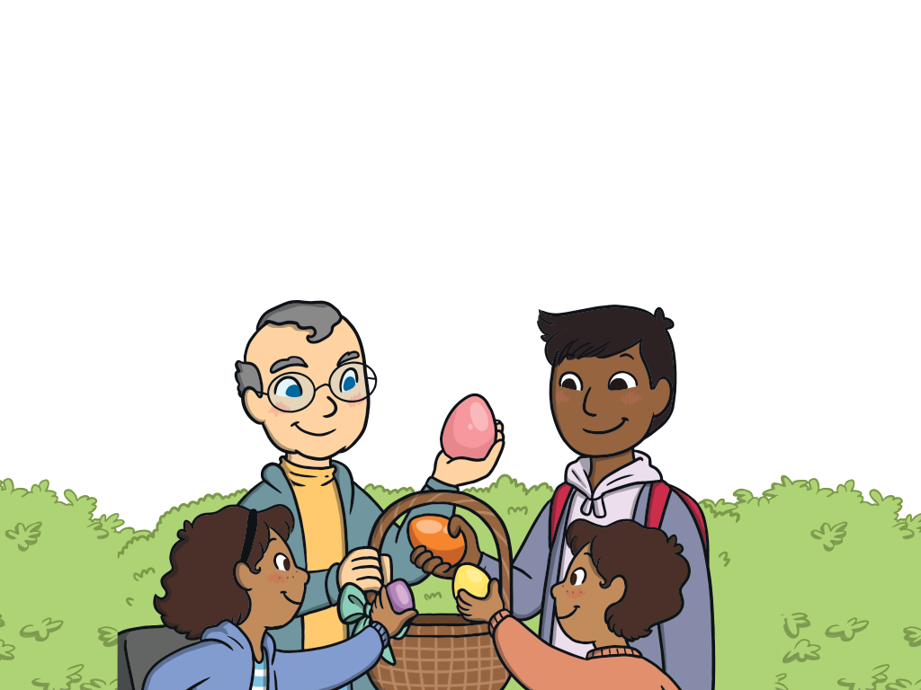
We are off on an Easter egg hunt!
Can you help us find the hidden Easter eggs?
Where are they hidden?
Play

Slide 3

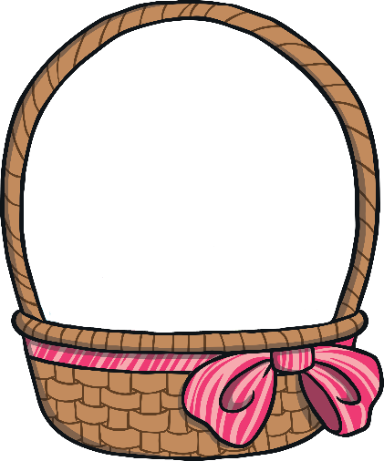


Where Is the Easter Egg?
Can you tell a friend where the Easter egg is hidden?
Click me to see where the egg is hidden.
The egg was hidden behind a bush.
back
next

Slide 4


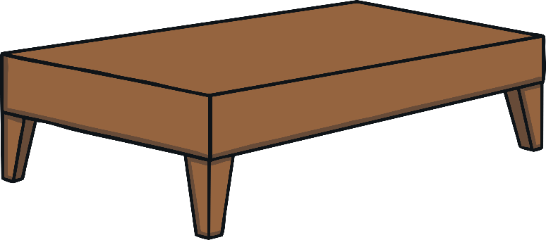
Where Is the Easter Egg?
Can you tell a friend where the Easter egg is hidden?
Click me to see where the egg is hidden.
The egg was hidden on the table.
back
next

Slide 5
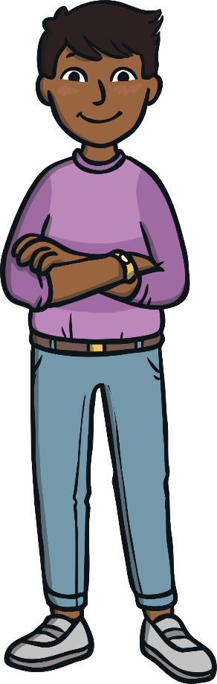


Where Is the Easter Egg?
Can you tell a friend where the Easter egg is hidden?
Click me to see where the egg is hidden.
The egg was hidden under the bench.
back
next

Slide 6
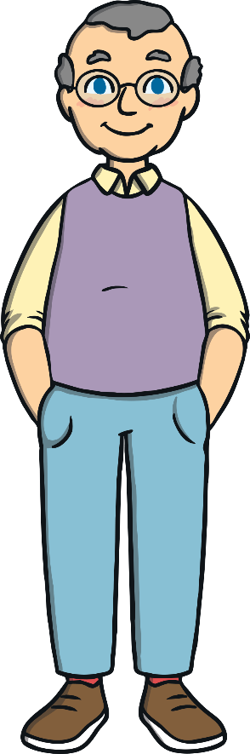

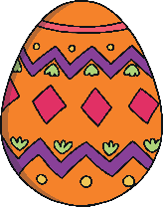
Where Is the Easter Egg?
Can you tell a friend where the Easter egg is hidden?
Click me to see where the egg is hidden.
The egg was hidden next to the flowers.
back
next

Slide 7



Where Is the Easter Egg?
Can you tell a friend where the Easter egg is hidden?
Click me to see where the egg is hidden.
The egg was hidden in front of the watering can.
back
next

Slide 8

Where Are the Easter Eggs?
Can you tell a friend where the Easter eggs are hidden?
The eggs are in the Easter basket.
back
finish

Slide 9
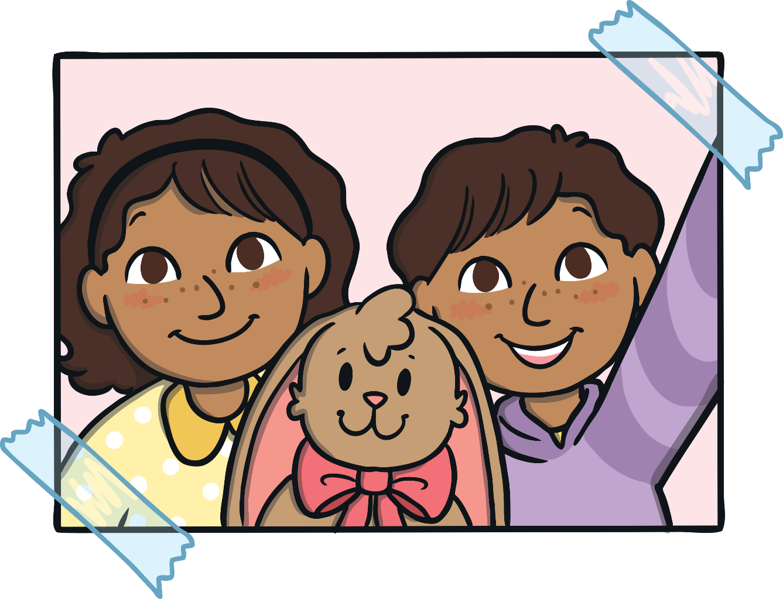
That was a fun Easter egg hunt! Thank you for helping us find and collect all the eggs.

