Slide 1

Friday
12th February 2021

Slide 2
L.O: To tell the time.

Slide 3
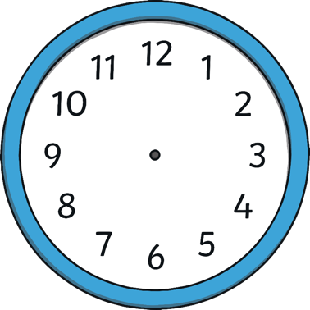
O’clock
8 o’clock.

Slide 4
Quarter past
Quarter past 8

Slide 5
Half past
Half past 1

Slide 6
Quarter to
Quarter to 6

Slide 7
What Time Is It?
Quarter to 10
Quarter to 11
Quarter to 12

Slide 8
What Time Is It?
3 o’clock
5 o’clock
6 o’clock

Slide 9
What Time Is It?
Quarter to 4
Quarter past 4
Half past 4

Slide 10
What Time Is It?
Quarter to 5
Quarter past 5
Half past 5

Slide 11
What Time Is It?
Quarter to 6
Quarter past 3
Quarter past 6

Slide 12

Task:

Slide 13
Task:
2

Slide 14
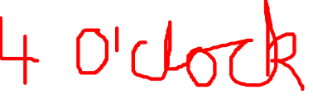
Task:

Slide 15
Task:

Slide 16
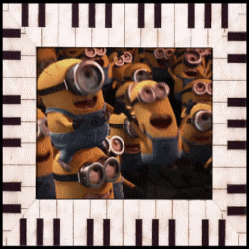
So proud of you all !

