Slide 2
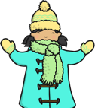

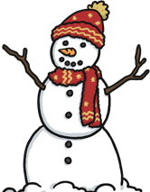
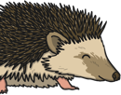
What Happens in Winter?
Winter is one of the four seasons.
It is the season that comes after autumn.
Winter begins on 22nd December
and finishes
in March.
During the winter there is less sunlight, which means the days are shorter and colder than during any other season.
Most trees and plants stop growing in
the winter.
Many animals hibernate.
Many festivals are celebrated during the winter including Christmas, New Year, Hanukkah and Valentine’s Day.
There are many outside
activities that people enjoy
in the winter season such
as making snowmen, sledging,
and ice skating. Cold weather
and snow can be a lot of fun!

Slide 3
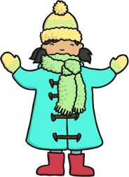

Staying Warm
To stay warm, people wear
extra clothing such as warm coats, hats, scarves and gloves.
To keep our houses warm
we light the fire or turn on
the heating system.

Slide 4

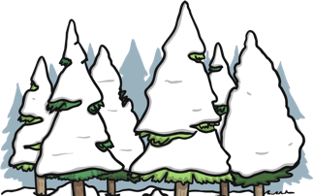
What Happens in Winter?
In winter the deciduous trees lose nearly all of their leaves. Tiny buds can be seen on tree branches, which are tightly wrapped together. When the weather begins to warm in spring the buds lengthen and begin to grow.
Evergreens will keep their leaves.
People bring evergreen trees inside and decorate them as Christmas trees.

Slide 5
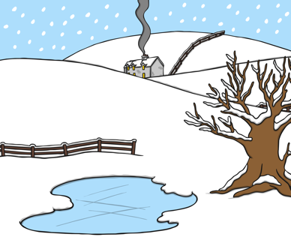
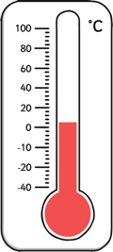
Winter Weather
When the temperature
outside becomes very cold,
water freezes and turns to ice.
The temperature outside
drops during the winter.

Slide 6
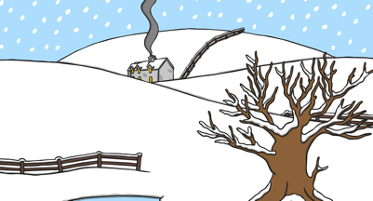
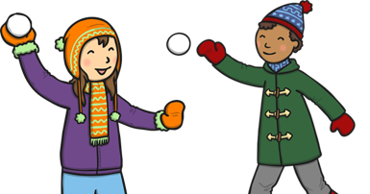
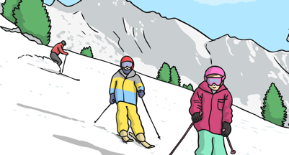
Winter Activities
Snow can be great fun. People take part in many activities such as building a snowman, having snowball fights and sledging.
These sports all need snow:
Tobogganing
Skiing
Snowboarding

Slide 7
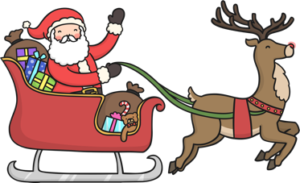
Celebrations in Winter
Christmas
Many people around the world celebrate Christmas Day on 25th December.
This is a time that Christians remember the birth of Jesus Christ.
Many people decorate their houses with
lights, Christmas trees and decorations.
Christmas cards are exchanged sending good wishes. Children look forward to a visit from Santa Claus on Christmas Eve.
On Christmas Day presents are opened and
family and friends often join together to
share a special meal.

Slide 8


Celebrations in Winter
New Year
New Year's Day is the first day of the new year. It is celebrated as a holiday in almost every country in the world. It is a time of fun, remembering the past, and hoping for good things in the future.
In Scotland, New Year is called Hogmanay.
Edinburgh’s Hogmanay is a world-famous
New Year festival and is three days of
spectacular events, fireworks and audiences from every corner of the globe.
Many people celebrate New Year’s Eve by spending time with family and friends, eating, drinking and dancing.
In England, Big Ben strikes at midnight to
welcome the New Year.

Slide 9
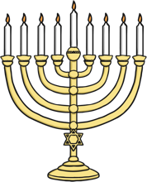
Celebrations in Winter
Hanukkah
Hanukkah is a Jewish winter festival.
Hanukkah is a time for family and friends
to get together. There are special meals, songs, stories and games. Food is cooked in oil to celebrate the miracle of the oil which burned in the temple.
Hanukkah is an annual festival which begins in December. The date changes yearly as it follows the Jewish calendar.
The festival is a reminder of the recapture of a temple which had been taken from the Jewish people. When the temple was cleaned the Ner Tamid, or everlasting light, was lit. But there was only enough oil to burn for one night. Eight days later the lamp was still lit. This was seen as a miracle, showing that God was on their side in the fight against evil.

Slide 10
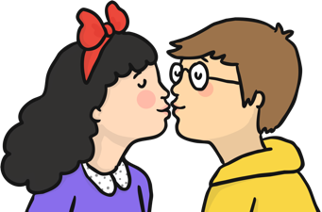
Celebrations in Winter
Valentine’s Day
Every February, in many parts of the world, flowers, cards and gifts are exchanged between loved ones, all in the name of St. Valentine. But why do we celebrate
this holiday?
St. Valentine was a Roman physician who was also a Christian priest during the days of the early church.
There are different versions of the Valentine’s Day story. One version is that Valentine was loved so much by the children of the town where he lived that they wrote him notes telling him how much they liked him and this is why people exchange Valentine’s cards today.

Slide 11
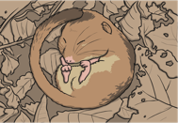

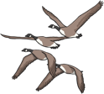

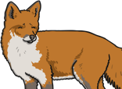
What Happens to Animals in Winter?
The weather becomes much colder in the winter.
People can wrap up with warm clothes and can buy their food from shops.
This is not possible for animals, so how do they survive?
Hibernation:
Hibernation is the way that some animals survive through the winter.
They find a safe place and fall into a very deep sleep. When the temperature is warmer, in the spring, they wake up again.
Migration:
Some birds fly south for the winter, where it is warmer.
This is called migration. They go to a warmer place to find food.
Adaptation:
Not all birds migrate - some stay here all winter. People can help these birds by feeding them. Other animals stay active in winter such as squirrels, rabbits and foxes. It is more difficult for them to find food. Some animals grow more fur in winter to help them stay warm.

Slide 18
Complete the worksheet

Slide 19


