Slide 1


Inspiring Writing at
Chalfont St Peter Infant School

Slide 2

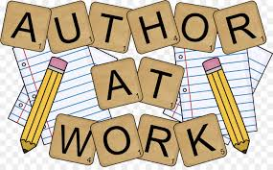
Our Writing Curriculum
  Children are encouraged to write at every opportunity and feel the joy of being an author in all sorts of contexts.
  We encourage all children to ‘think’, ‘feel’, and ‘live’ experiences before putting pencil to paper. Many lessons involve group collaboration, speaking and listening, movement and practical experiences thus enhancing content and attainment of writing.

Slide 3

Writing is a Journey
  The writer is an explorer. Every step is an advance into a new land.
  Ralph Waldo Emerson, Philosopher

Slide 4
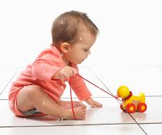
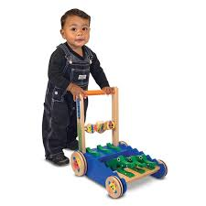

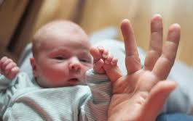

Part 1- The Science bit
  Preparation for writing does not happen by magic - it is all part of the science of child development. Each time a baby pulls, pushes and grasps something they are taking the first steps to prepare their body for writing. Laying on their tummy helps to strengthen their neck muscles for a good writing stance and time spent looking at adults and mimicking them are their first steps to communication and language.

Slide 5

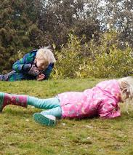
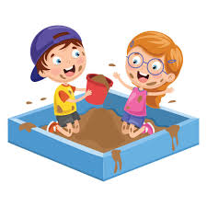
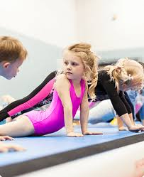
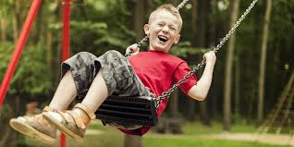

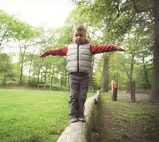
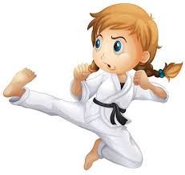
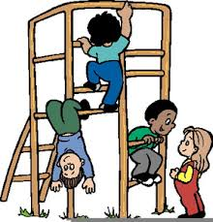

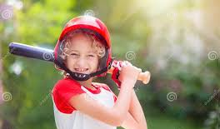
Even before the pencil is picked up….

Slide 6
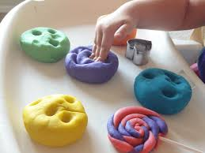

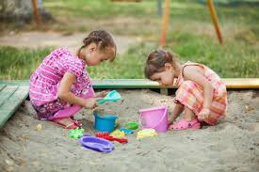

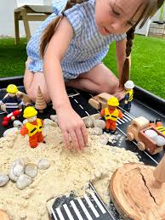
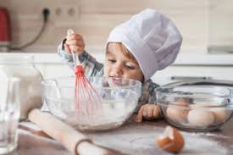

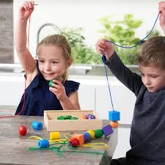
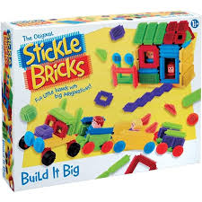
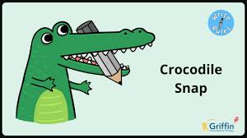
Now time for fine motor skills….

Slide 7

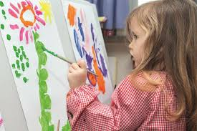
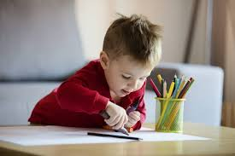
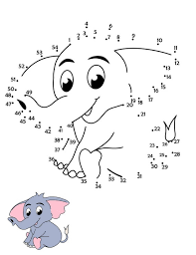
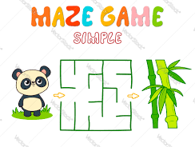
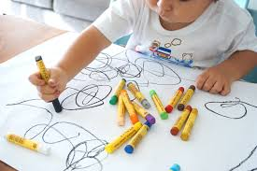

Now the pencil is picked up….

Slide 8
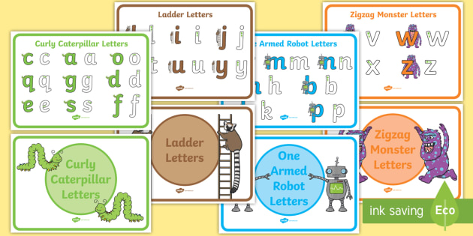
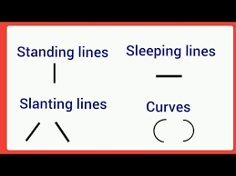
Letter Formation Families

Slide 9
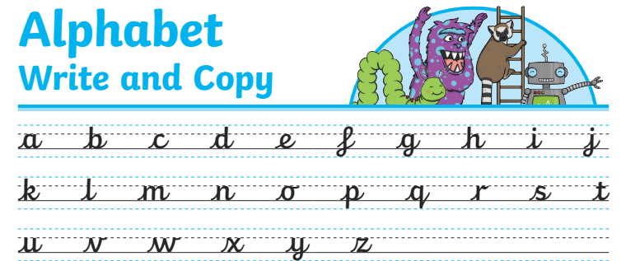
Handwriting

Slide 10

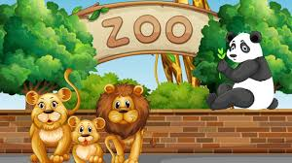
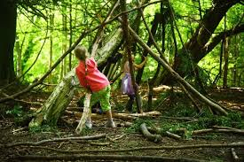
Part 2- The Creative bit
  Some children , even once they have mastered the physical and mechanical part of writing, find they have nothing to say. In the early years of their life it is our job as their adults and role models to fill up their creative banks so they always have memories, experiences, stories and ideas to fall back on. This filling of the bank is a never ending story and will help our children to ‘magpie’ and find a starting point and inspiration for their writing.

Slide 11
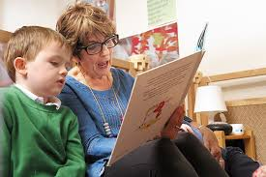




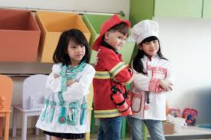
Filling the memory bank …

Slide 12

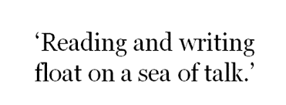

The power of oracy
ideas
confidence
Good oracy skills can help children in every subject that they learn in school. It enables them to express their thoughts and opinions about what they're learning and interact with others thoughtfully and productively.
We need to give our children enough time to converse - not just talk.
structures
expression
organisation
vocabulary
listening skills

Slide 13
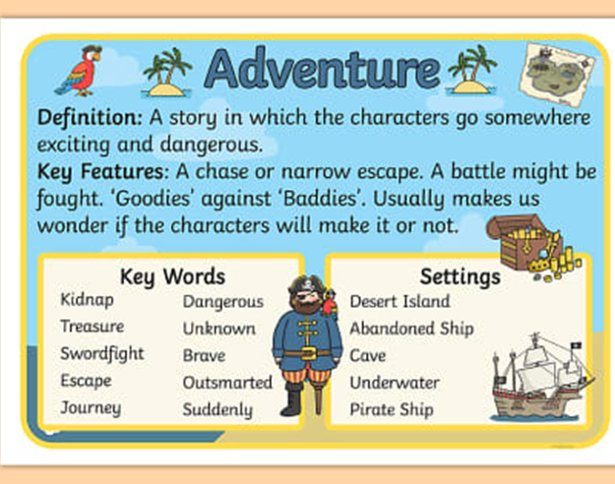

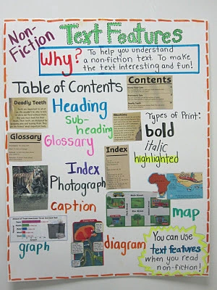
Types of writing…

Slide 14
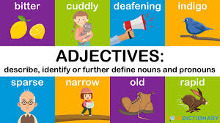
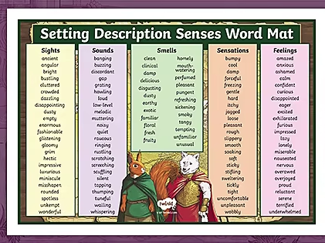
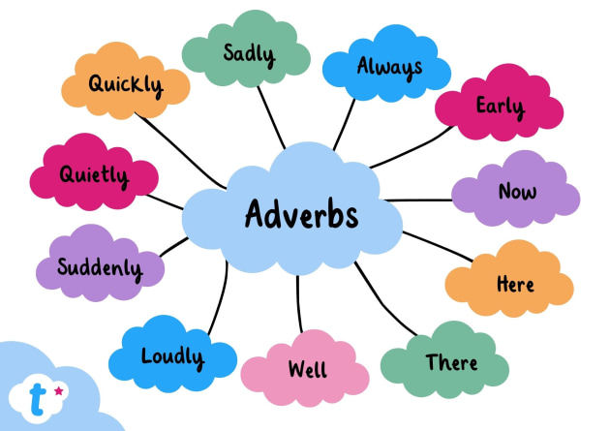
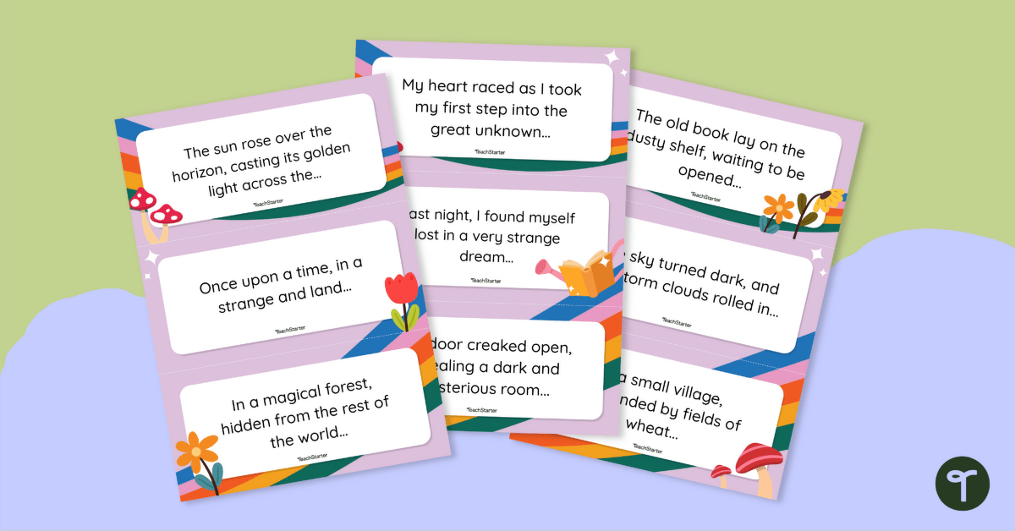
Vocabulary, vocabulary vocabulary…

Slide 15
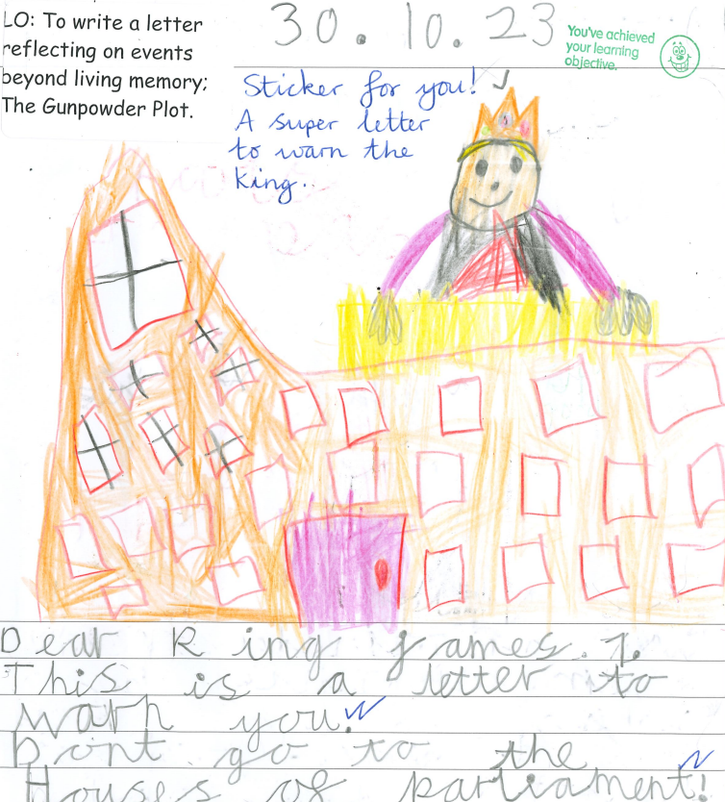
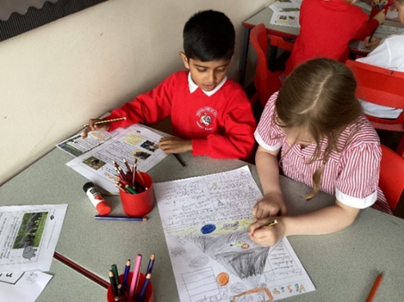
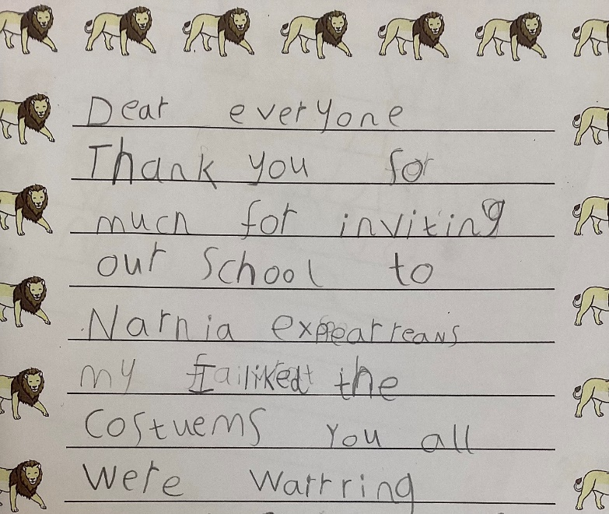
Writing across the curriculum
  Writing is an important lifelong skill. Children need to learn to write so they can communicate and express themselves. In the age of technology, the lifelong skill of learning remains so important in a child’s education.
  Writing can improve reading skills, motor skills, emotional intelligence, cognitive ability, creativity and patience and resilience.
  In school we give so many opportunities for writing across all subjects.

Slide 16
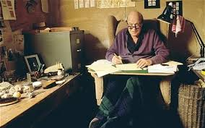
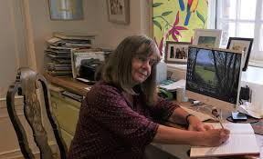
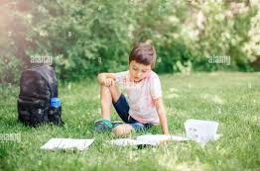
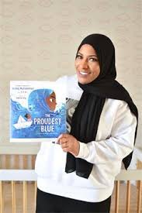


The enjoyment of being an author
Julia Donaldson
Roald Dahl
Your child
Ibtihaj Muhammad

Slide 17
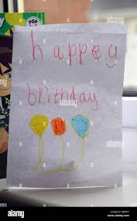
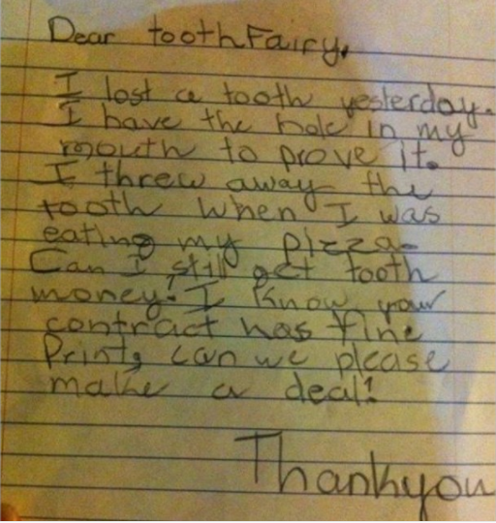
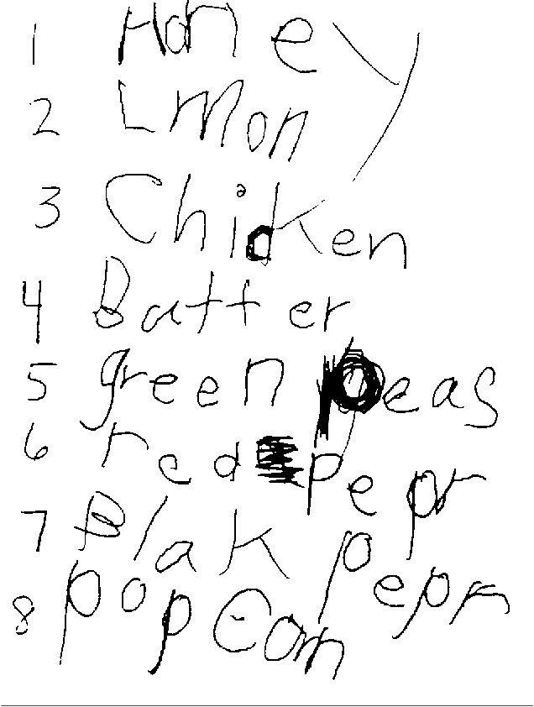

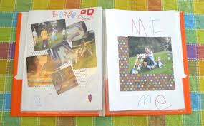

Helping harness the joy of writing…
Dear Grandpa….
Pen Pal….

