Slide 1


Year 2 SATs Meeting
.

Slide 2
Do not panic!
We do not want anybody worrying about these assessments.
It is really important that the children do not worry about these assessments too. They will perform so much better without any worry/anxiety or stress.
Their best is good enough. Teacher assessment will count for more than the assessments – these tests are just to validate our teacher judgements.

Slide 3
When, what and how?
SATs will take place in May
They will be carried out as a class or in small groups with an adult close by.
They are NOT timed.
4 assessment papers in total…

Slide 4
Maths…
Arithmetic Paper
  20 questions
  Covers addition, subtraction, multiplication, division and fractions
Reasoning Paper
  Between 30/35 worded/problem solving questions
  Selection of questions covering all elements of the Year 2 mathematics curriculum
  Questions can be read to them (except key mathematical vocabulary)
  The paper starts off with 5 questions that are verbally read by the teacher
10 minutes…
Have a look at the samples

Slide 5
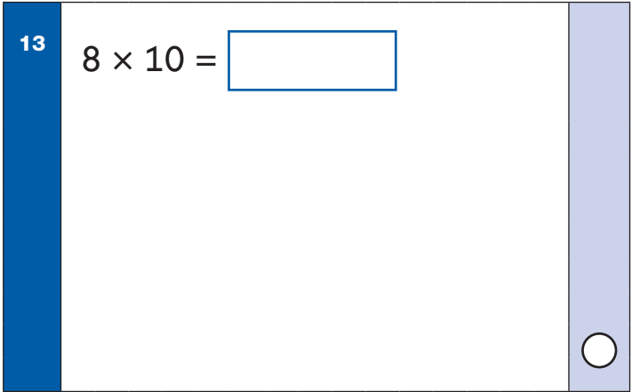
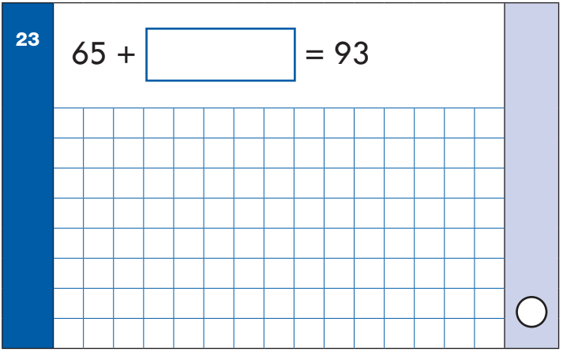
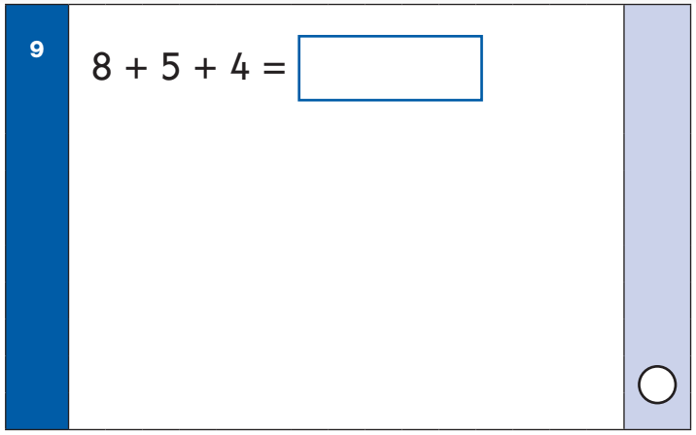
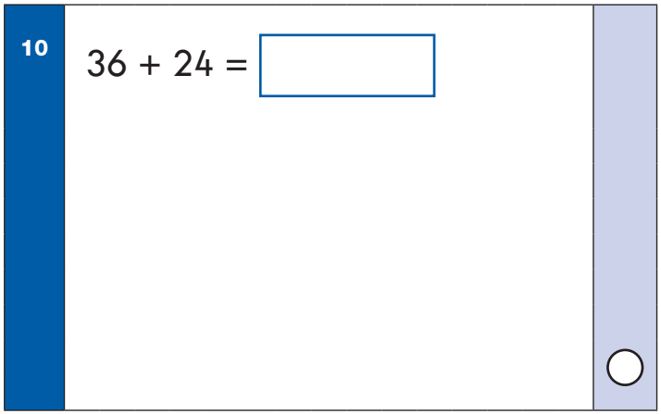
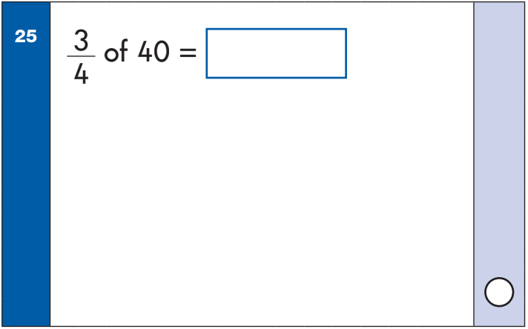
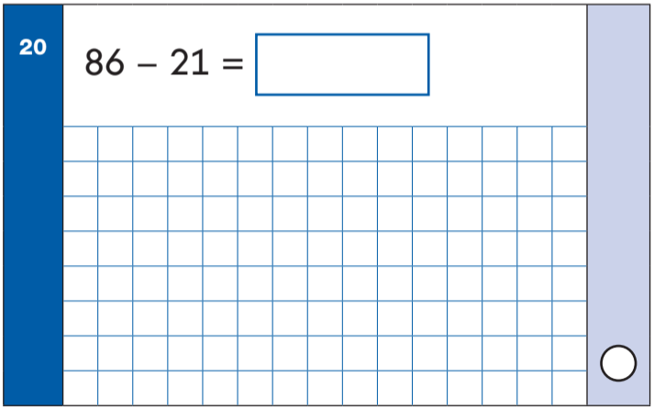
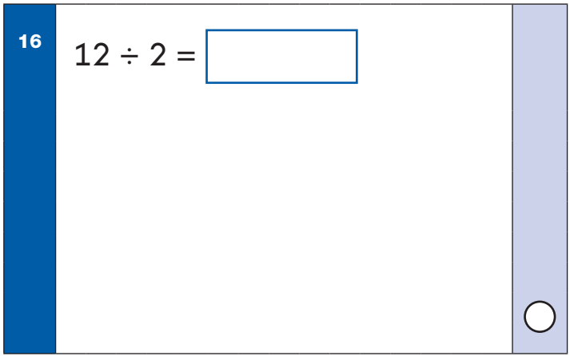
Arithmetic Paper

Slide 6
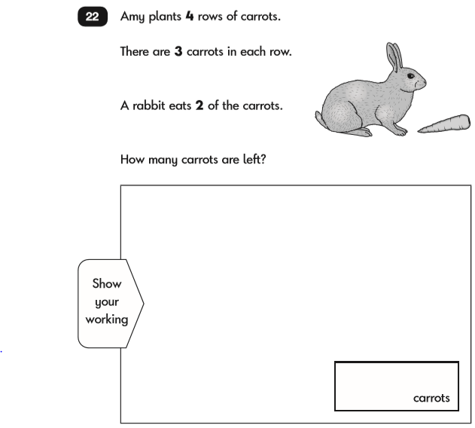
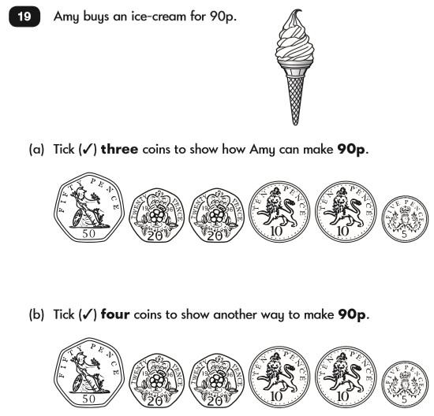
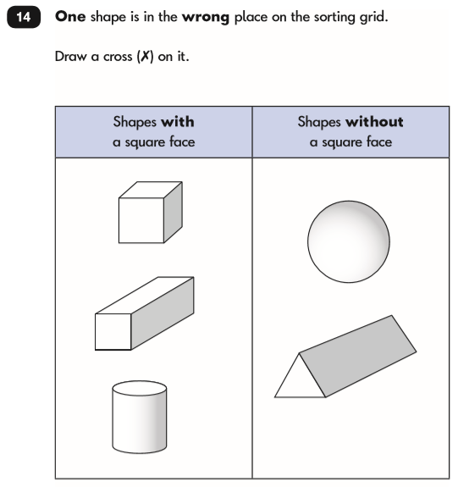
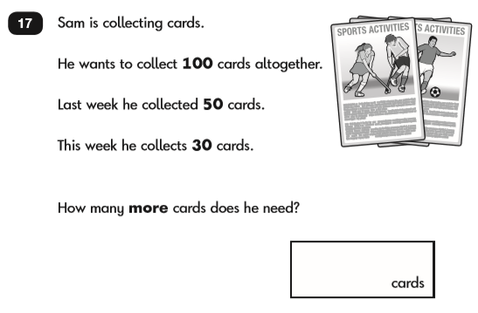
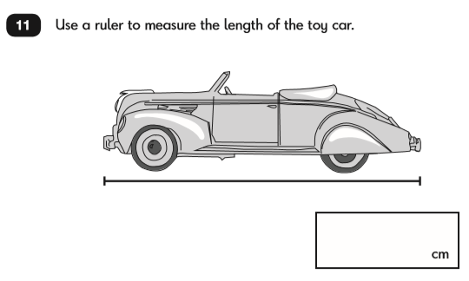
Reasoning Paper

Slide 7
Reading…
Reading Paper 1
  20 questions
  2/3 texts broken into short passages (fiction, non-fiction, poetry)
  Retrieval, prediction, inference, sequencing, vocabulary
Reading Paper 2
  A reading booklet and answer booklet
  Around 20 questions
  Retrieval, prediction, inference, sequencing, vocabulary
10 minutes…
Have a look at the samples

Slide 8
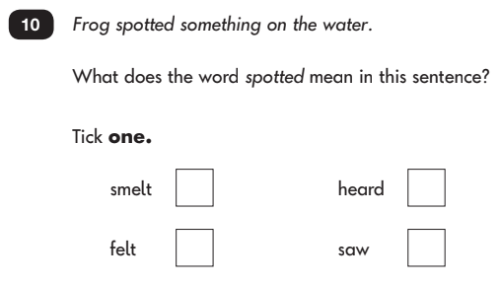
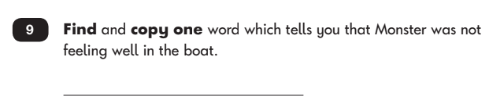
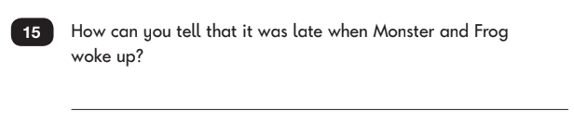
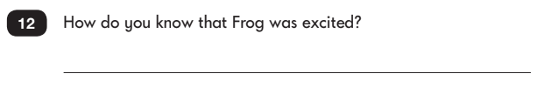
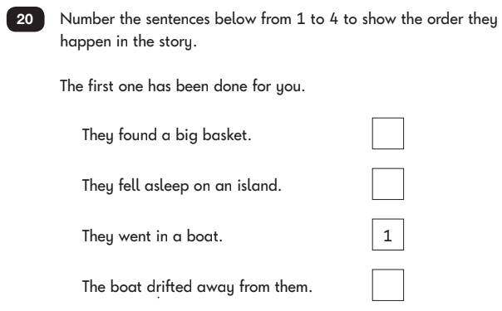
Reading Paper 1

Slide 9
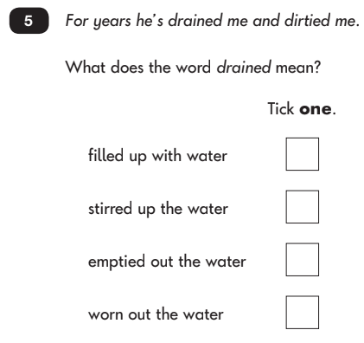
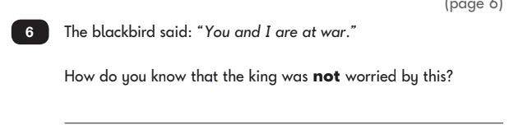
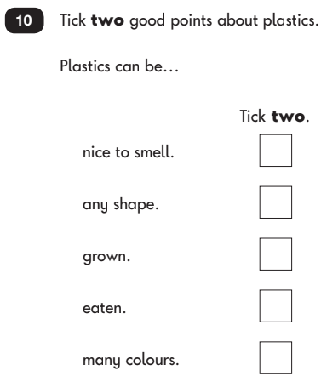
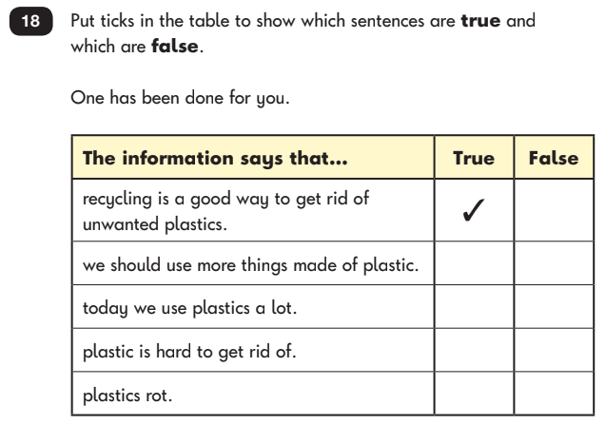
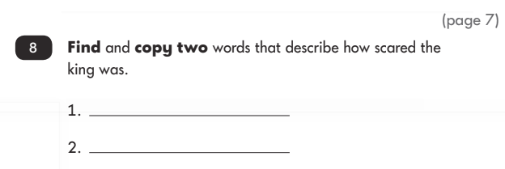
Reading Paper 2

