Slide 1
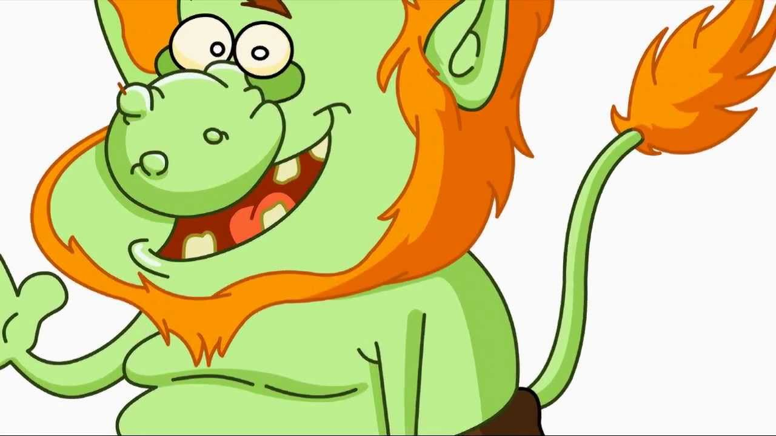

English

Slide 2
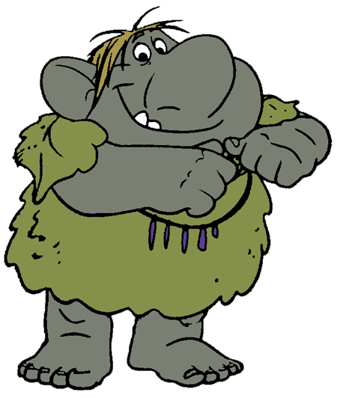
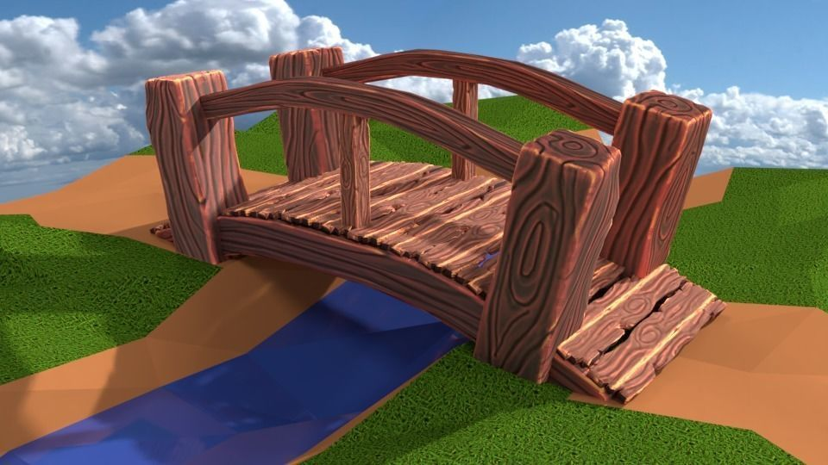
Learning Objective: To design and describe a Troll!

Slide 3
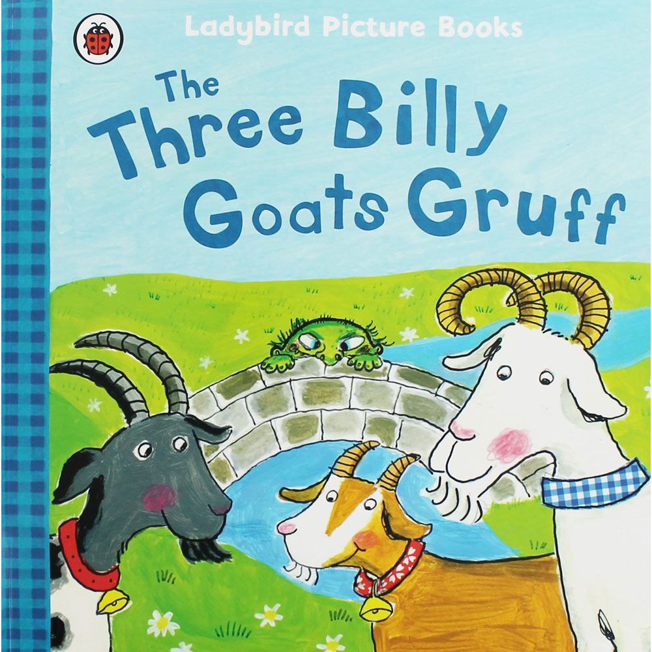
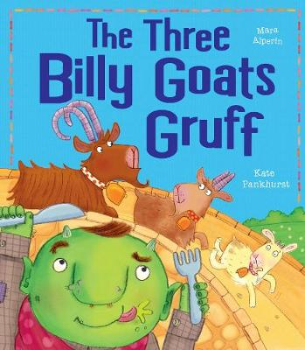
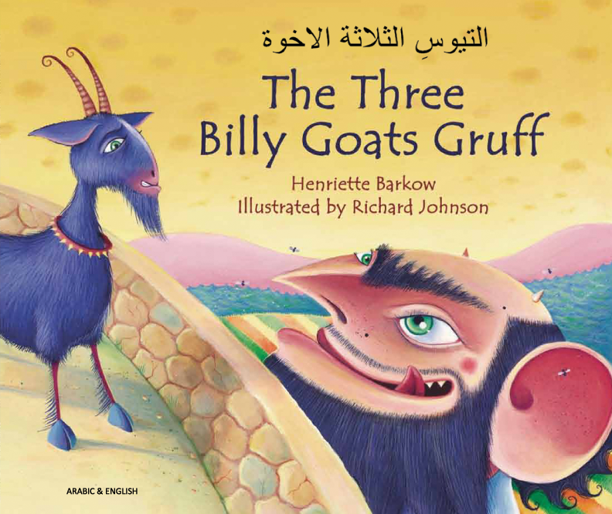
Let’s design!
The book of the Three Billy Goats Gruff has been retold many times.
Often illustrators will draw characters in different ways.

Slide 4
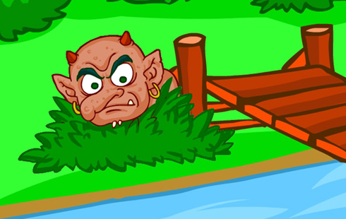
Trolls!

Slide 5
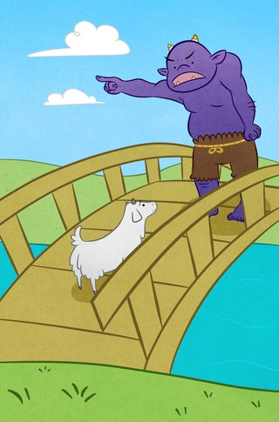
Trolls!

Slide 6
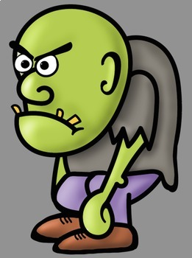
Trolls!

Slide 7
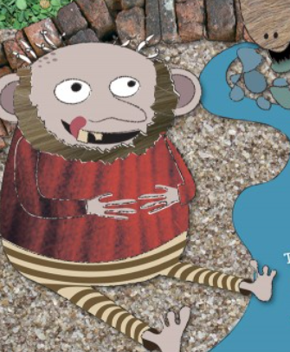
Trolls!

Slide 8
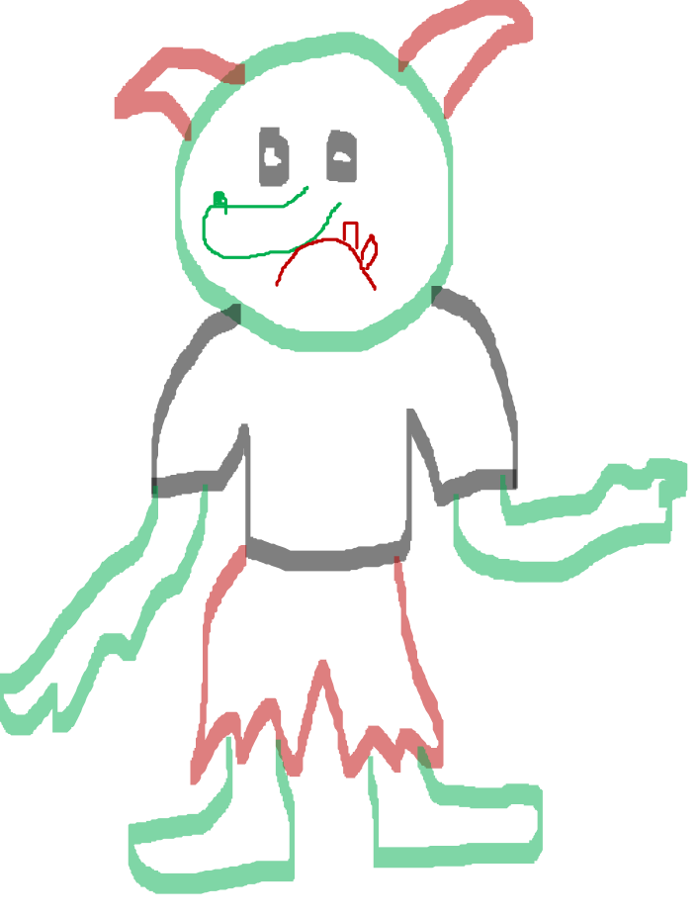

Slide 9
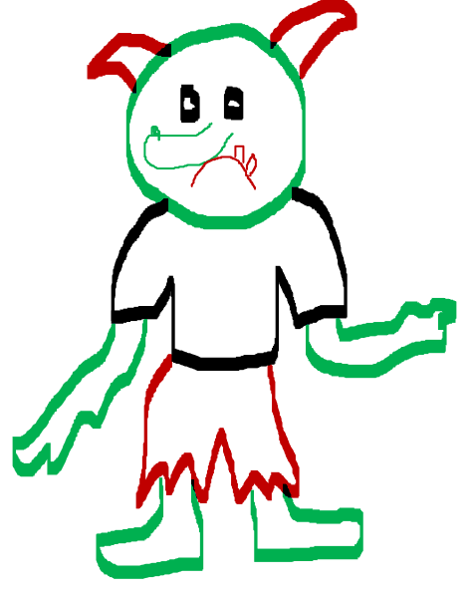
Let’s describe!
My Troll has two brown horns.
He has a big, long nose with a
small wart on the end! He loves to eat goats but he doesn’t have many teeth! I think he should go to the dentist… Would you like to meet my Troll?

Slide 10
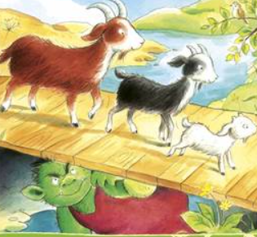
Write your description…
Please use capital letters at the start of a sentence.
Remember to use full stops.
Can you try to use some adjectives please?
Read your work to check it makes sense.

