Slide 1

Friday
08.01.21
L.O: To subtract:
A single digit from single digit number.
A single digit from two digit number.

Slide 2
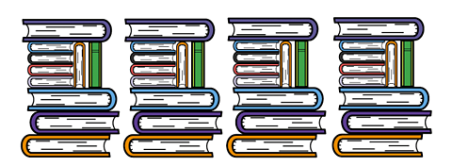
Starter

Slide 3
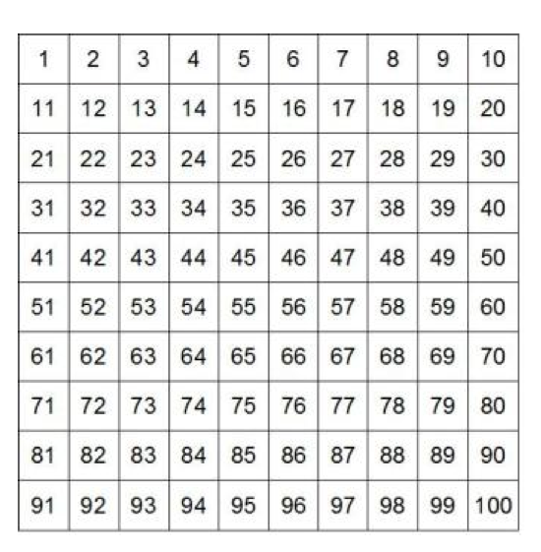
Starter

Slide 4
Starter

Slide 5

Starter

Slide 6
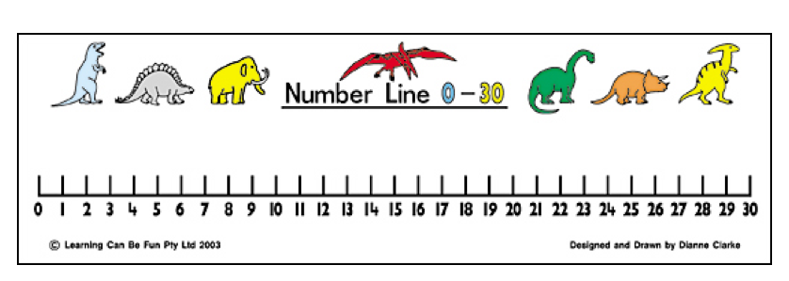
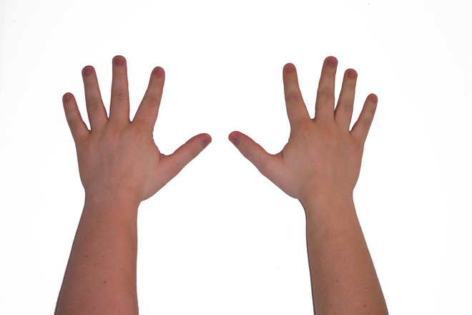

Remember we can use these to help us subtract?

Slide 7

9 - 5 =
4

Slide 8

12 - 6 =
6

Slide 9
9 -5 =
4

Slide 10

2
5 - 3 =
8

Slide 11
23 - 3 =
20

Slide 12
23 - 13 =
10

Slide 13
Remember to use a number line or hundred square to help.
Task
6 - 5 = 10 - 7 = 9 - 6 = 16 - 6 = 11 - 3 = 19 - 4 = | 7 - 5 = 11 - 7 = 8 - 6 = 15 - 6 = 13 - 3 = 11 - 4 =
8 - 5 = 13 - 7 = 6 - 6 = 12 - 6 = 17 - 3 = 14 - 4 = | 9 - 5 = 15 - 7 = 6 - 4 = 11 - 6 = 10 - 3 = 15 – 4 =
Choice which star sheet you would like to complete. Answer at least 2 sections of subtraction sums.

