Slide 1


Year 1
High Frequency Words

Slide 2
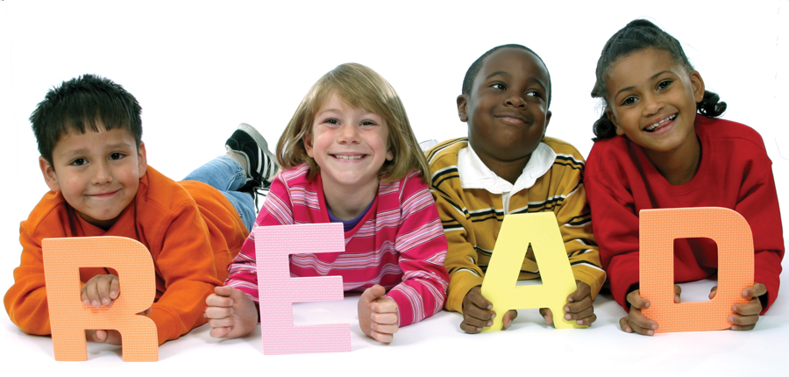
Let’s read!
the
and
a
to
said
in
he
I
of
it
is
for
at
his
but
was
you
they
on
she

Slide 3
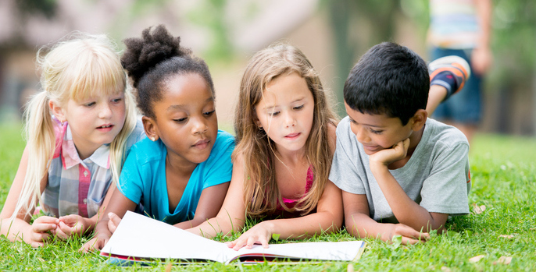
Let’s read!
that
with
all
we
can
are
up
had
my
her
what
there
out
this
have
went
be
like
some
so

Slide 4
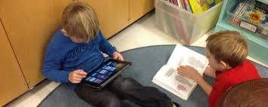
Let’s read!
not
then
were
go
little
as
no
mum
one
them
do
me
down
dad
big
when
it’s
see
looked
very

Slide 5
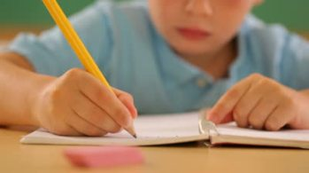
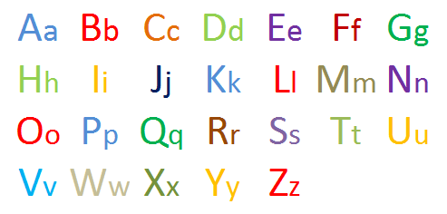


Let’s write…
Choose three words and write a sentence/s using each word.
Remember to use a capital letters.
Remember to use a full stop.
Remember to use finger spaces.

