Slide 1

Wednesday
05.01.21
LO: To write numbers correctly and in order up to 20 or more.

Slide 2

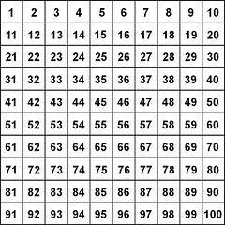
Starter – Counting in 2’s

Slide 3
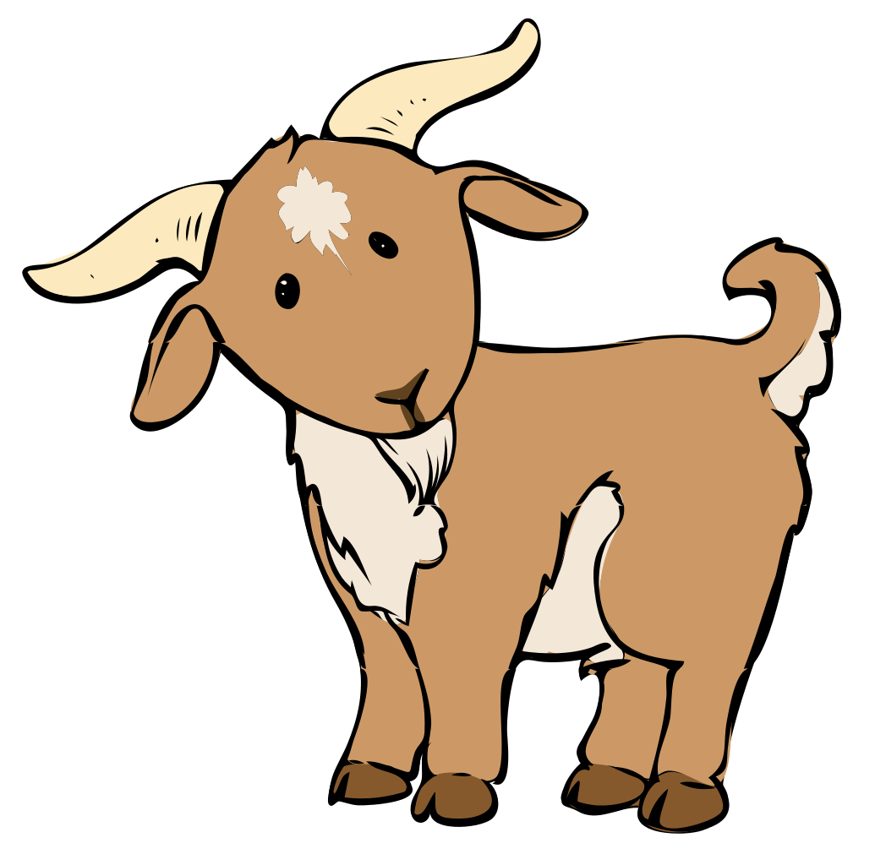
Starter – Counting in 5’s

Slide 4
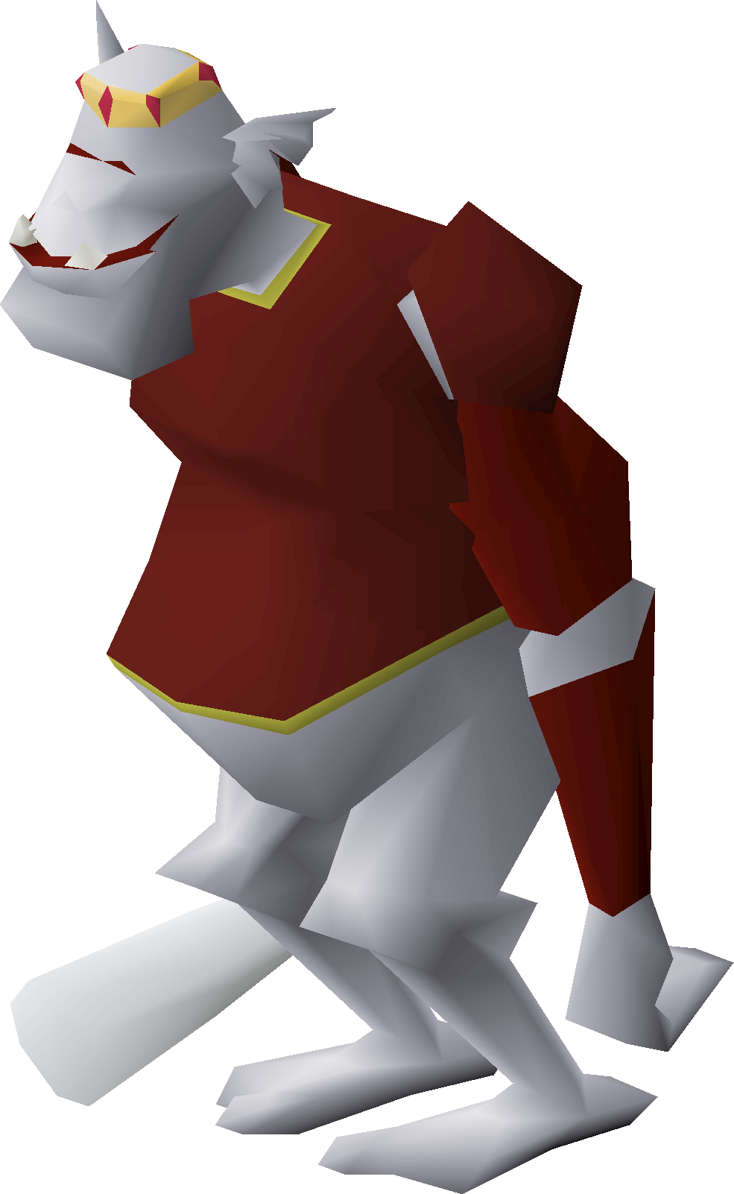
Starter – Counting in 10’s

Slide 5

1
2
3
4
5
6
7
8
9
10
11
12
13
14
15
16
17
18
19
20
21
22
23
24
25
26
27
28
29
30
31
32
33
34
35
36
37
38
39
40
41
42
43
44
45
46
47
48
49
50
51
52
53
54
55
56
57
58
59
60
61
62
63
64
65
66
67
68
69
70
71
72
73
74
75
76
77
78
79
80
81
82
83
84
85
86
87
88
89
90
91
92
93
94
95
96
97
98
99
100

Slide 6
1
2
3
4
5
6
7
8
9
10
11
12
13
14
15
16
17
18
19
20
21
22
23
24
25
26
27
28
29
30
31
32
33
34
35
36
37
38
39
40
41
42
43
44
45
46
47
48
49
50
51
52
53
54
55
56
57
58
59
60
61
62
63
64
65
66
67
68
69
70
71
72
73
74
75
76
77
78
79
80
81
82
83
84
85
86
87
88
89
90
91
92
93
94
95
96
97
98
99
100

Slide 7

2
1
3
4
5
6
7
8
9
10
11
12
13
14
15
16
17
18
19
20
21
22
23
24
26
27
28
29
30
31
32
33
34
35
36
37
38
39
40
41
42
43
44
45
47
48
49
50
51
52
53
54
55
56
57
58
59
60
61
62
63
64
66
67
68
69
70
71
73
74
75
76
77
78
79
80
81
82
83
84
85
86
87
88
89
90
91
92
93
94
95
96
97
98
99
100

