Slide 1

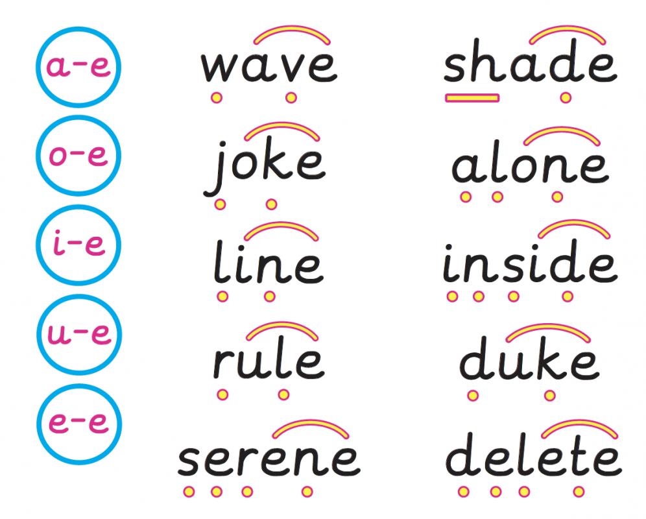
Year 1
Words with Split Digraphs

Slide 2

Let’s read a-e!
game
rake
shape
lane
bake
awake
shake
cake
came
same
wave
lake
flame
gate
make

Slide 3

Let’s read i-e!
bike
ride
line
fine
shine
like
dine
dive
hive
while
wide
lime
mine
time
kite

Slide 4

Let’s read o-e!
bone
rode
code
cone
stone
hole
joke
mole
note
poke
tone
vote
dose
those
phone

Slide 5
Let’s read u-e!
tune
flute
dune
tube
cube
rude
huge
rule
cute
use
June
duke
prune
amuse
include

Slide 6
Let’s read e-e!
these
delete
complete
even
theme
swede
extreme

Slide 7

Let’s ‘hunt’…
Cut out the words with split digraphs.
Hide them around the room.
Find the words and read them.
Write the words on the word sorting worksheet.

