Slide 1
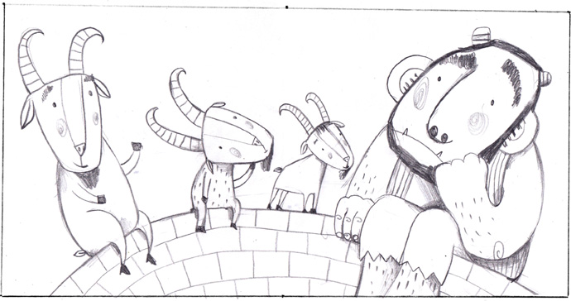

English

Slide 2
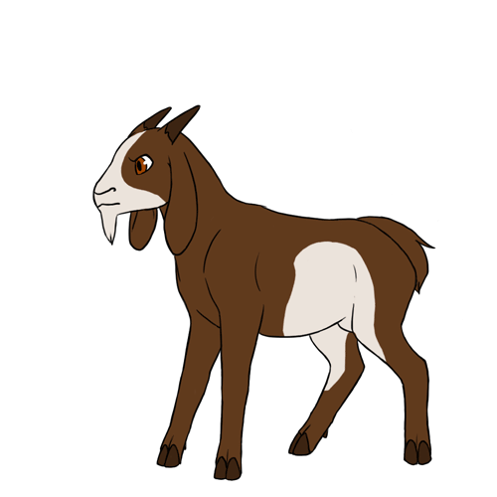
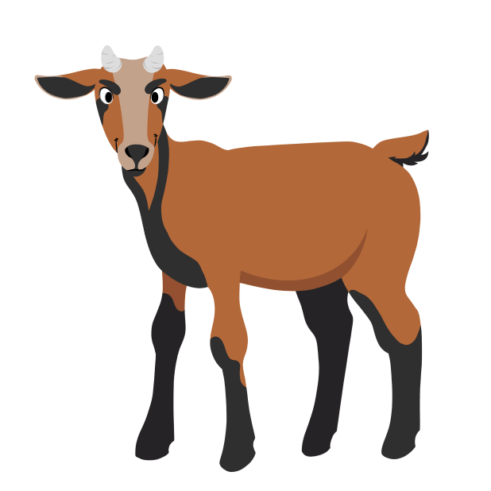
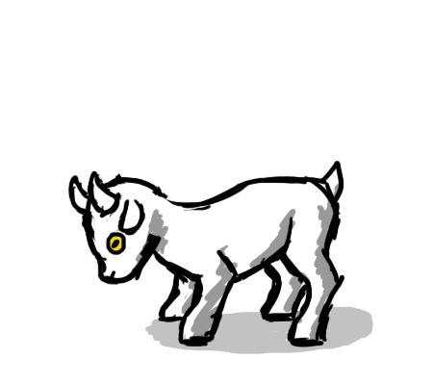
Learning Objective: To write a letter of apology.

Slide 3
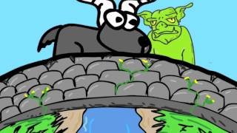
What is an apology?
An apology is something that we say when we wish we had not said or done something.
An apology is another way of saying ‘sorry’.

Slide 4
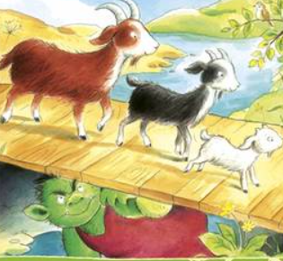
Today you will imagine that you are the Troll who lives under the bridge!
You are going to write a letter to the Three Billy Goats Gruff to explain why you are sorry.
Try to use the word ‘I’ to say why you are sorry and that you won’t do it ever again!

Slide 5
Why are you sorry?
Are you sorry for chasing the goats across the bridge?
Does the grass on the other side belong to you?
Did you use a very loud voice to scare the goats?
Do you wish that you could try again to be kind?

Slide 6
What would you like to change?
Would you like some friends?
Do you think you could eat a different meal than goat pie?
Do you think it might be fun to play with the goats?
Do you wish that you hadn’t been knocked into the water?

Slide 7
Remember to start your letter:
Dear Billy Goats Gruff,
Use capital letters, full stops and finger spaces.
Maybe you could write a question and use a question mark.
Remember to end your letter:
From the Troll.

