Slide 1

Thursday
07.01.21
L.O: To add two digits together.

Slide 2
Starter

Slide 3
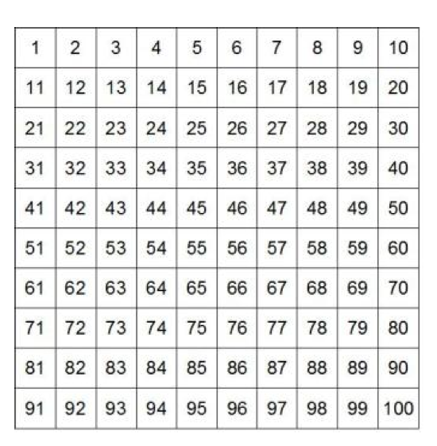
Starter

Slide 4
Starter

Slide 5
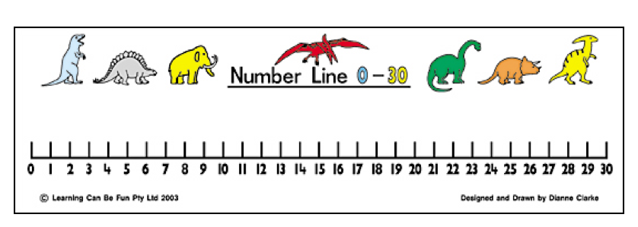
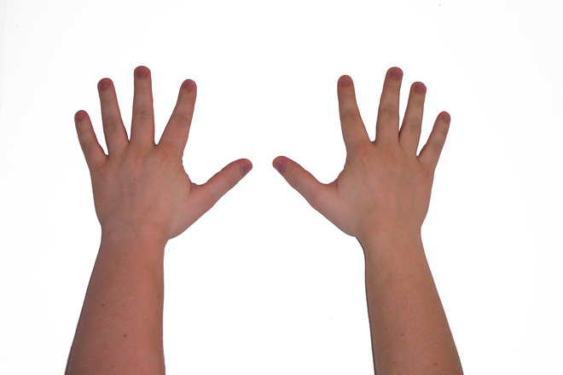

Remember we can use these to help us add.

Slide 6

9 + 5 =
14

Slide 7

12 + 6 =
18

Slide 8
9 + 5 =
14

Slide 9
23 + 3 =
26

Slide 10
23 + 13 =
36

Slide 11
Remember to use a number line or hundred square to help.
Task
3 + 4 = 5 + 5 = 7 + 4 = 10 + 5 = 12 + 4 = 16 + 3 = | 5 + 4 = 6 + 5 = 8 + 4 = 11 + 5 = 13 + 4 = 17 + 3 =
9 + 4 = 5 + 5 = 7 + 6 = 10 + 6 = 12 + 7 = 16 + 8 = | 8 + 5 = 4 + 4 = 9 + 5 = 10 + 7= 12 + 8 = 16 + 6 =
Choice which star sheet you would like to complete. Answer at least 2 sections of addition sums.

