Slide 1
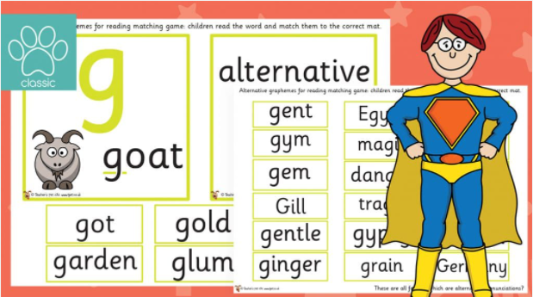

Year 1
Alternative sound for ‘g’
g
g

Slide 2

What sound does g make?
get
c
gem

Slide 3

Let’s read!
gate
c

Slide 4

Let’s read!
magic
c

Slide 5

Let’s read!
gold
c

Slide 6

Let’s read!
cage

Slide 7
Let’s read!
garden
c

Slide 8
Let’s read!
garage
c

Slide 9

Let’s read!
ginger
c

Slide 10
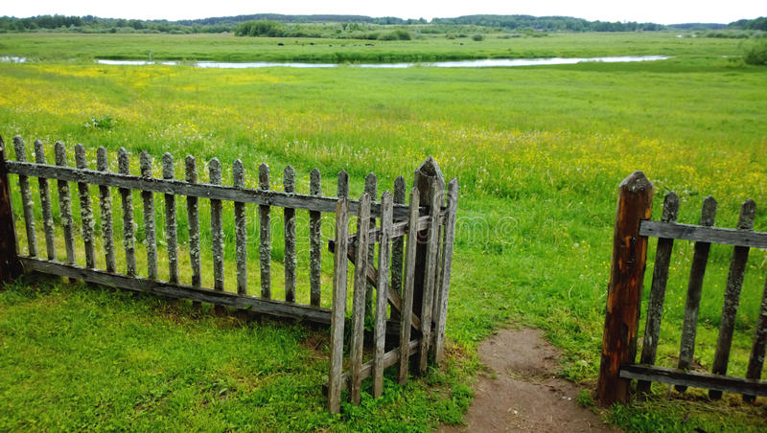
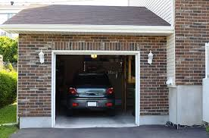
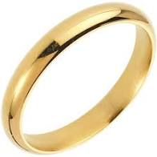

Read and Match
The gate is open.
I have a gold ring.
My car is in the garage.

Slide 11
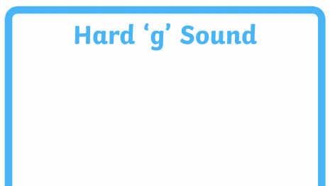
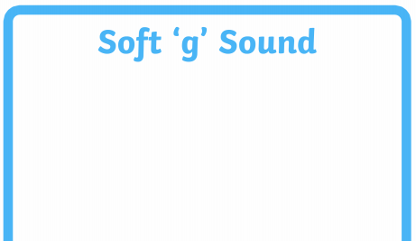




Look at the pictures and sort the words.

