Slide 1

Science
Tuesday 19th January
L.O. To know why plants are important to humans, that plants will grow from seeds in favourable conditions.

Slide 2
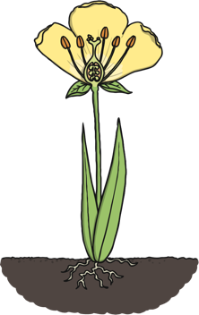
Parts of a Plant
Can you remember the parts of a plant and what each part does?
petal – attracts insects
stem – carries water around the plant and holds the plant up
leaves – turns sunlight into food for the plant
roots – suck up water and nutrients from the soil

Slide 3
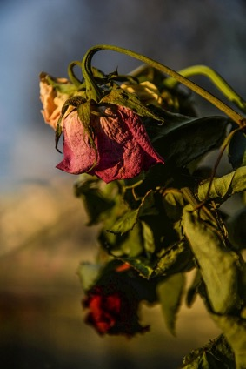
Is It Healthy?
Look at the picture of this plant.
Does it look healthy?
Why do you think that?

Slide 4

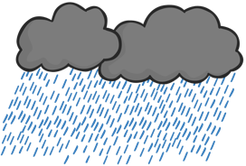
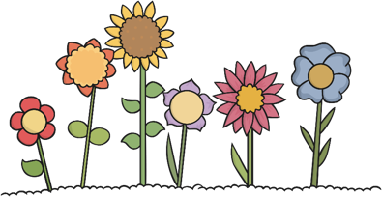
What a Plant Needs:
Air
Light
Water
Nutrients
Warmth

Slide 5
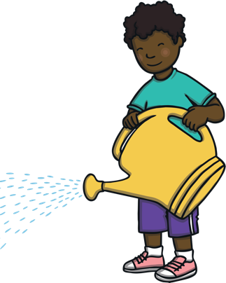
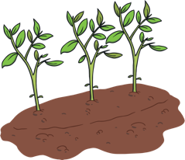
Water
Plants need water for
many reasons…
When you first plant a seed, water is needed to help turn the seed into the start of a plant.
Plants need water to suck up nutrients from the soil. Nutrients are the good things in soil which will help a plant grow and be healthy.
The leaves of a plant need water to help it turn sunlight in to food.
Children should try to drink around five glasses of water a day. Plants need water to grow and be healthy too!’

Slide 6

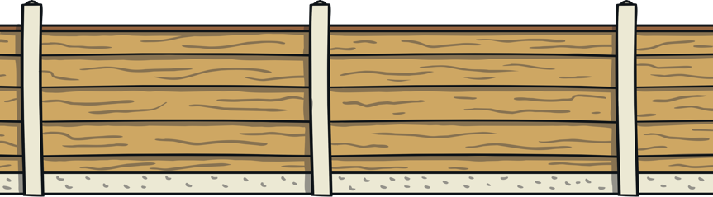
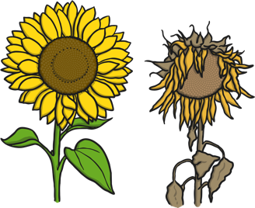
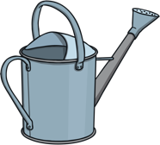
How Much Water?
How do we know what the right amount of water is?
Although plants need water, it is important that they get the right amount of water. If plants don’t have enough water, they will die. However, they can also die if they have too much water.

Slide 7
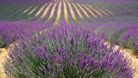
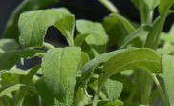
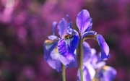

How Much Water?
To know how much is the right amount of water, we need to know what type of plant it is. For example, lavender and sage need very little water. Whereas, irises and hydrangeas need lots of water.
When you buy a packet of seeds, the packet will often give you information about how much water a plant needs. If you aren’t sure, you could find out using a book or the Internet.
lavender
sage
iris
hydrangea

Slide 8

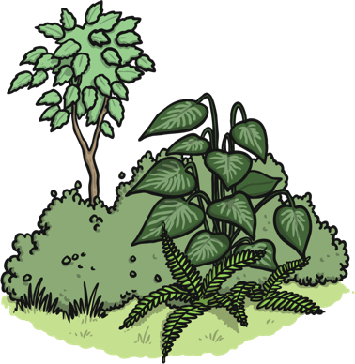

Light
We need sunlight to keep healthy. Our bodies make vitamin D from sunlight. Vitamin D helps our bodies use something called calcium which makes our bones strong. Plants need light to keep them strong too!
Leaves turn sunlight in to food for the whole plant. Without light, a plant won’t be healthy.

Slide 9
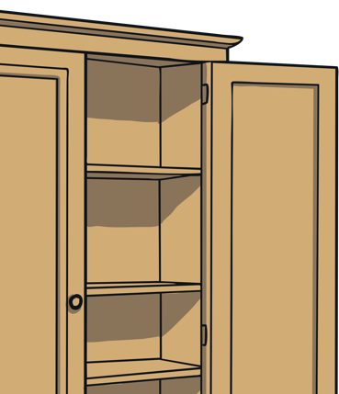

Light
If you put a plant in a very dark place, such as a cupboard, you will notice some interesting things…
As the plant grows, it will grow in the direction of the cupboard door, trying to find some sunlight.
At first, the plant might grow taller, but it will be thinner than usual. This is because the plant is putting all its energy in to finding light.

Slide 10




Temperature
What you think the word temperature means?
temperature – how hot or cold something is
When you’ve been poorly, the people you live with might have used a thermometer to check your temperature.
If the temperature outside is high (hot), you wouldn’t go out wearing a coat, hat and gloves. You’d get very hot and sweaty and might begin to feel unwell.

Slide 11


Temperature
If the temperature outside is low (very cold), you wouldn’t go outside in flip flops and a T-shirt.
This may also make you feel unwell.
The right temperature is important to help us stay healthy.

Slide 12
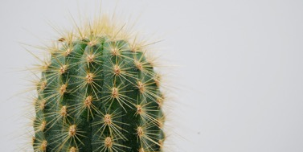
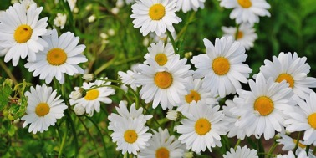
The Right Temperature
Plants need the right temperature to stay healthy too!
The right temperature is different for different types of plants.
A cactus is from the desert, so it is used to a hot temperature.
Daisies can grow and be healthy in much cooler temperatures.
Seeds need the right temperature to start turning in to a plant. Plants also need the right temperature to be able to turn sunlight into food.

Slide 13


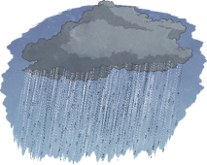
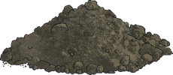
What a Plant Needs
air
    light
    water
nutrients
warmth

Slide 14
Task
Draw a picture of a healthy plant. Write some sentences about what a plant needs to be healthy.

