Slide 1
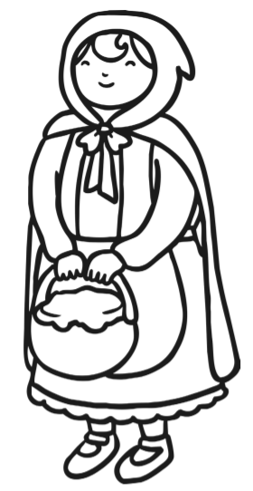

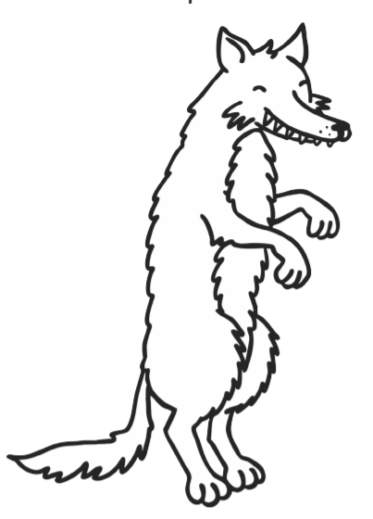
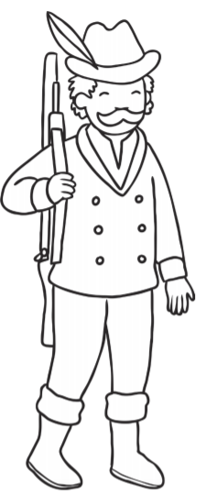

English
Twinkl Go → Pin No:JW4079

Slide 2

Learning Objective: To write a character description

Slide 3
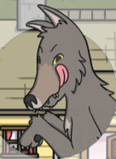


Describing a character…
Appearance
What does the character look like?
What is the character wearing?
Personality
How does the character act and speak?
How does the character think and feel?

Slide 4
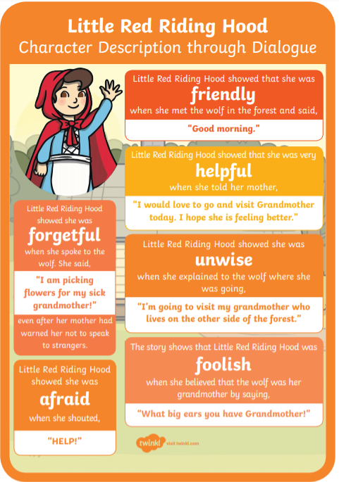
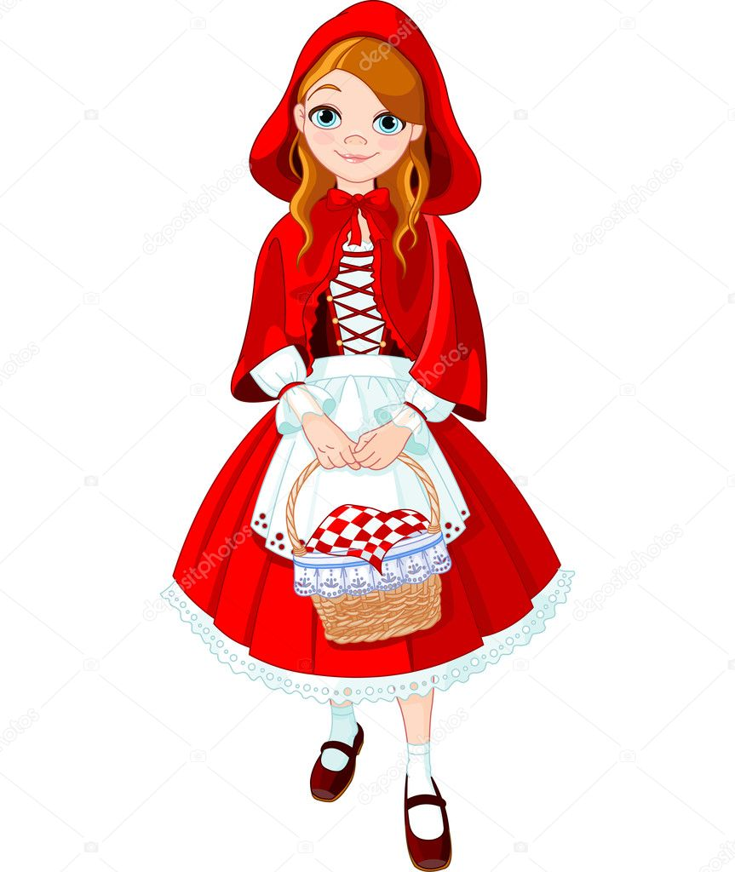

Slide 5
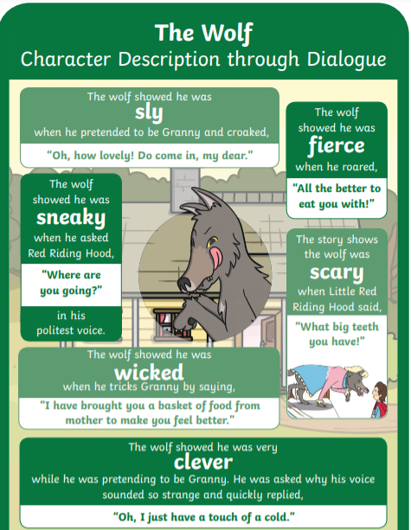
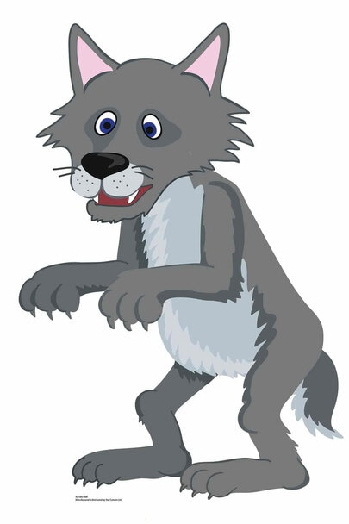

Slide 6
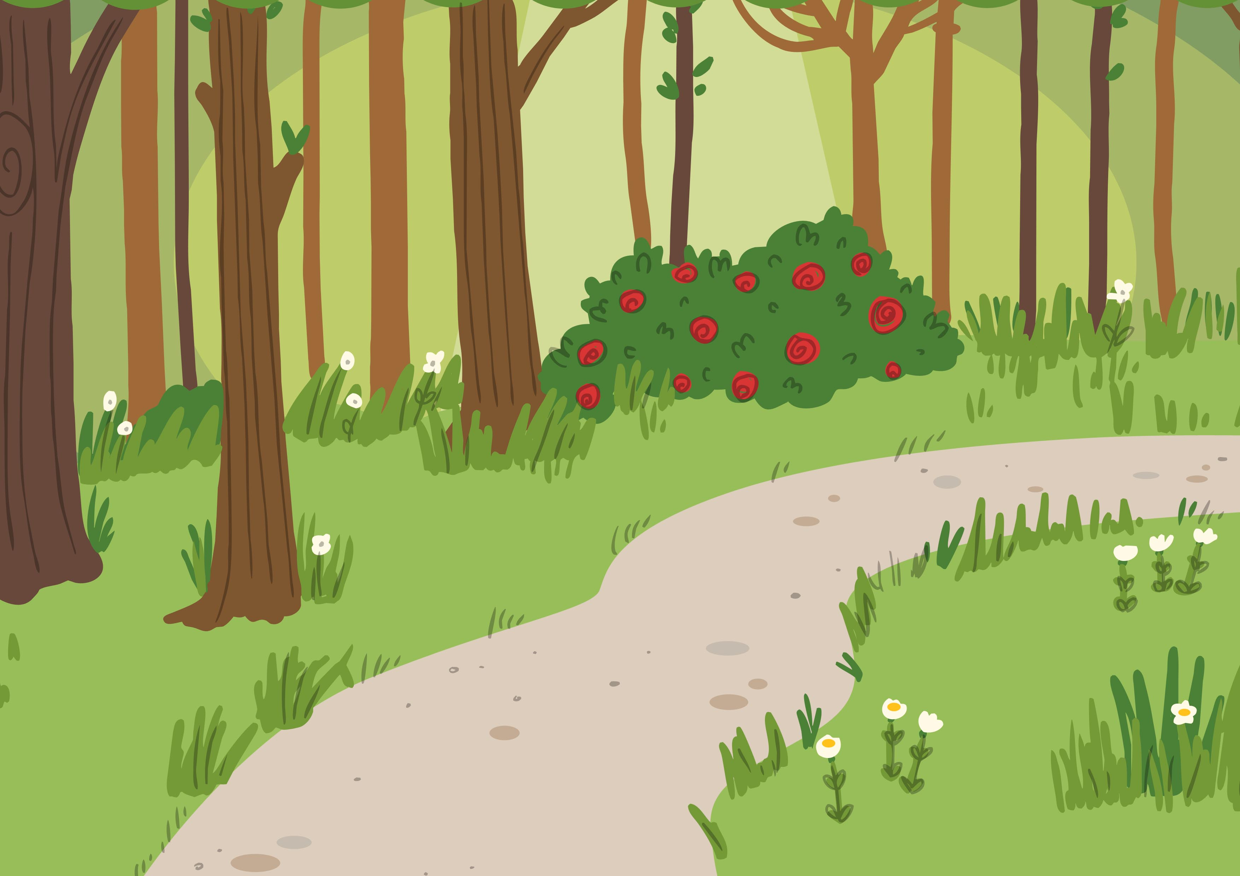

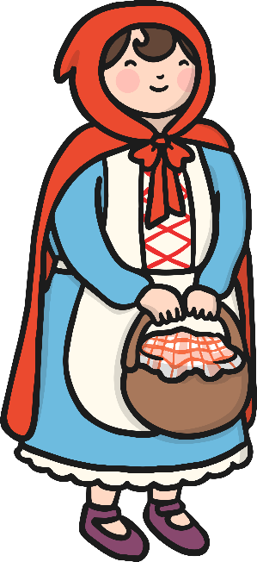

Little Red Riding Hood Character Description Sorting Activity
gentle
friendly
wicked
cunning
nice
caring
mean
cruel
kind
scared
evil
scary

Slide 7
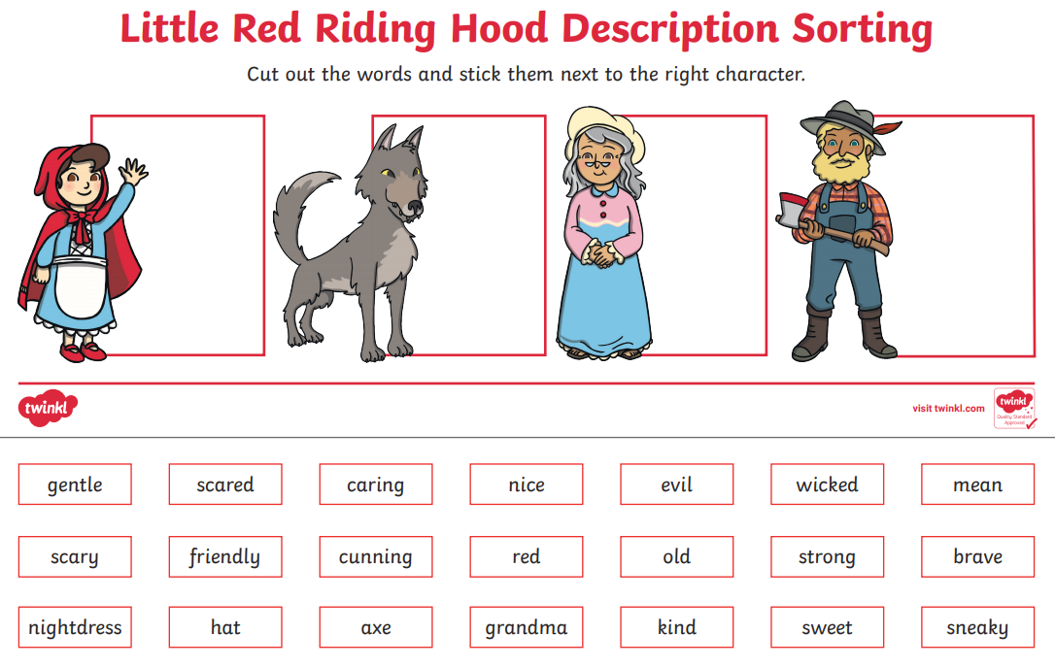

Slide 8
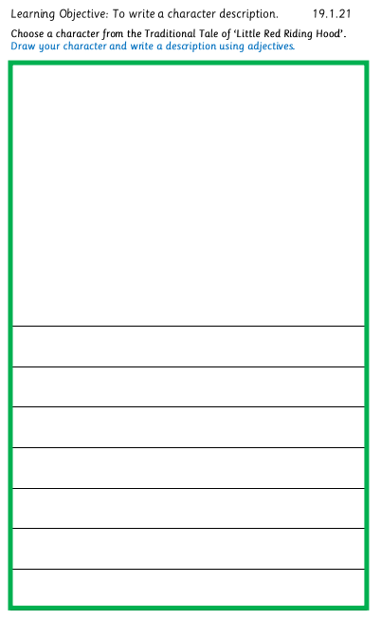
Let’s draw and write…
Choose
Draw
Describe

Slide 9
Writing sentences…
Please use capital letters at the start of your sentence.
Please use full stops at the end of your sentence.
Please use finger spaces.
Please use adjectives.
Please use conjunctions. (and, but, so, because)

