Slide 1
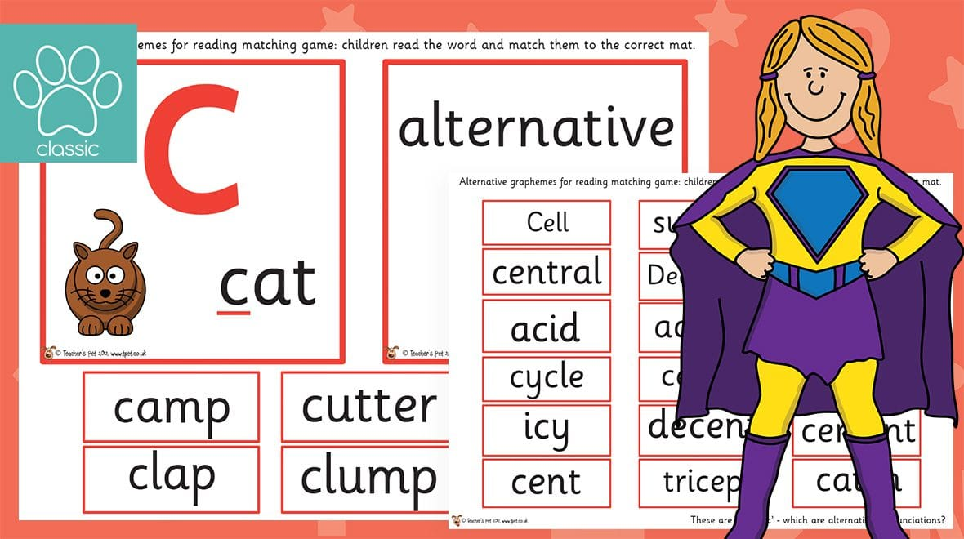

Year 1
Alternative sound for ‘c’
c

Slide 2
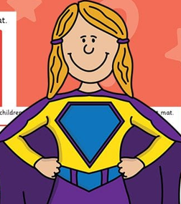
What sound does c make?
can
c
face

Slide 3
Let’s read!
cat
c

Slide 4
Let’s read!
city
c

Slide 5
Let’s read!
cot
c

Slide 6
Let’s read!
ice
c

Slide 7
Let’s read!
coat
c

Slide 8
Let’s read!
circle
c

Slide 9
Let’s read!
circus
c

Slide 10
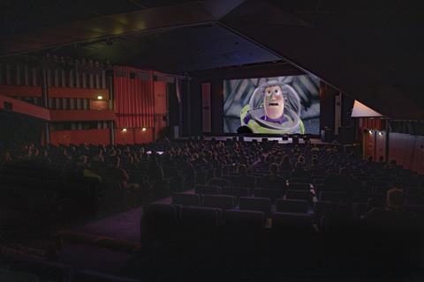
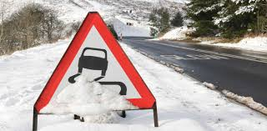
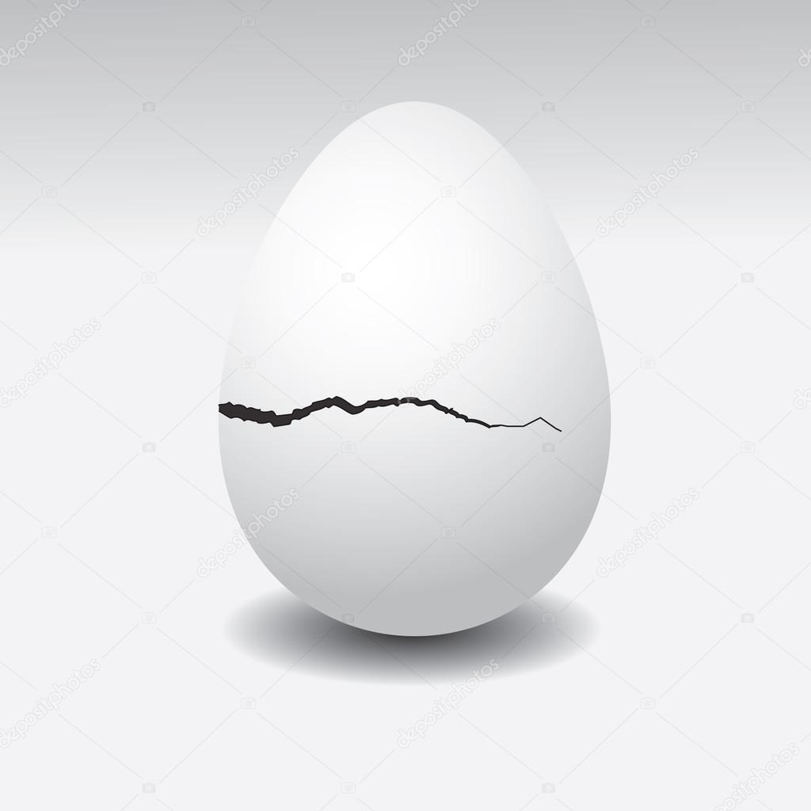

Read and Match
It is icy on the roads.
The egg has a crack.
I like to go to the cinema.

Slide 11
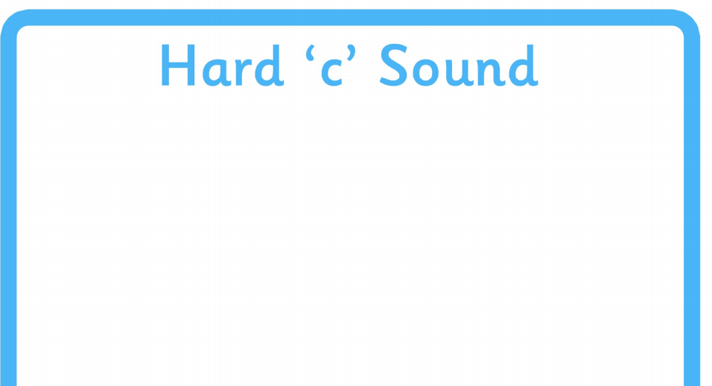
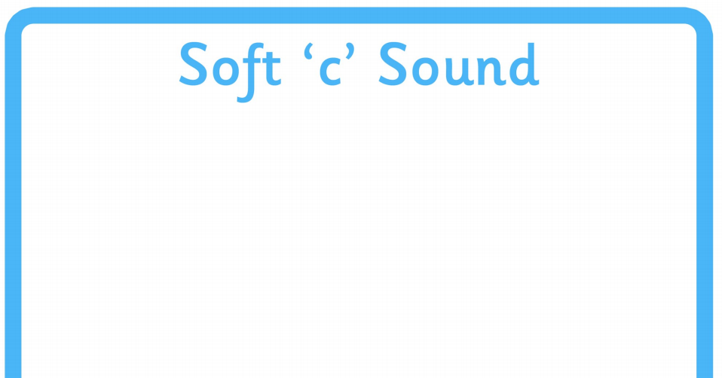

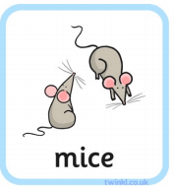

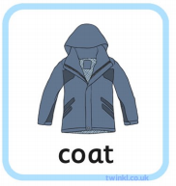

Look at the pictures and sort the words.

