Slide 1

Science
Monday 18th January
L.O. To know why plants are important to humans. To label the parts of a plant and a tree.

Slide 2
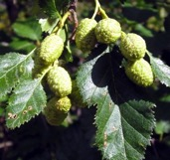
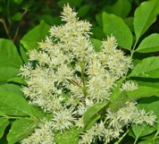
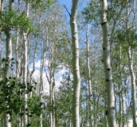
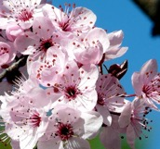
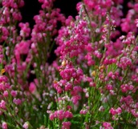
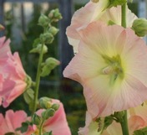
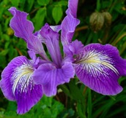

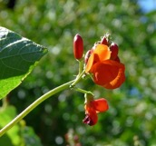
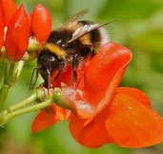
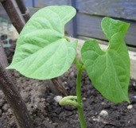
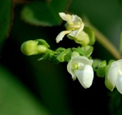
We will be learning about…
Plants.

Slide 3
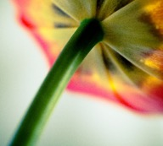
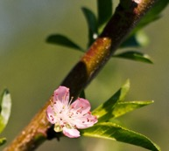
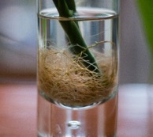
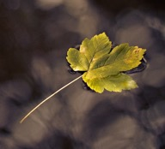
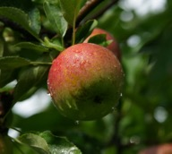
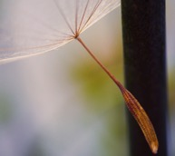
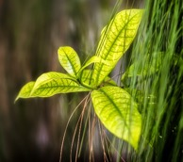
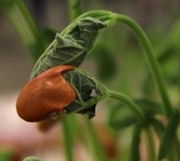
Plants
Today we are going to learn about different parts of plants.
Photos courtesy of Nomadic Lass, Christina Ann VanMeter, coofdy, Herr Olsen, Capt Kodak, fOtOmoth, Sunny_mjx, LadyDragonflyCC - >;< (@flickr.com) - granted under creative commons licence – attribution

Slide 4
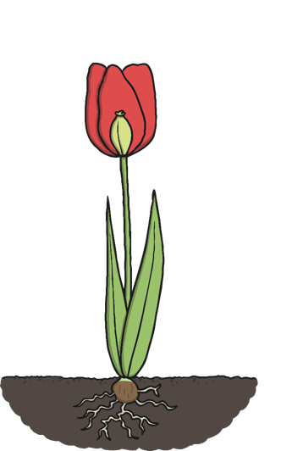
Parts of Plants
Look at this plant.
Do you know what any of the parts are called?

Slide 5
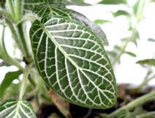
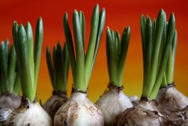
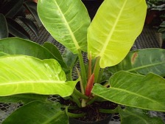
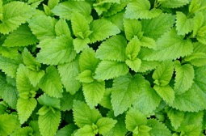
Leaves

Slide 6
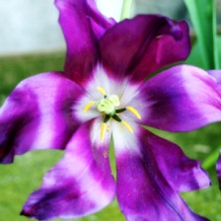
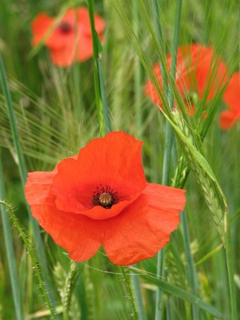

Flower

Slide 7
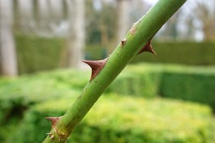
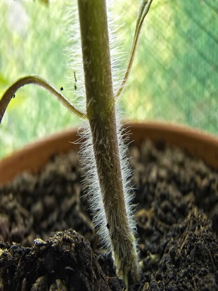
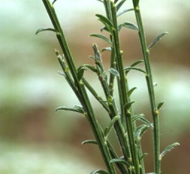

Stem

Slide 8
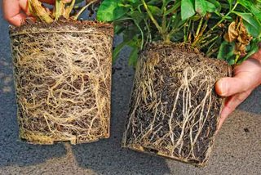
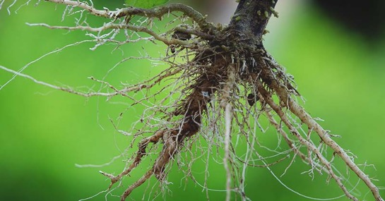
Roots

Slide 9
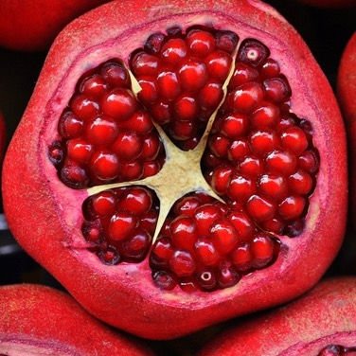
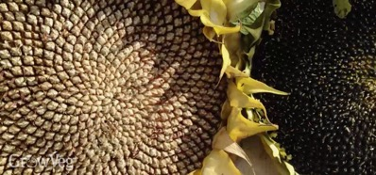
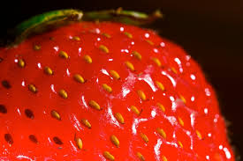
Seeds

Slide 10




Parts of Plants
Let’s see if we got them all right!
leaves
seed
stem
roots
flower

Slide 11



Parts of Plants
What are all the parts of a plant for?
leaves
seed
stem
roots
flower
Catches sunlight to make energy.
Grow into new plants when they fall into the soil.
Holds the plant up.
Takes in water and nutrients from the soil.
Attracts insects and birds.

Slide 12
Label a plant
Now we need to label the parts of the plant.
Where should these labels go?
seed
petal
leaf
stem
seed
leaf
stem
petal
roots
roots

Slide 13
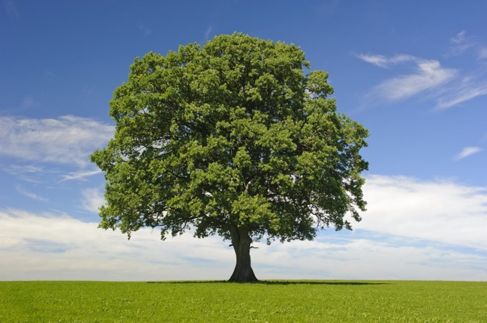
Trees

Slide 14
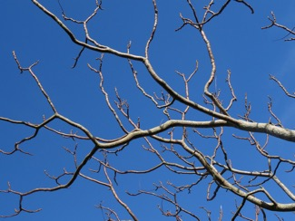
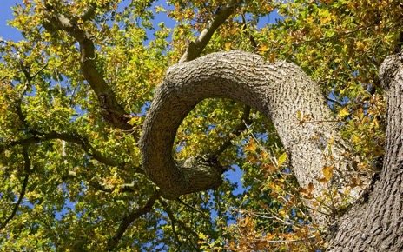
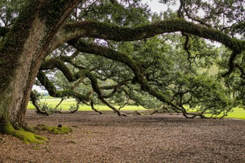
Branches

Slide 15
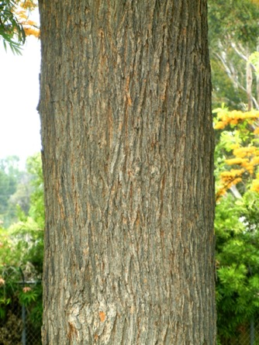
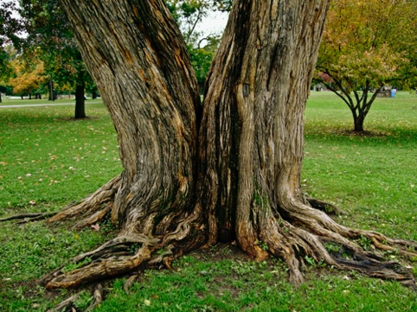
Trunk

Slide 16
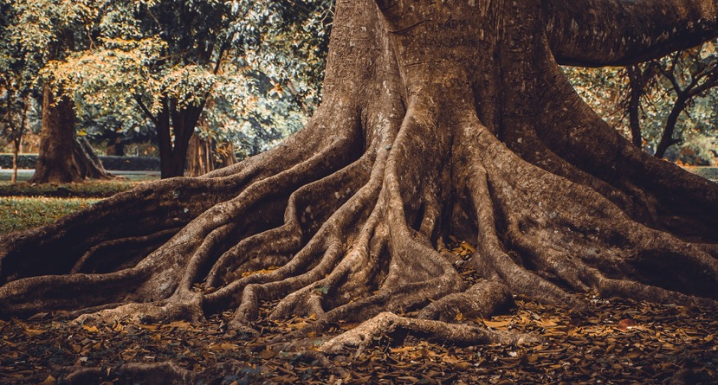
Roots

Slide 17
Label a tree
leaves
Now we need to label the parts of a tree.
Where should these labels go?
branches
trunk
leaves
Branches
trunk
roots
roots

Slide 18
Task

