Slide 1

Monday
18th January 2021

Slide 2
L.O: To name 2D shapes and know their properties.

Slide 3

Starter
https://www.bbc.co.uk/bitesize/topics/zjv39j6/articles/ztpwdmn

Slide 4
2D Shapes

Slide 5
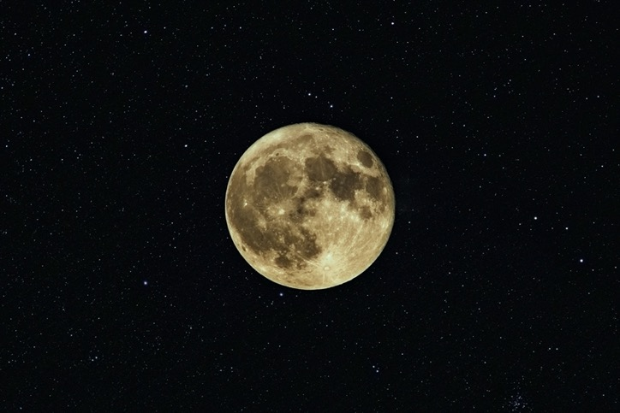
circle

Slide 6
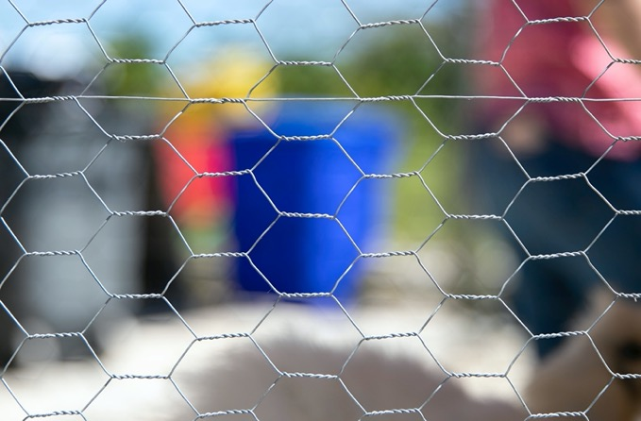
hexagon

Slide 7
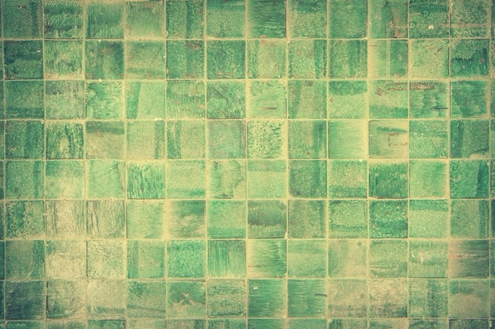
square

Slide 8
Guess the 2D shape

Slide 9
This shape has four straight sides and
four corners.
All the sides are the same length.

Slide 10
Square
1
4
1
4
2
3
3
2

Slide 11
This shape has three straight sides and
three corners.

Slide 12
Triangle
1
1
2
3
3
2

Slide 13
This shape has one curved side.
It has no corners.

Slide 14
Circle
1

Slide 15
This shape has four straight sides and four corners.
Two sides are long and two sides are short.

Slide 16
Rectangle
1
1
2
4
2
4
3
3

Slide 17
This shape has five straight sides and five corners.

Slide 18

Pentagon
1
1
2
5
2
5
3
4
4
3

Slide 19
This shape has six straight sides and six corners.

Slide 20

Hexagon
1
1
2
6
2
6
3
5
3
5
4
4

Slide 21
This shape has eight straight sides and eight corners.

Slide 22
Octagon
1
1
2
8
2
8
3
7
3
4
7
6
4
6
5
5

Slide 23

Task

Slide 24
Task

Slide 25
Task

Slide 26
Lines of symmetry
The line is called a line of symmetry. This is sometimes called a 'mirror line' or 'mirror symmetry', because if you put a mirror on the line, the reflection would show the whole shape

Slide 27
.
Extension Task

