Slide 1
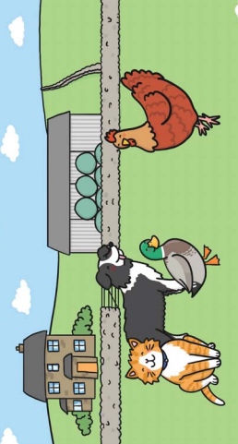

RE

Slide 2

Learning Objective: To understand the importance of being helpful.

Slide 3

How can you help others?

Slide 4

How can you help others?

Slide 5
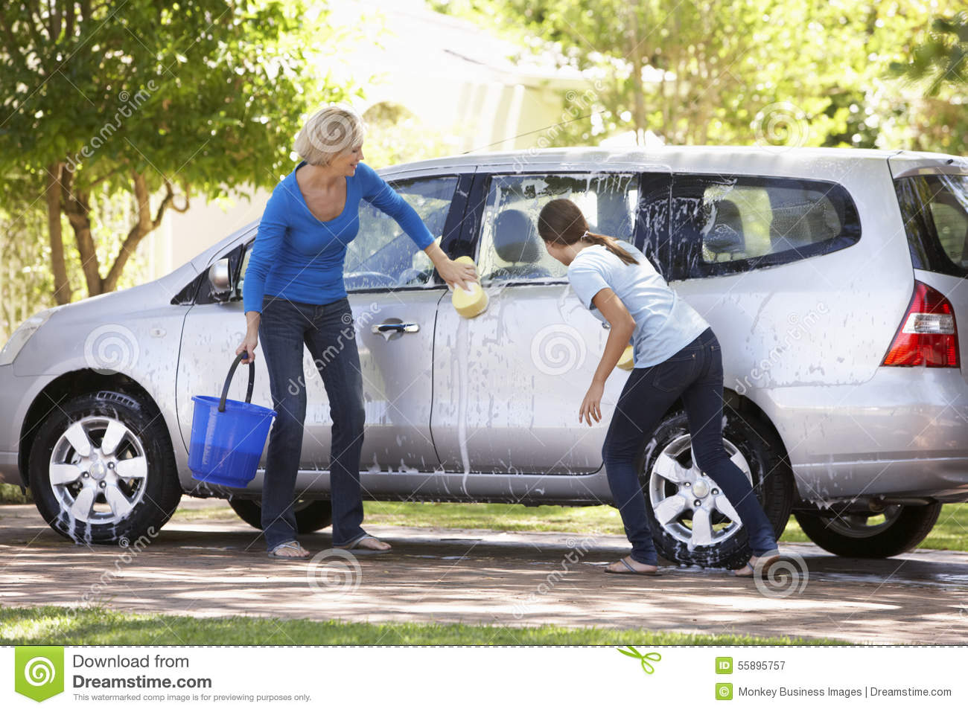
How can you help others?

Slide 6
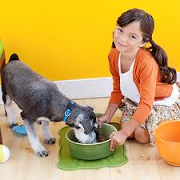
How can you help others?

Slide 7

How can you help others?

Slide 8

Are you helpful?

