Slide 1
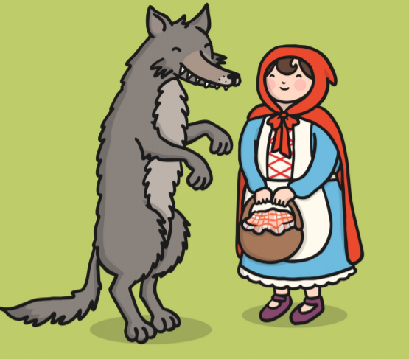

English

Slide 2

Learning Objective: To read and answer questions.

Slide 3
What is Reading Comprehension?
When you read words in a book it helps you to understand the story or facts within the pages.
Reading Comprehension is where you answer questions about the story .

Slide 4

Answering questions…
Read the text.
Read the questions.
If you can’t remember the answer, then read the text again.

Slide 5
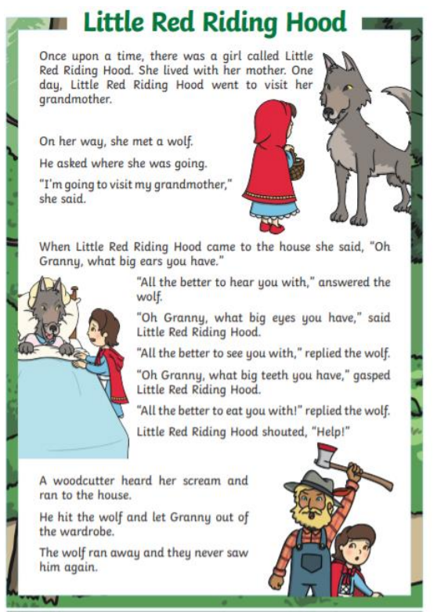
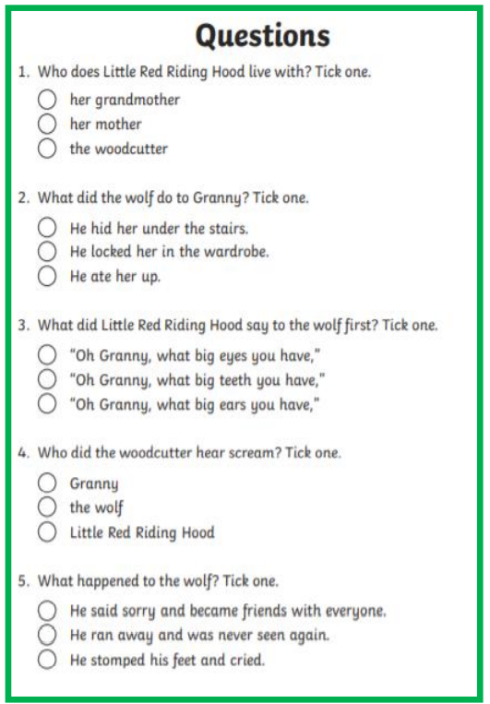
Read the story and the questions out loud.

