Slide 1
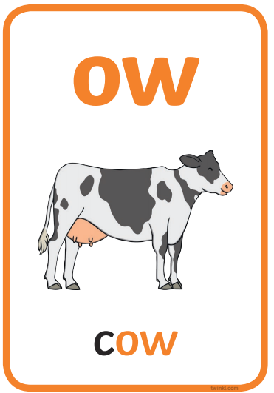


Let’s recap ‘ow’ and ‘ou’

Slide 2
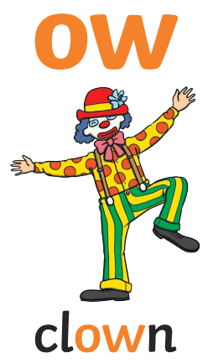

clown

Slide 3
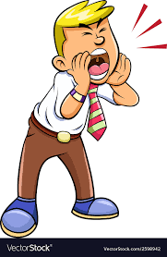

shout

Slide 4


flower

Slide 5


crowd

Slide 6
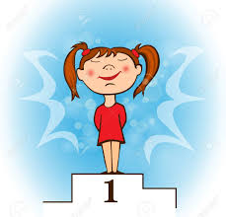

proud

Slide 7
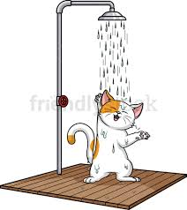
shower

Slide 8
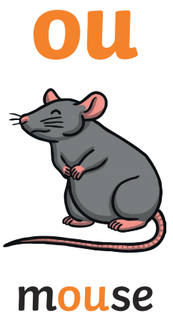
mouse

Slide 9


loud

Slide 10


growl

Slide 11


house

Slide 12


cloudy

Slide 13
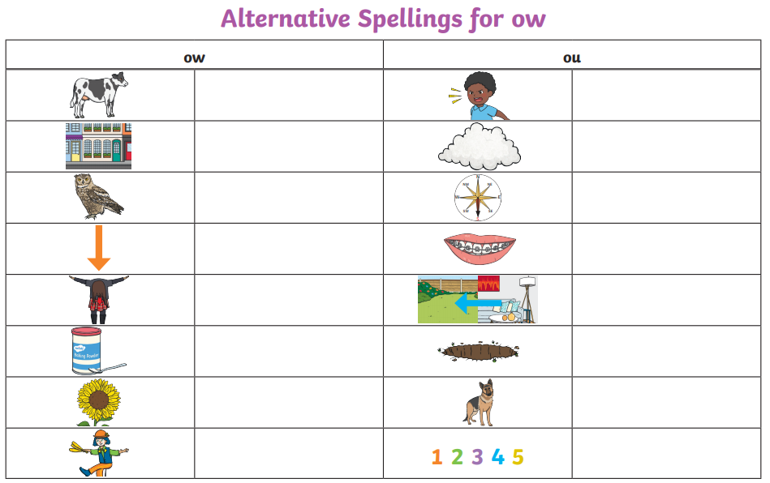
Let’s write ‘ow’ and ‘ou’ words…

