Slide 1

Science
Wednesday 20th January
L.O. To know the importance of bees.

Slide 2
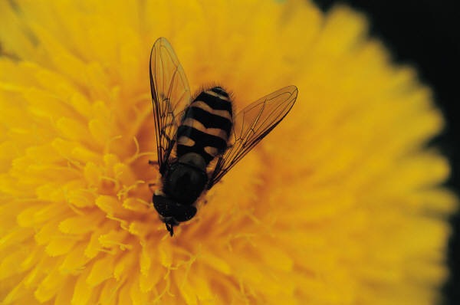
Bees
… and why we need to
care about them!

Slide 3
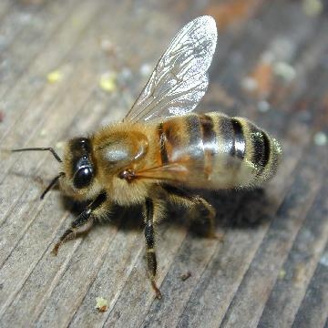
Bees are insects.
They have a three part body and six legs. They also have 2 pairs of wings.
A honey bee

Slide 4
How many different bees are there?
There are about 260 species of bee in the United Kingdom.
Only one is a honey bee.
There are about 17 Bumble Bee species. Honey bees and bumble bees are social bees and live as colonies.
The other 230 types of bees are solitary, which means they live on their own.

Slide 5
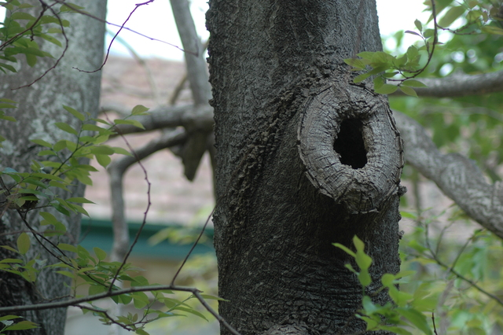
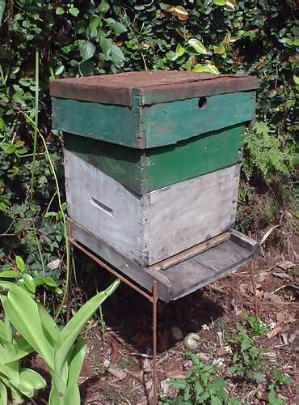
Where do bees live?
Honey bees in the wild
make their nests in
trees, sometimes using
holes in trunks or branches
People keep honey bees
in bee hives which are
usually made from wood.

Slide 6
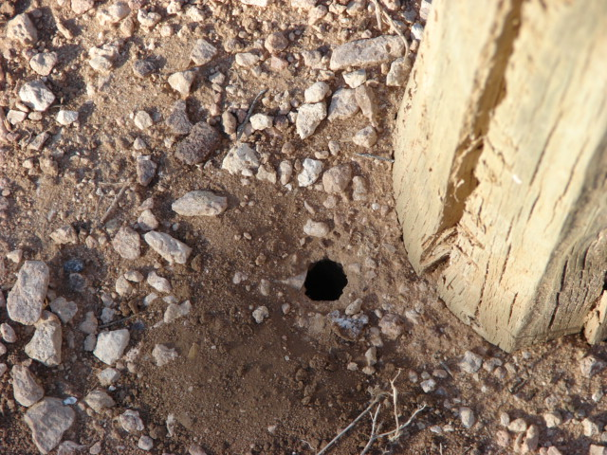
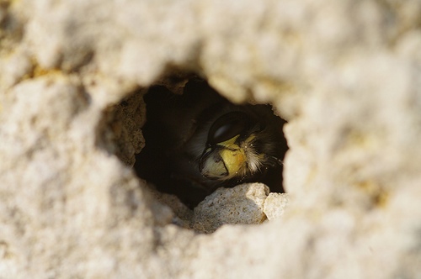
Where do bees live?
Bumble bees make small
nests, often in the ground.
Solitary bees live in
lots of places, including
in a hole in a wall or in
the lawn.

Slide 7
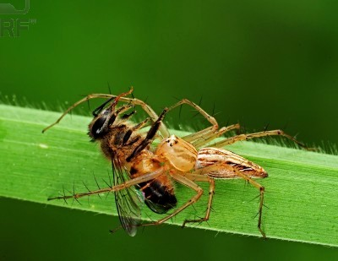
What eats bees?
Lots of animals, large or small, eat bees:
Birds
Spiders
Wasps or ants
Grasshoppers and crickets
Bigger animals like bears
Humans kill bees, sometimes deliberately and sometimes by accident when using sprays in the garden.

Slide 8
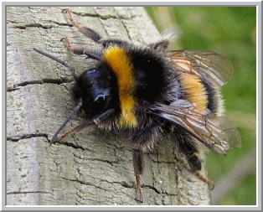
Bumble Bees
They are round and furry
and fly a lot more slowly
than honey bees.
They rarely use their
sting, and do not die
when they do use it.

Slide 9
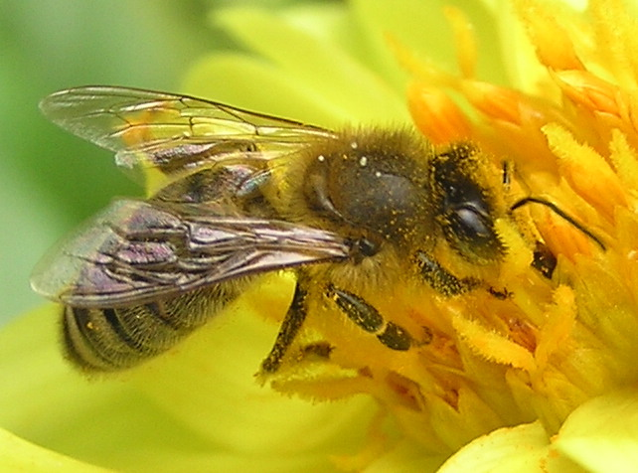
Honey Bees
How many types of honey bee are there?
Honey bees are
very busy bees.
They live in colonies
with lots of other honey
bees – many thousands.
Bees make and store honey to
eat in autumn and winter.
They make so much honey that people can take
some without harming the bee colony.

Slide 10
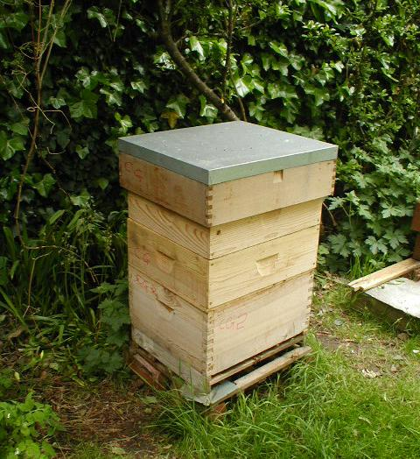
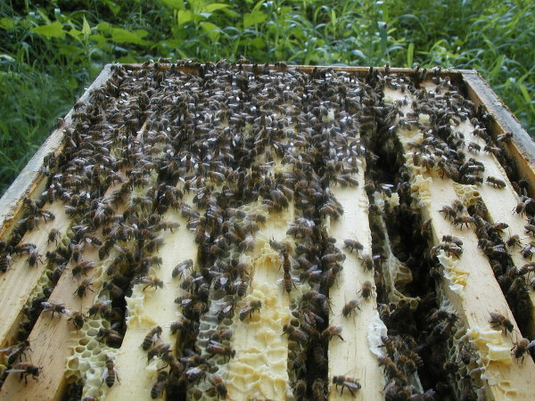
A honey bee hive
The hive Inside the hive

Slide 11
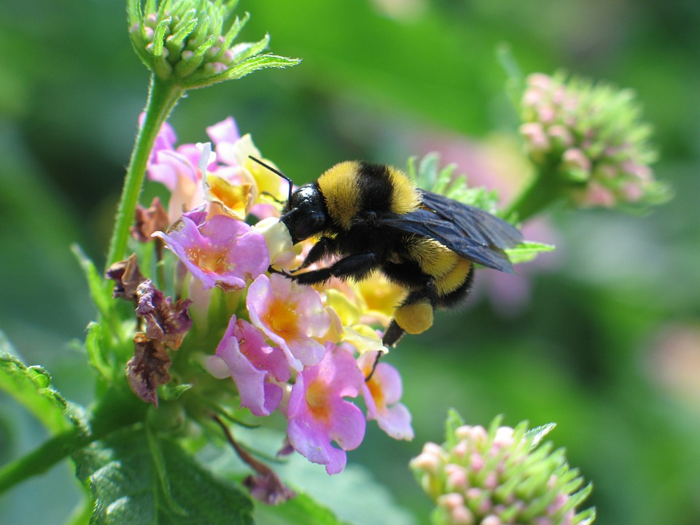
How do bees help plants?
Bees fly around and land on a flowers.
As the bee touches the flower it picks up the pollen.

Slide 12
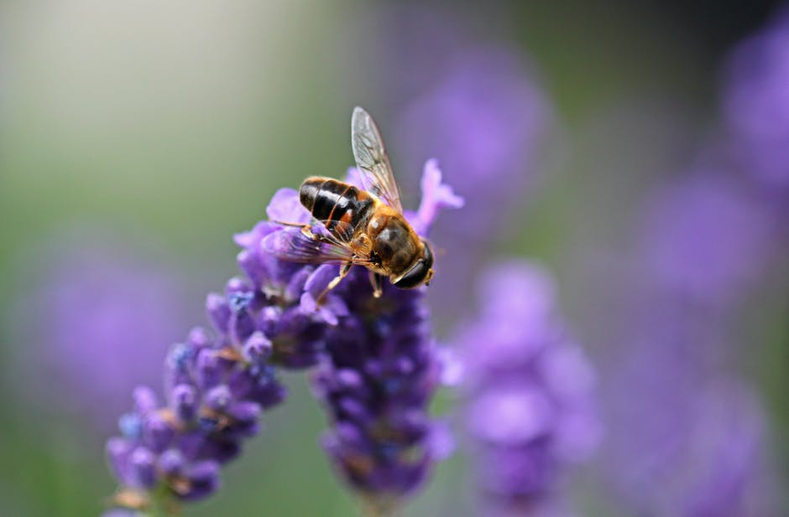
How do bees help plants?
The bee then flies to another flower. As the bee moves around the pollen rubs off to help pollinate the flower..

Slide 13
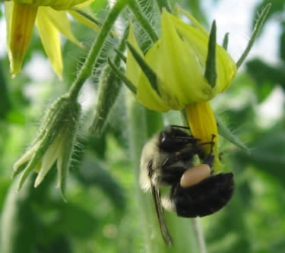
Here is the really important bit!
Why are we worried about bees?
Bees are dying out. This is a problem for us.
Besides feeding themselves when they collect pollen, bees do a very important job
They pollinate many, many
of the plants we eat.

Slide 14
How does that affect us?
Bees of all types pollinate more than half of the plants that grow food for us.
If bees did not pollinate these plants, no fruits or seeds would develop.
That means no apples, no pears, no tomatoes, no cherries, no strawberries, no cucumbers, no nuts, no beans, no……….

Slide 15
Task
Bees are important because

