Slide 1



Year 1
Alternative Sounds for ‘c’ and ‘g’
Picture Quiz!
c

Slide 2

Look at the pictures…
Say the word out loud and try to hear the correct sound for ‘c’ or ‘g’?
Write the words.

Slide 3
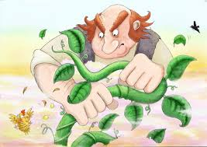
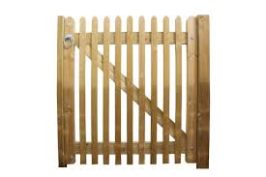


Write the words…

Slide 4



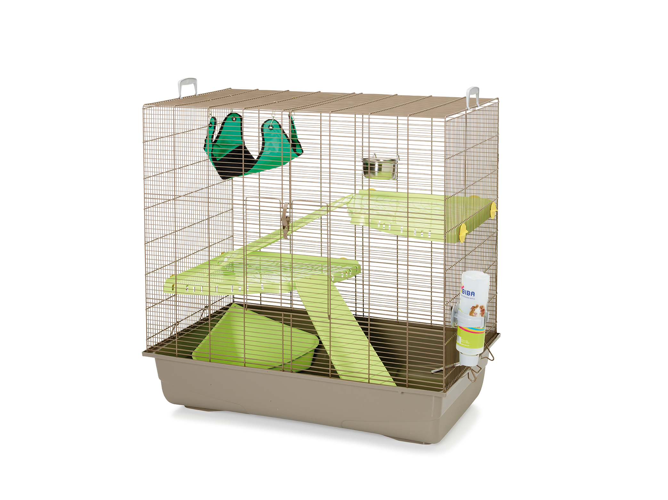
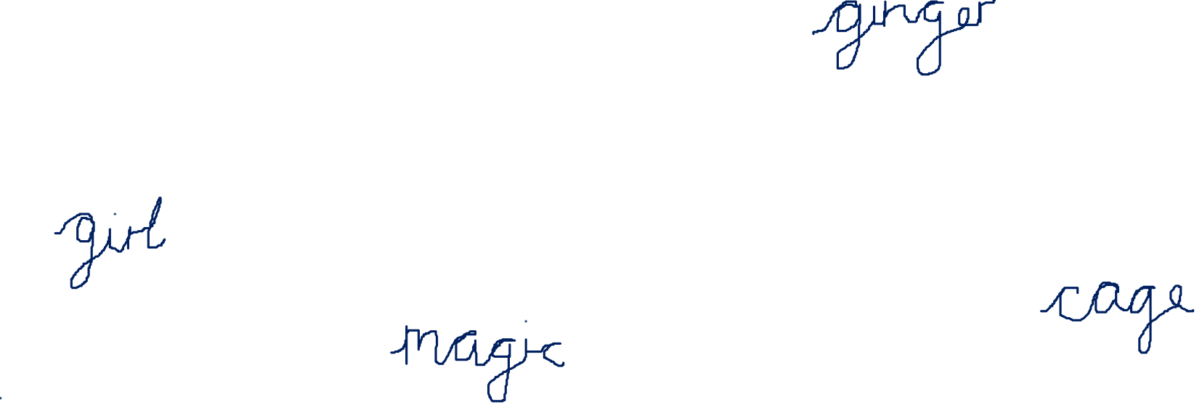
Write the words…

Slide 5
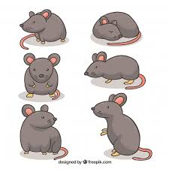
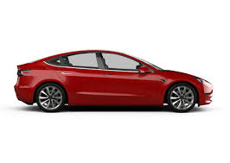
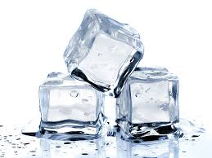
Write the words…

Slide 6
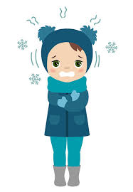

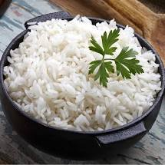
Write the words…

Slide 7
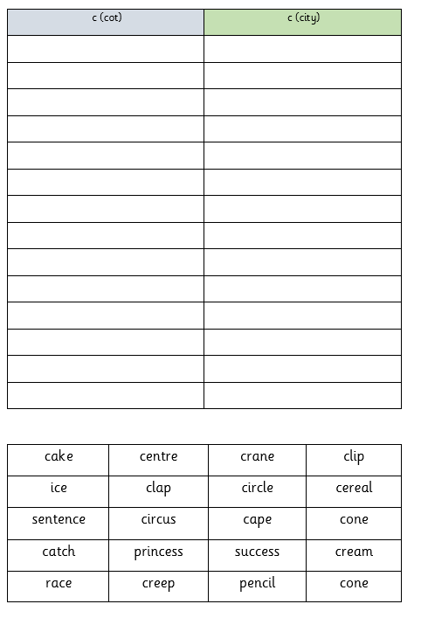
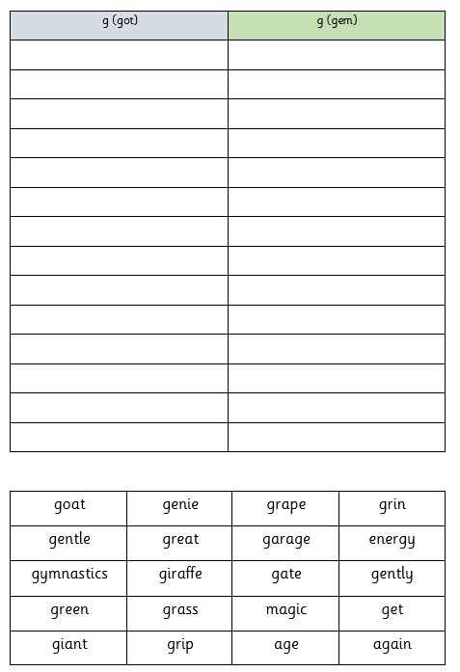

Slide 8

Fantastic effort!

