Slide 1
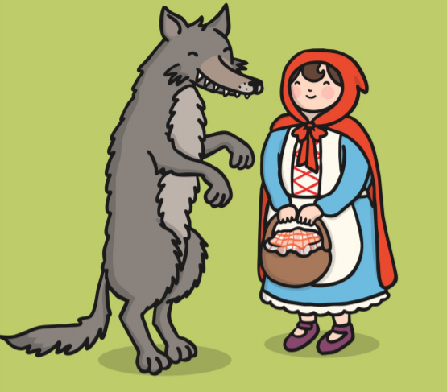

English

Slide 2

Learning Objective: To write a speech bubble.

Slide 3
What is a speech bubble?
A speech bubble is used to show that a character is talking.
Only the actual words that are spoken can go in the bubble.

Slide 4
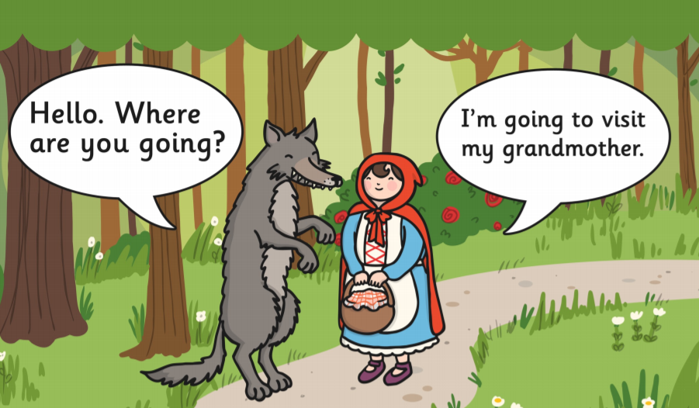

Slide 5
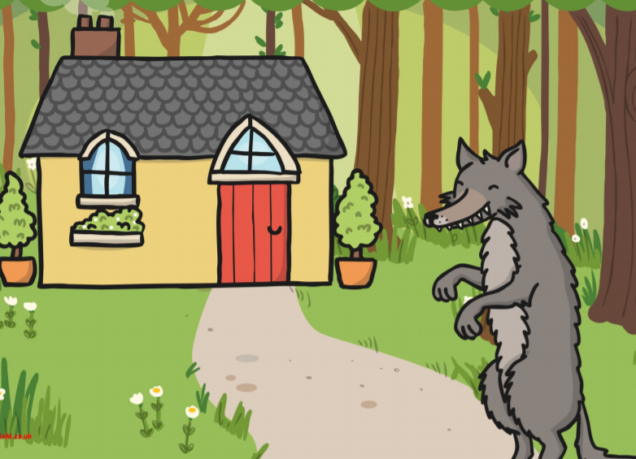
I’m coming Grandmother!

Slide 6
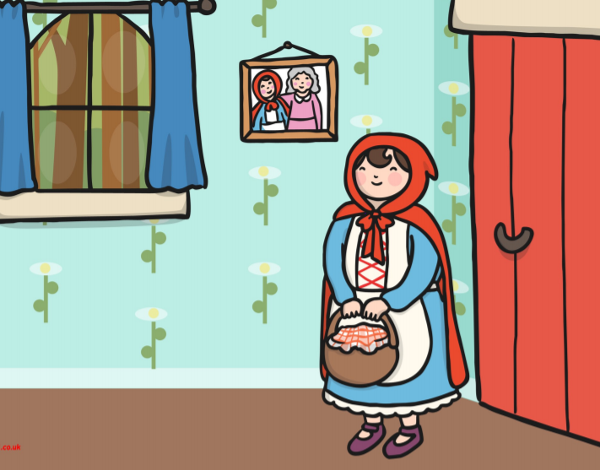
I’ve made you some cakes!

Slide 7
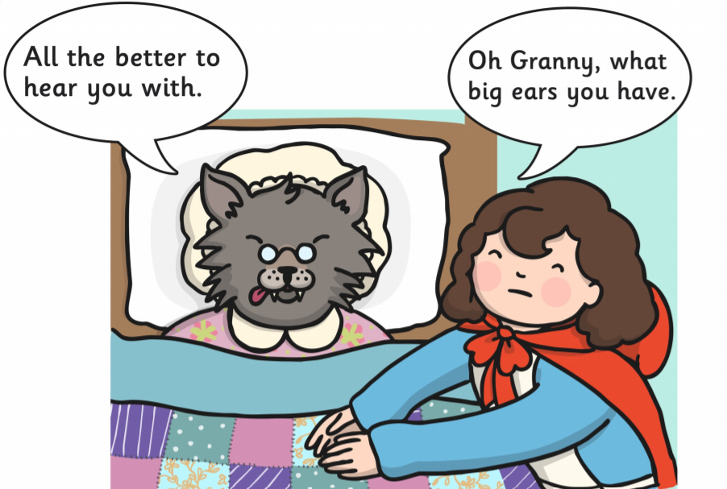
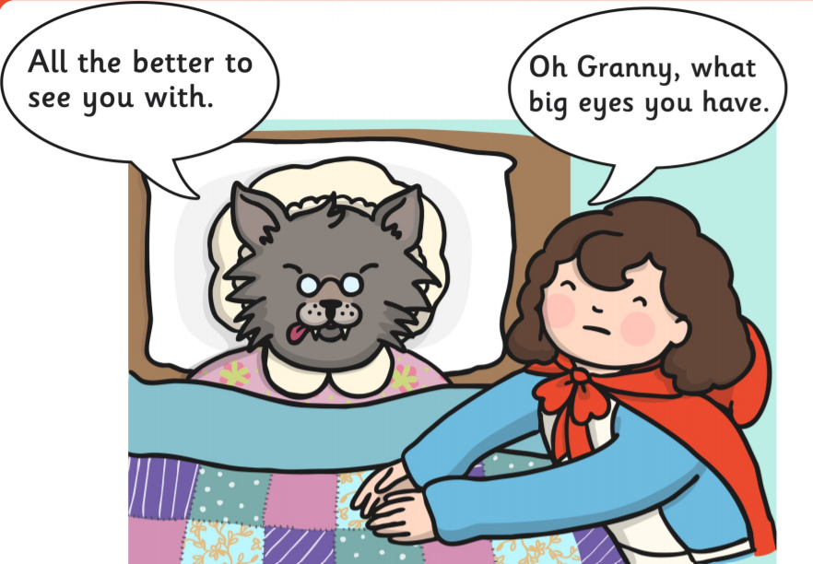
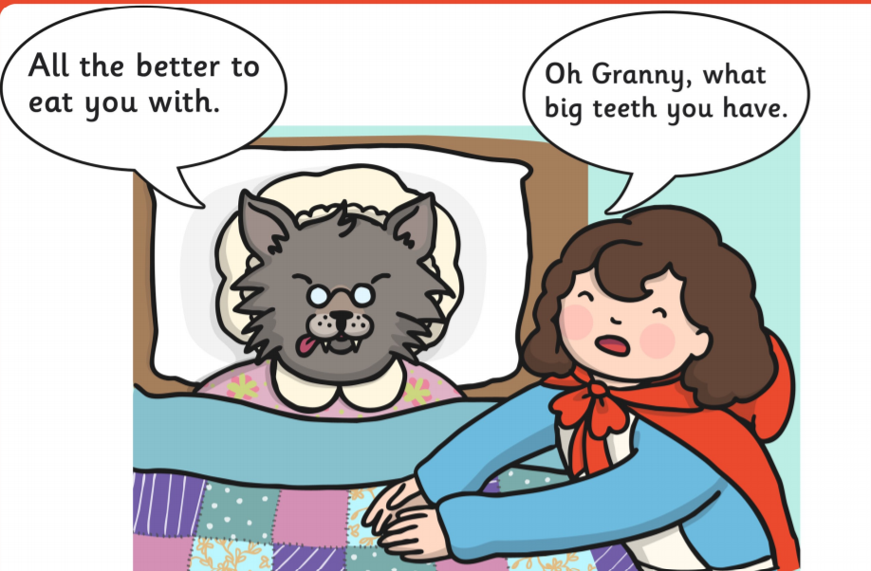

Slide 8
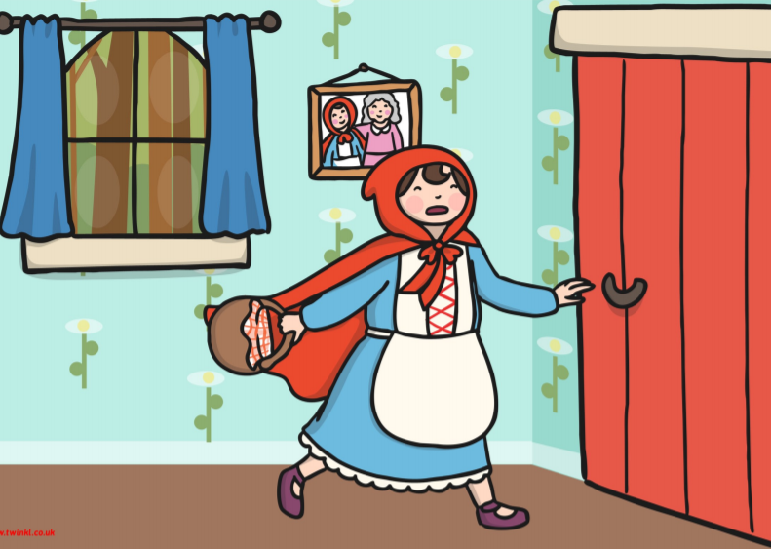
HELP!

Slide 9
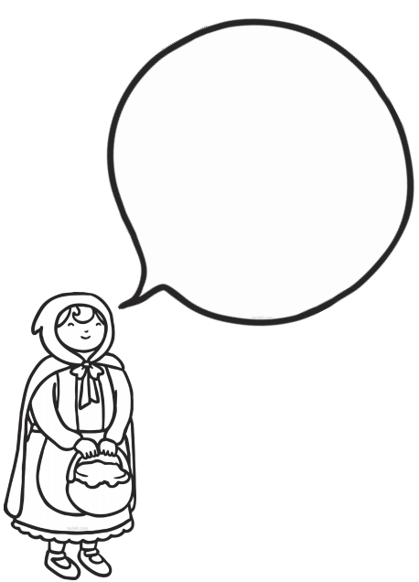
Remember, you only need to write exactly what Little Red Riding Hood is saying.
You don’t need to write ‘said Little Red Riding Hood’.
Remember to use the sentence rules!

