Slide 1


Slide 2
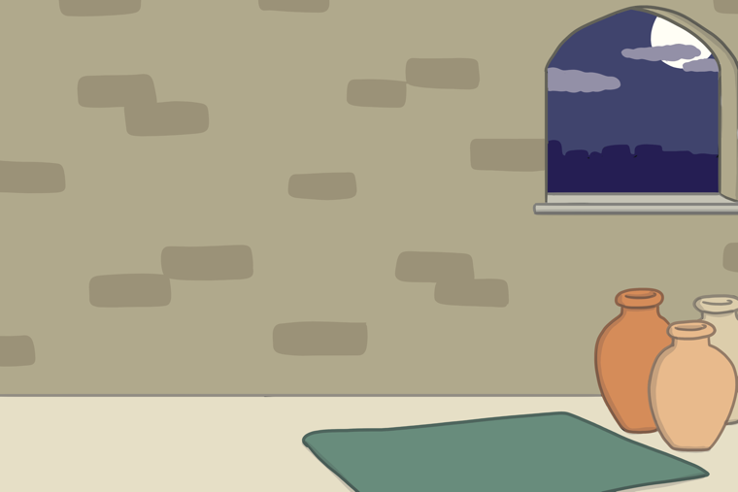
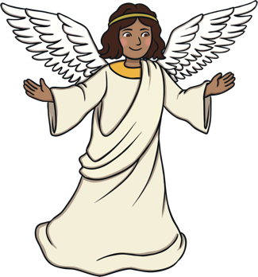
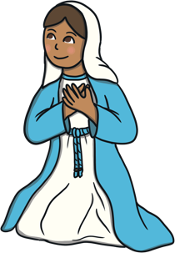
The Angel Gabriel visited Mary and told her she was going to have a baby called Jesus. The baby would be God’s son.

Slide 3
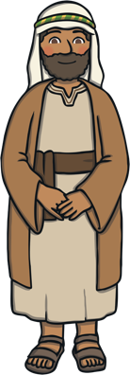
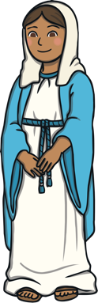
Mary told Joseph what Gabriel had told her; they prepared for the arrival of the special baby.

Slide 4
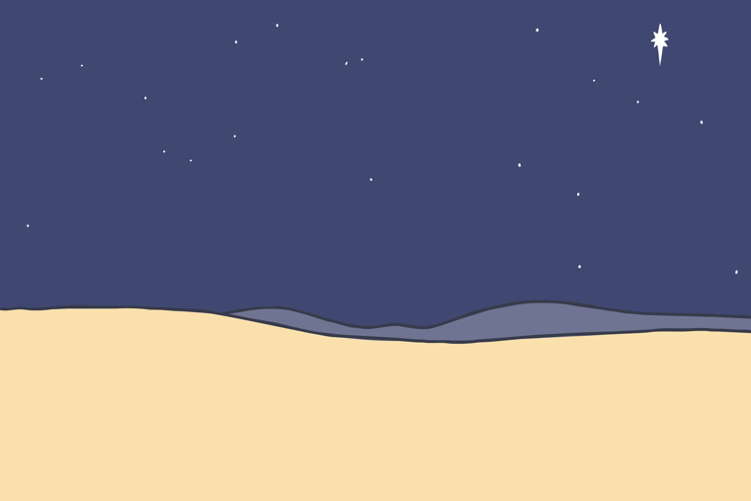
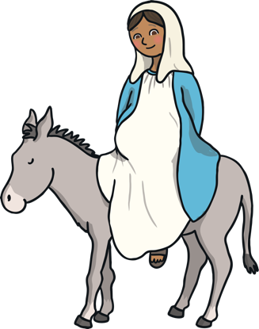

Mary and Joseph had to travel to Bethlehem to register in a census.

Slide 5
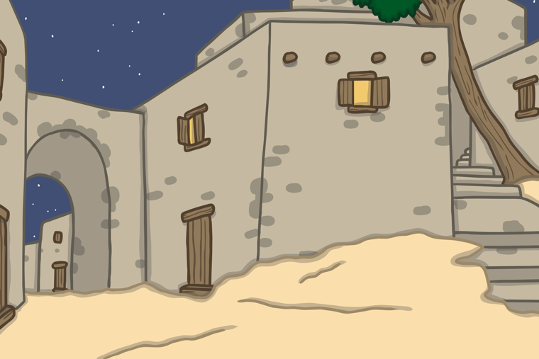
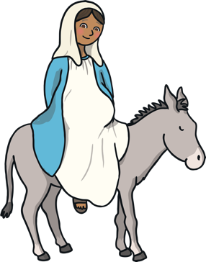
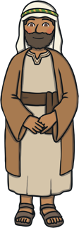
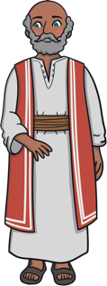
A kind innkeeper in Bethlehem let Mary and Joseph
stay in his stable for the night.

Slide 6
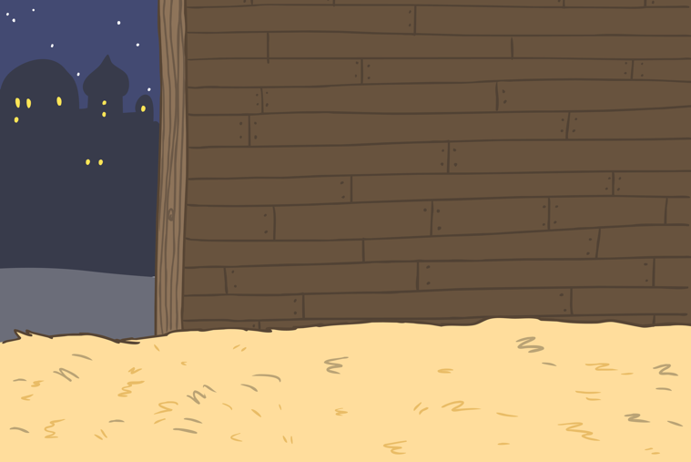


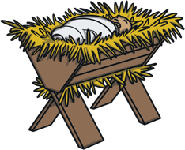
Baby Jesus was born in the stable.

Slide 7
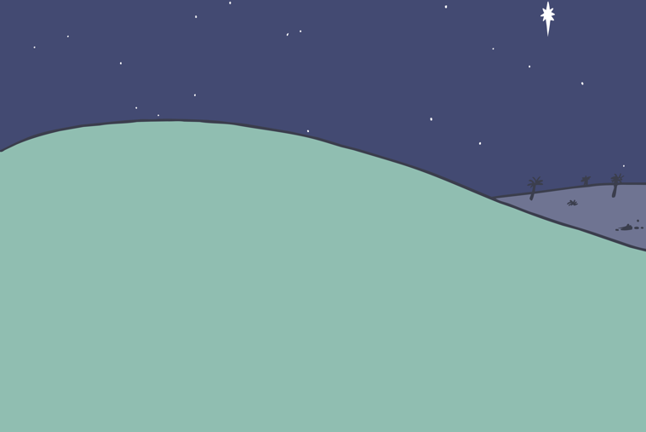
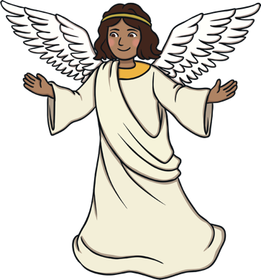
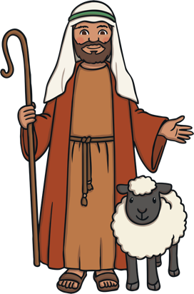
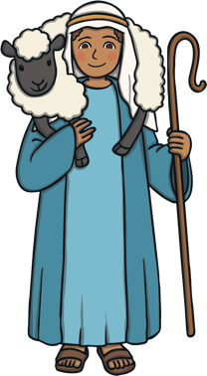
At the same time, an angel appeared to some shepherds. The angel told them that the son of God had been born in Bethlehem.

Slide 8

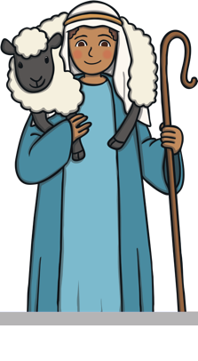
The shepherds walked to Bethlehem to visit the baby Jesus.

Slide 9
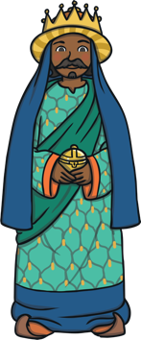
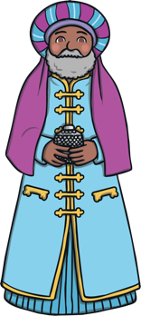
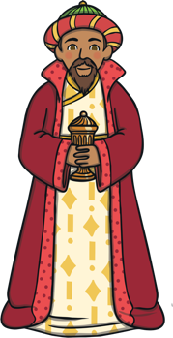
Far away in the East, wise men saw a bright star in the sky. They knew it meant that a new king had been born and followed the star.

Slide 10
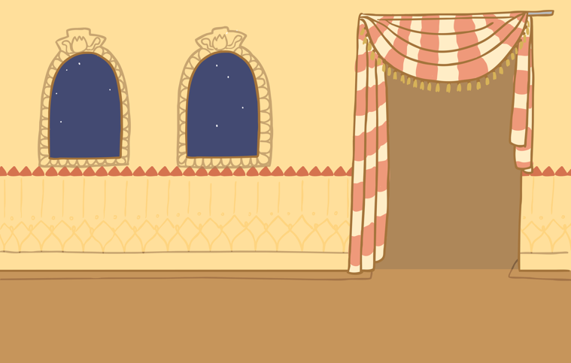
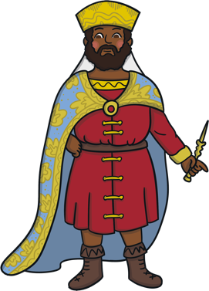

On the way they came to King Herod’s palace.
Herod was curious about the new king; he asked the wise men to tell him where the baby was.

Slide 11

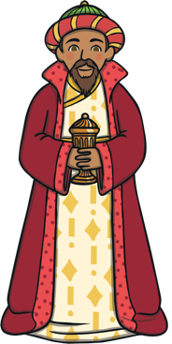
The wise men reached Bethlehem. They gave Jesus gifts of gold, frankincense and myrrh.

Slide 12
That night, the wise men had a dream warning them not to tell King Herod where Jesus was. They did not return to King Herod’s palace.

Slide 13
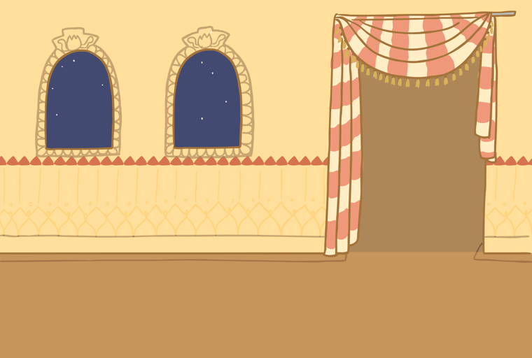

Herod began to search for baby Jesus. He ordered that all baby boys in Bethlehem be killed.

Slide 14


Joseph had a dream where an angel told him to take Mary and Jesus to Egypt.

Slide 15

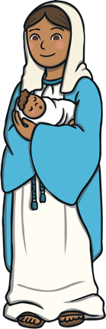
Mary and Joseph travelled to Egypt with baby Jesus and he was safe.

