Slide 1

Elm Class
English lesson
Wednesday 16th December

Slide 2
L.O: To write a list

Slide 3

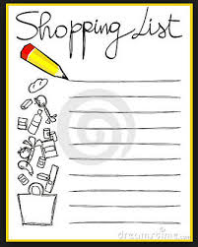

What do we use list for?
We use lists for lots of different things such as; instructions , putting things in order, things we want to do or even items to buy for shopping.
You don’t always need to write a list down but it does help you to remember.

Slide 4
A list of my top 5 favourite colours in order.
Blue
Turquoise
Red
Lilac
Yellow

Slide 5

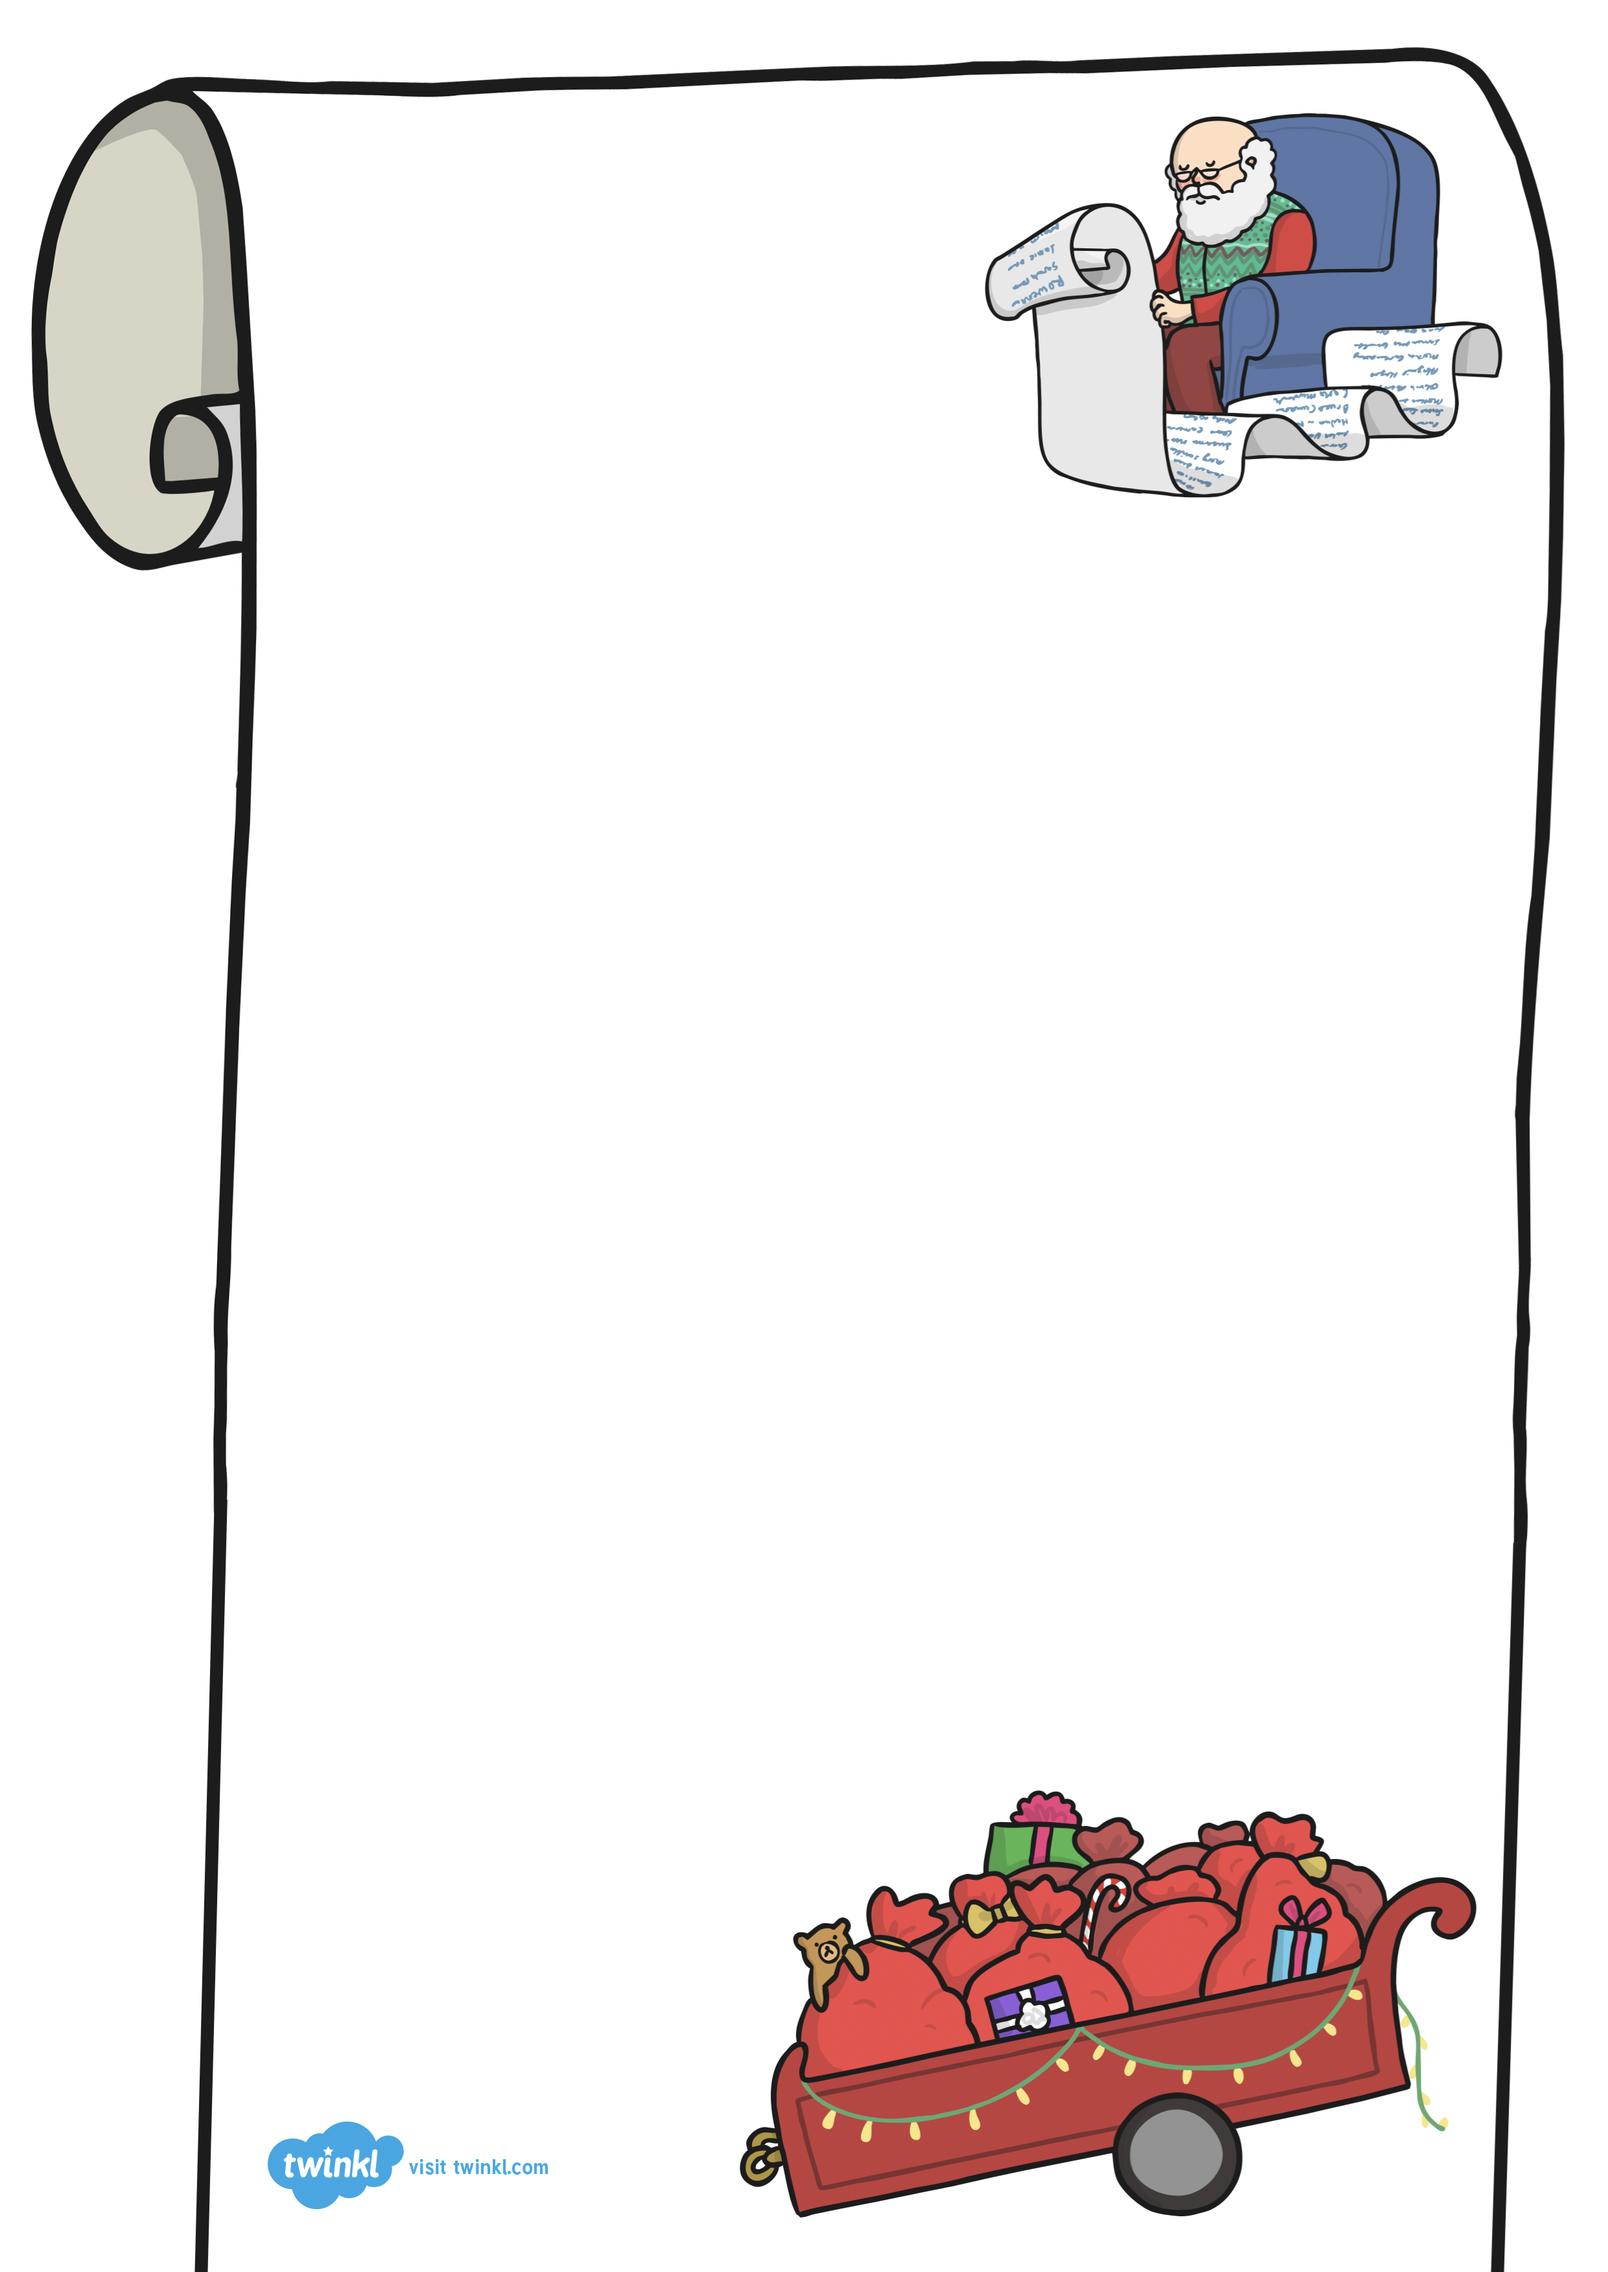

A hug from my Mummy
2. Garden chair
3. Bicycle
Your task today is to write your own list of things you would like Santa to bring.

