Slide 1
Year 1’s
Christmas Math’s Quiz

Slide 2

How to Play
Click on a present to reveal a question. Think carefully about the question before sharing your answer. Once you have solved the problem, click on the 'Show Answer' box once to check that you are correct, then click on the 'Choose another Question' box to reveal a part of the picture.

Slide 3
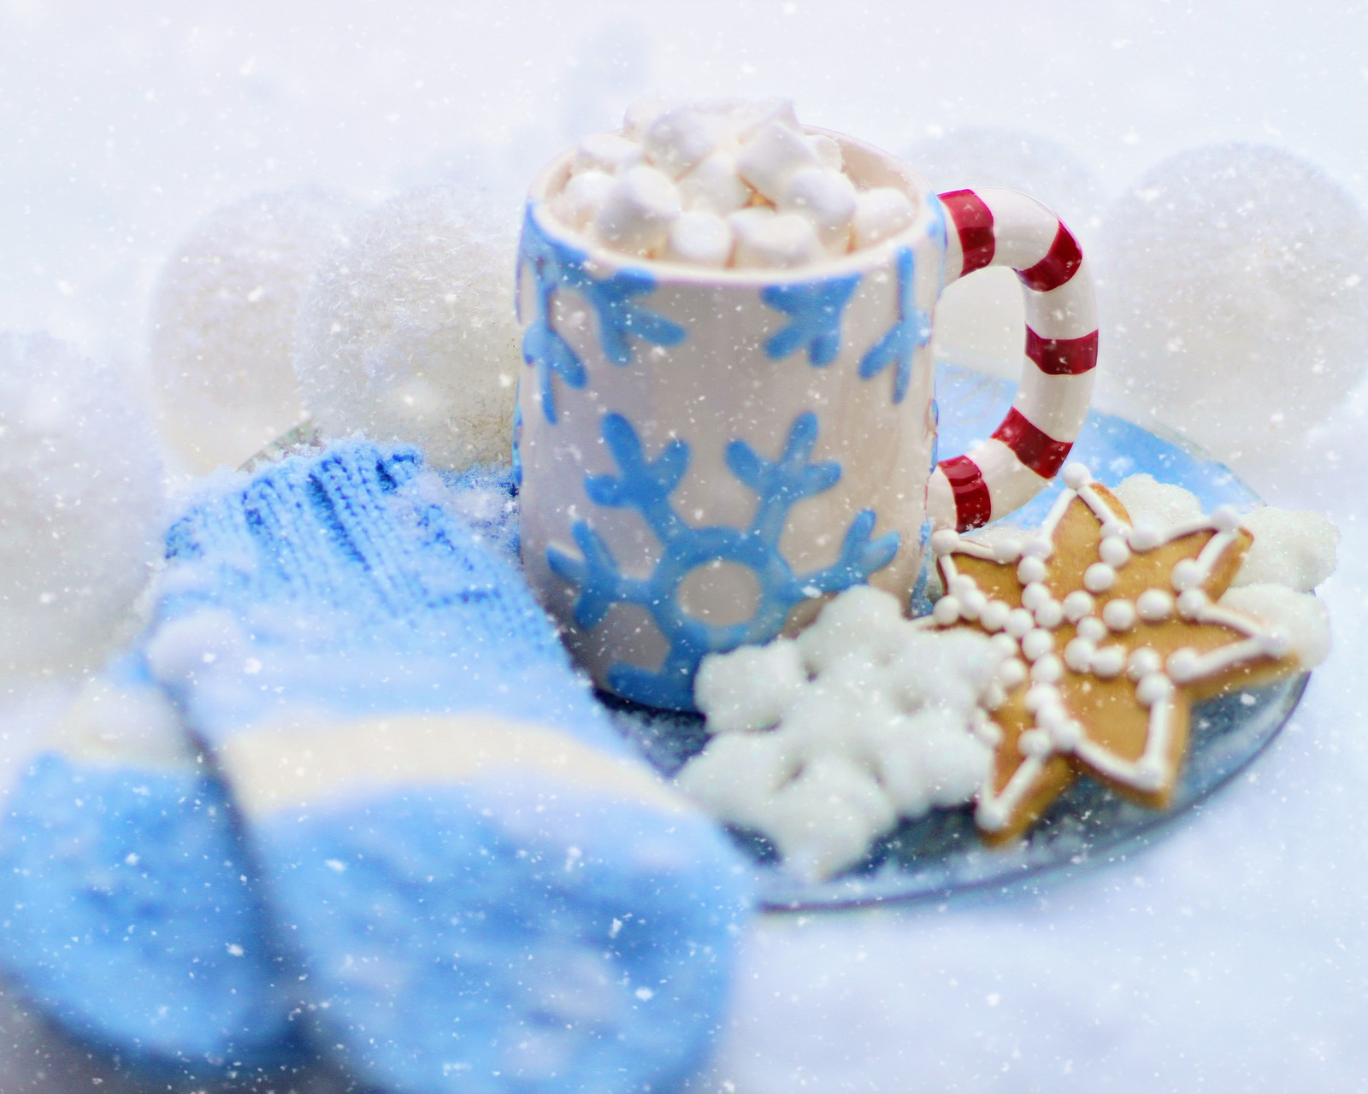

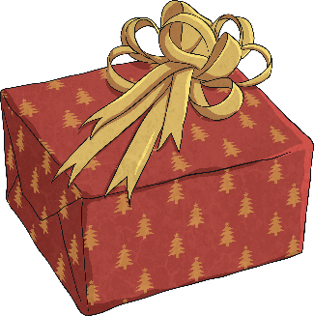



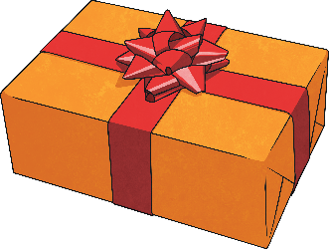
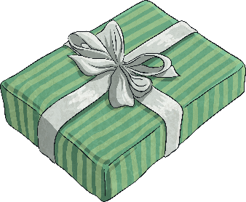
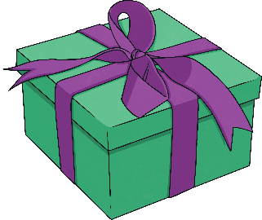


Photo courtesy of (@pixabay.com) - granted under creative commons licence – attribution

Slide 4
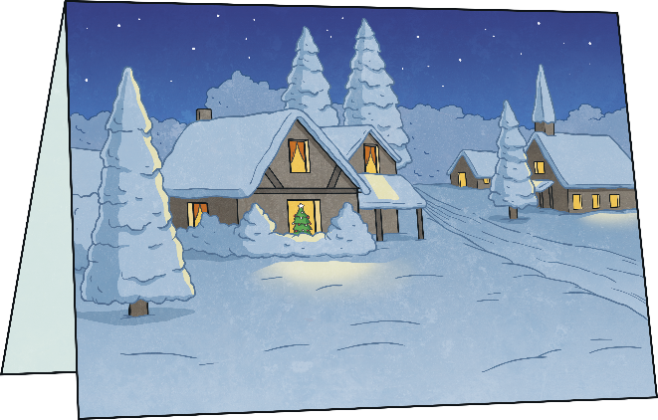
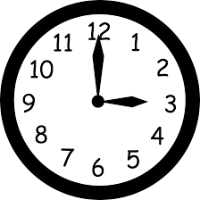
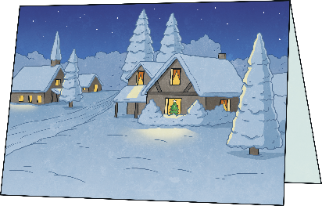
Mrs Bagley begins writing her Christmas cards at 3.00 p.m. It takes her I hour. What time does she finish writing them?
4.00 p.m.
Choose another Question
Show Answer

Slide 5
>
Does this sign mean
More than
Less than
Equals to
a) More than
Choose another Question
Show Answer

Slide 6
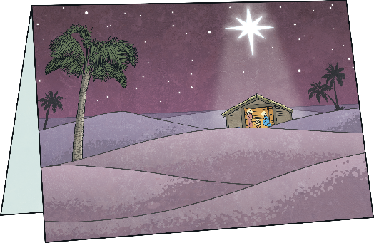
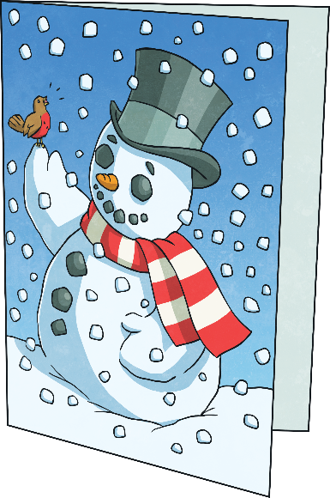
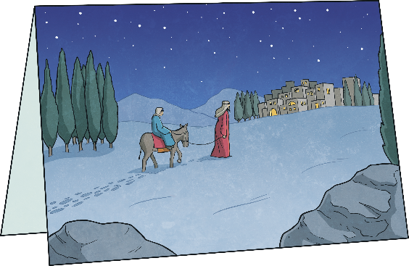
I am counting my Christmas cards in 2’s. What’s my next number?
2, 4 , 6, 8, ?
10
Choose another Question
Show Answer

Slide 7
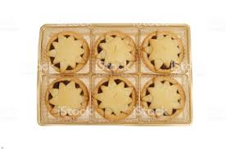
Mrs Claus has made two trays of mince pies. On each tray there are 6 mince pies. How many pies has she made altogether?
12 mince pies
Choose another Question
Show Answer

Slide 8
Is 6 an odd or even number?
Even
Choose another Question
Show Answer

Slide 9
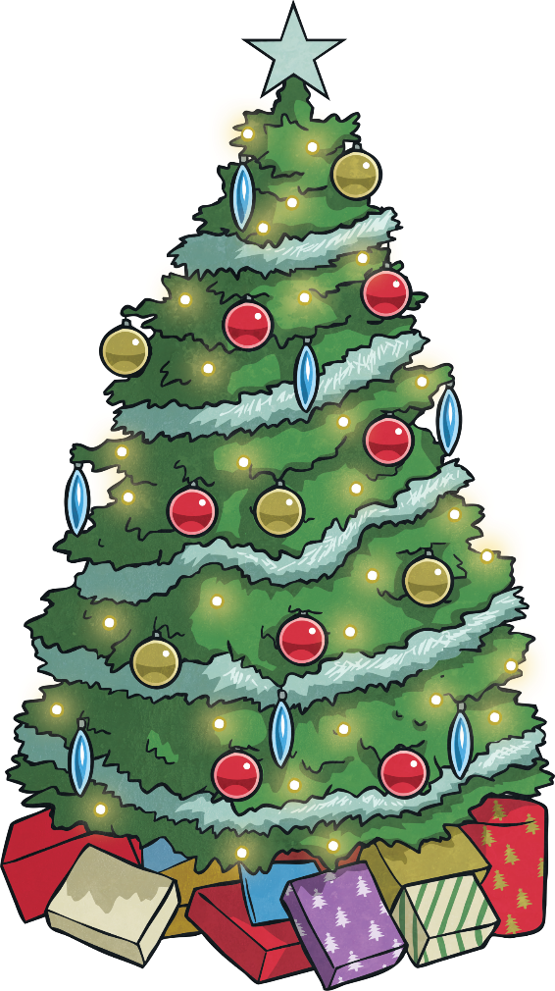
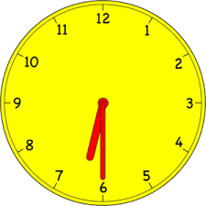
Jack wakes up at 6.30a.m! He has to wait half an hour before he can go downstairs. What time can he go downstairs?
7 o’clock
Choose another Question
Show Answer

Slide 10
Each box contains 10 chocolates. If
Mrs West buys 4 boxes for her friends, how many chocolates will there be altogether?
40 chocolates
Choose another Question
Show Answer

Slide 11
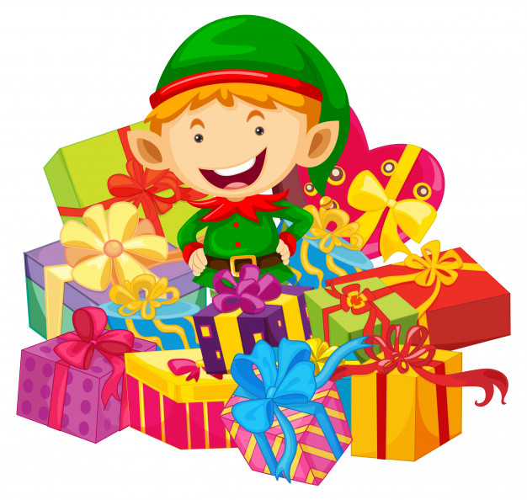
Santa’s elves are having problems counting all the presents! Can you help?
10 + 9 =
19
Choose another Question
Show Answer

Slide 12


Santa’s elves have put sparkly red bows on 6 presents and blue sparkly bows on 4 presents. How many presents have they put bows on altogether?
10 bows
Choose another Question
Show Answer

Slide 13
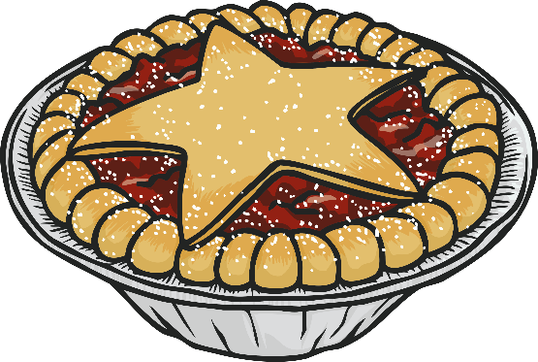

Mrs Claus was making mince pies for the annual North Pole party. She made 6 mince pies. Half of them have been eating by a cheeky elf! How many does she have left?
3 mince pies
Choose another Question
Show Answer

Slide 14
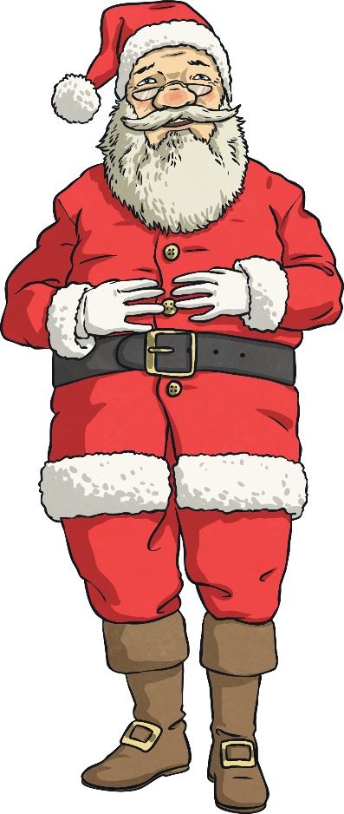
Ho! Ho! Ho!
I have a 2D shape it has 3 sides. What shape is it?
Triangle
Choose another Question
Show Answer

Slide 15
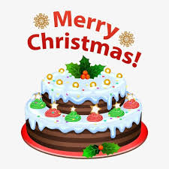
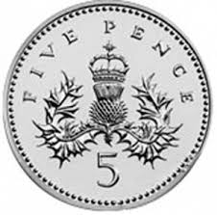
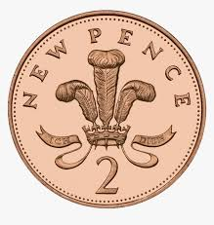
Mrs Bagley wants to buy a Christmas cake. It costs 10p. Does she enough money?
10p
No
Choose another Question
Show Answer

Slide 16
I want to use the number to solve this sum. Do I jump forwards or backwards?
22 – 9 =
backwards
Choose another Question
Show Answer

Slide 17
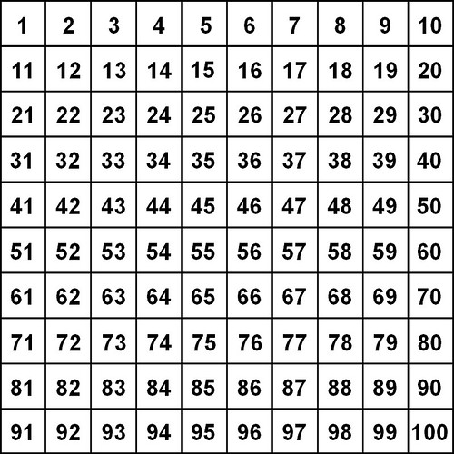
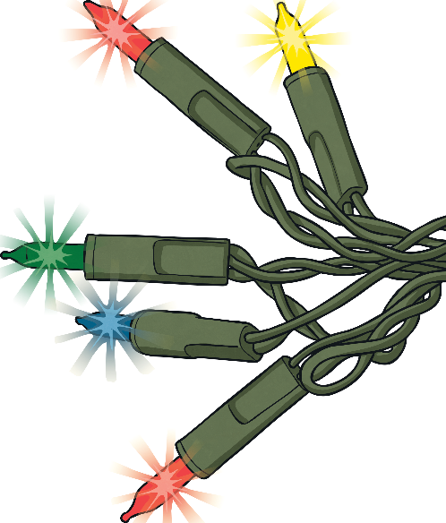
The Christmas lights are switched on. There are 100 fairy lights but 10 of them don’t work.
How many do work?
90
Choose another Question
Show Answer

Slide 18
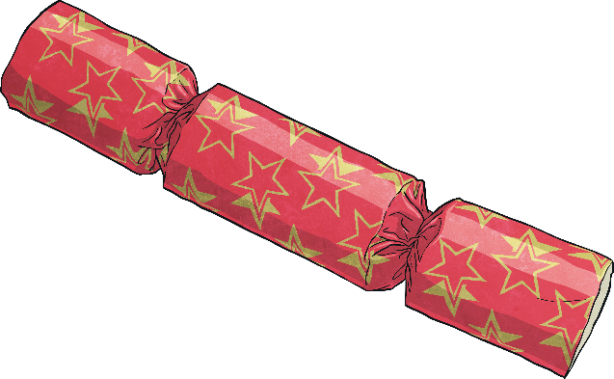

One cracker cost 5p. How much will two crackers cost?
10p
Choose another Question
Show Answer

Slide 19
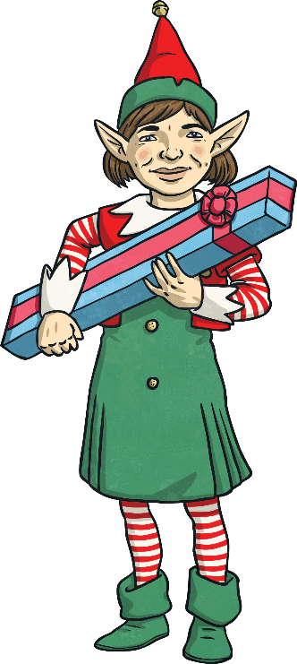


Jazzy the elf has wrapped 2 presents. She has another 3 to wrap. How many will she have wrapped altogether?
5 presents
Choose another Question
Show Answer

Slide 20

What 3D shape are the baubles on the tree?
sphere
Choose another Question
Show Answer

Slide 21

What 3D shape is my present?
cube
Choose another Question
Show Answer

Slide 22
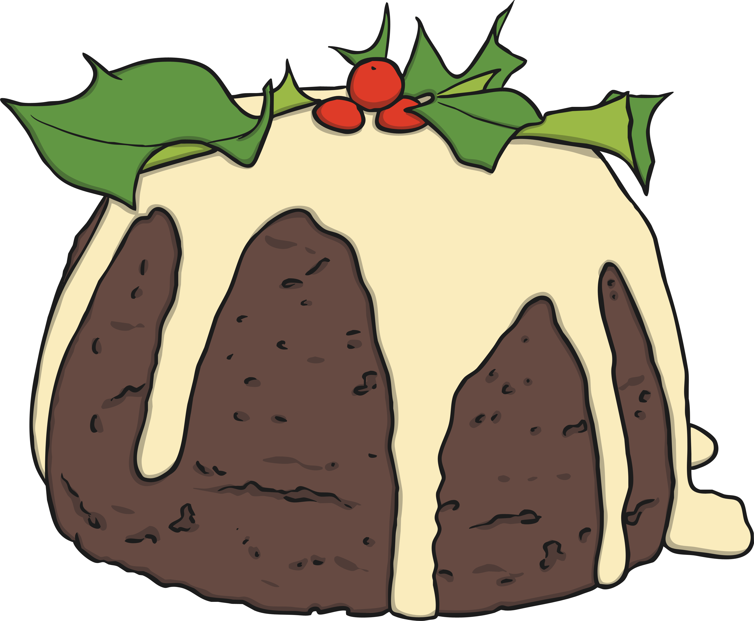
What is my hidden shape?
Pentagon
Choose another Question
Show Answer

Slide 23
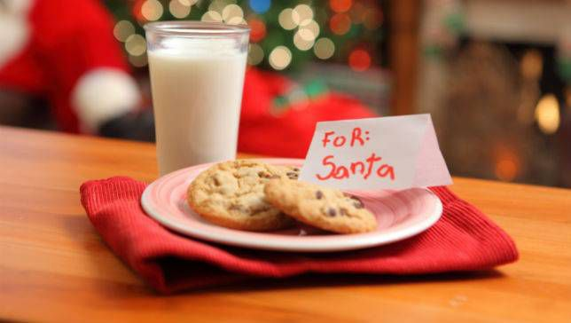
Is Santa’s milk class full or half full?
full
Choose another Question
Show Answer

Slide 24
Merry Christmas everyone!

