Slide 1
Welcome Elm Class
20.11.20
Today we will be consolidating this weeks work.

Slide 2
Learning Objective
To count forwards in steps of 2, 5 and 10.
Extension: To count backwards in steps of 2, 5 and 10.
Success Criteria
I can use place value to spot a pattern.
I can work out the next numbers in a sequence.
I can explain what happens to the ones digit and the tens digit.
I can use the pattern to help me count on and back from any number.

Slide 3

Let’s recap counting in 10’s

Slide 4







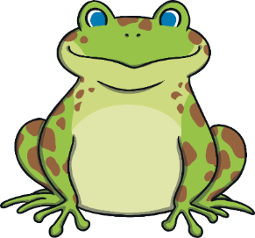
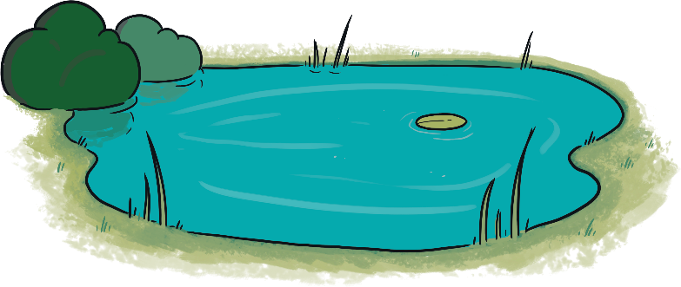

Remember It
Which is the odd one out?
Prove it!
A
B
C
A is the odd one out.
There are 11 circles. B and C both have 10 shapes each.

Slide 5





Counting in Tens from Zero
Can you count to 100
in steps of 10?
10
20
30
40
50
60
70
80
90
100

Slide 6

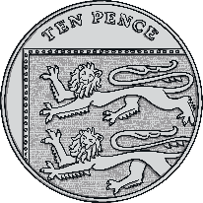
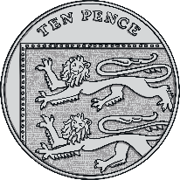

Counting in Tens from Zero
How much money is there?
There is 60 pence.
10
20
30
40
50
60
How many pencils are there?
There are 80 pencils.
1 ten
2 tens
3 tens
4 tens
5 tens
6 tens
7 tens
8 tens

Slide 7
Counting in Tens from Zero
Let’s count in tens and watch what happens on the 100 square.
1
2
3
4
5
6
7
8
9
10
11
12
13
14
15
16
17
18
19
20
21
22
23
24
25
26
27
28
29
30
31
32
33
34
35
36
37
38
39
40
They all end in zero !
41
42
43
44
45
46
47
48
49
50
51
52
53
54
55
56
57
58
59
60
61
62
63
64
65
66
67
68
69
70
71
72
73
74
75
76
77
78
79
80
81
82
83
84
85
86
87
88
89
90
91
92
93
94
95
96
97
98
99
100
What do you notice?

Slide 8
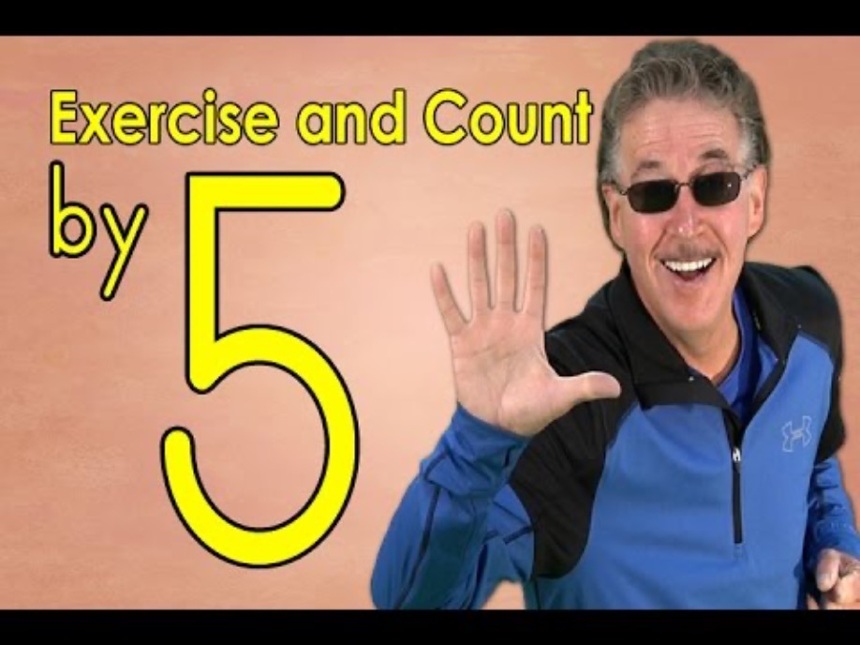
Let’s recap counting in 5’s

Slide 9

Count in 5s
25
How many fingers can you count?
Remember to count in 5s.

Slide 10
Counting in Fives from Zero
Let’s count in fives and watch what happens on the 100 square.
1
2
3
4
5
6
7
8
9
10
11
12
13
14
15
16
17
18
19
20
21
22
23
24
25
26
27
28
29
30
31
32
33
34
35
36
37
38
39
40
They all end in a five or zero!
41
42
43
44
45
46
47
48
49
50
51
52
53
54
55
56
57
58
59
60
61
62
63
64
65
66
67
68
69
70
71
72
73
74
75
76
77
78
79
80
81
82
83
84
85
86
87
88
89
90
91
92
93
94
95
96
97
98
99
100
What do you notice?

Slide 11
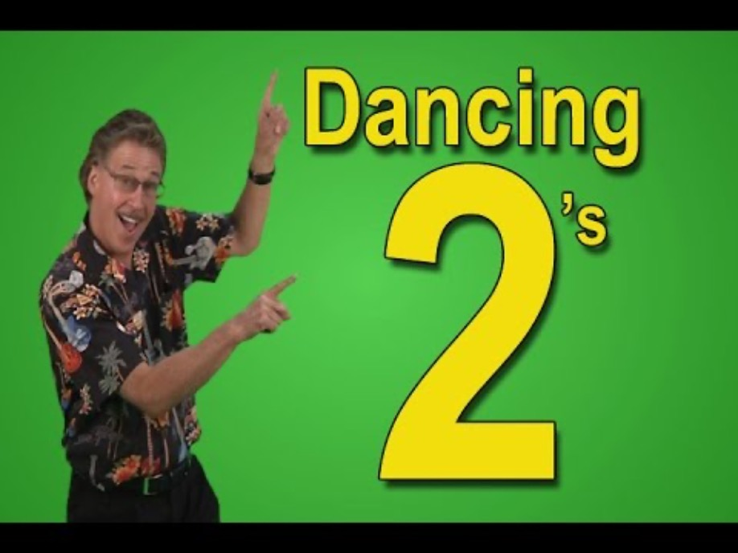
Let’s recap counting in 2’s

Slide 12


Counting in Twos
Let’s look at counting forwards in twos on a number line.
2 more
2 more
2 more
2 more
2 more
2 more
2 more
2 more
2 more
2 more
2 more
2 more
0
1
2
3
4
5
6
7
8
9
10
11
12
13
14
15
16
17
18
19
20
21
22
23
24
25
What do you notice about the numbers?
When counting forwards in 2s, we count on 2 more at a time, so our number gets bigger by 2 each time. They are even numbers. These numbers are in the 2 times table, which means they are multiples of 2.

Slide 13





Counting in Twos
Let’s look at counting backwards in twos on a number line.
2 less
2 less
2 less
2 less
2 less
2 less
2 less
2 less
2 less
2 less
2 less
2 less
0
1
2
3
4
5
6
7
8
9
10
11
12
13
14
15
16
17
18
19
20
21
22
23
24
25
What do you notice about the numbers?
When counting backwards in 2s, there is 2 less at a time, so our number gets smaller by 2 each time. They are even numbers. These numbers are in the 2 times table, which means they are multiples of 2.

Slide 14
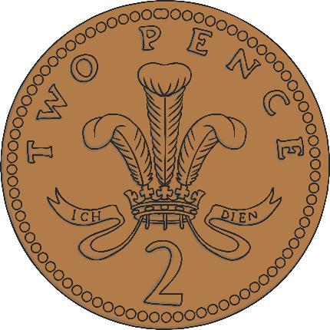
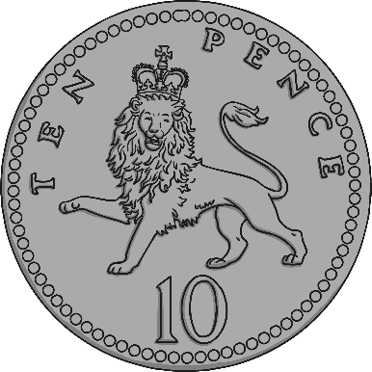
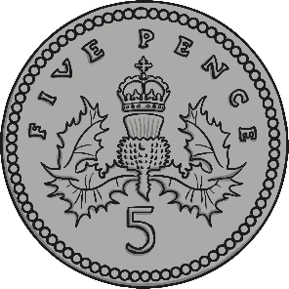
Can you remember the value of these coins?
2p
5p
10p

Slide 15


Count the coins in the jar.
4p

Slide 16

Count the coins in the jar.
14p

Slide 17
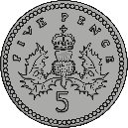
Count the coins in the jar.
15p

Slide 18
Count the coins in the jar.
45p

Slide 19
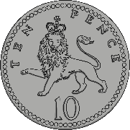
Count the coins in the jar.
60p

Slide 20
Count the coins in the jar.
50p

Slide 21
Todays challenges
1. Write in 10’s to 100
2. Write in 5’s to 50
3. Write in 2’s to 30
Extension Tasks. (for those who want to challenge themselves)
How high can you go writing in 2’s, 5’s or 10’s.
Can you write then backwards?

Slide 22
Fun Math's things you can do at home.
1. Sort some coins.
2. Count the money in 2’s , 5’s ,10’s
3. Sort out your socks. Count in 2’s
to count how many you have.
4. Time yourself – how quickly can you
count to 100 in 2’s, 5’s and 10’s?
5. Play an online Math's game.

