Slide 1


Year 1
High Frequency Words

Slide 2

Let’s read!
the
and
a
to
said
in
he
I
of
it
is
for
at
his
but
was
you
they
on
she

Slide 3

Let’s read!
that
with
all
we
can
are
up
had
my
her
what
there
out
this
have
went
be
like
some
so

Slide 4
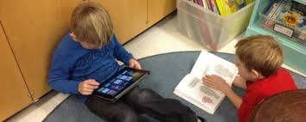
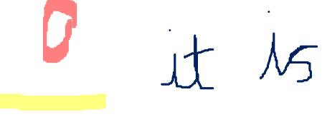
Let’s read!
not
then
were
go
little
as
no
mum
one
them
do
me
down
dad
big
when
it’s
see
looked
very

Slide 5
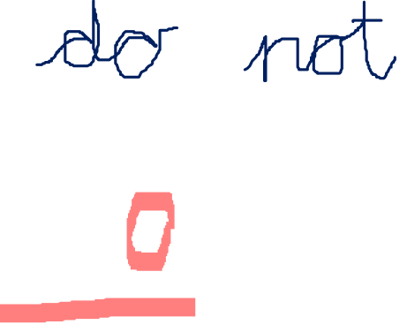
Let’s read!
look
don’t
come
will
your
back
from
got
him
Mr
get
just
now
came
oh
about
children
their
people
into

Slide 6

Let’s read!
put
could
house
old
too
by
made
time
day
I’m
if
help
Mrs
called
here
off
asked
saw
make
an

Slide 7

Year 1
Picture Quiz!

Slide 8
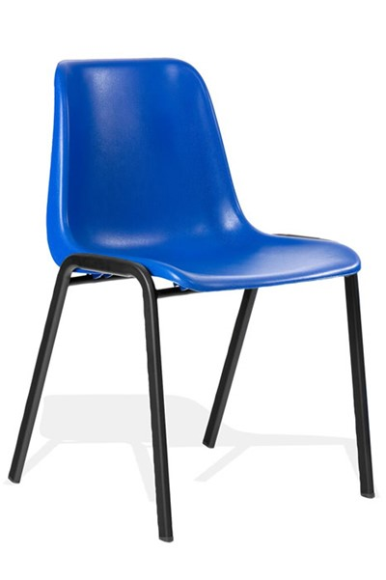
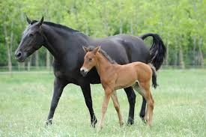
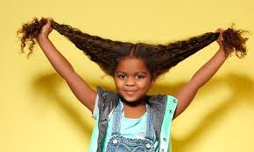
Look at the pictures…
Use Phonic knowledge to write and spell the word.

Slide 9

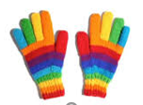

Look at the pictures…
Use Phonic knowledge to write and spell the word.

Slide 10
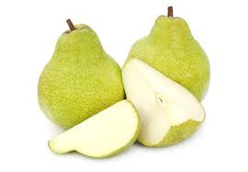
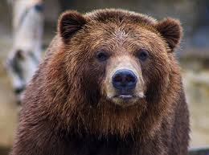

Look at the pictures…
Use Phonic knowledge to write and spell the word.

Slide 11
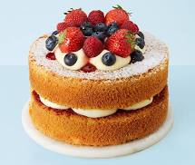

Guess the split digraph!
?
c - k -

Slide 12
Today, I would like you to practise writing sentences using the sentence rules.
Using words from the list of High Frequency Words for Year 1, please write 6 sentences.
How many words can you place in one of your sentences?

