Slide 1
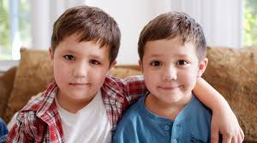

RE

Slide 2

Learning Objective: To identify a special person.

Slide 3
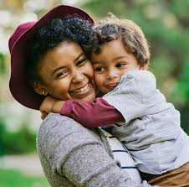
Who are the special people in your life?

Slide 4
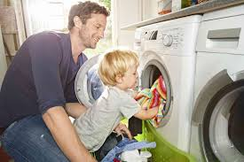
Do you have a special person that you sometimes help?

Slide 5
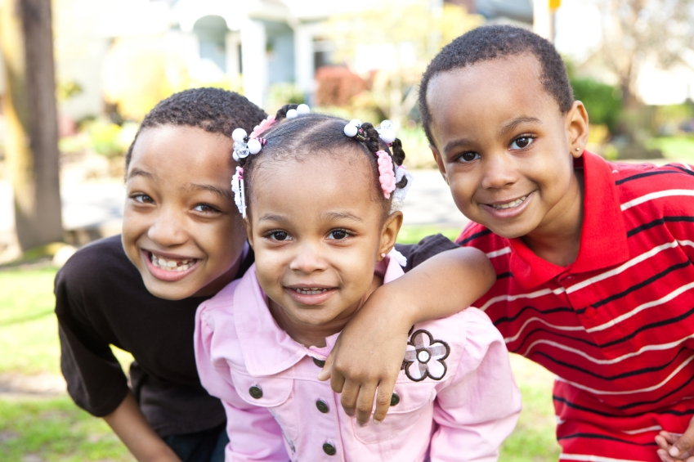
Do you have a special brother or sister?

Slide 6
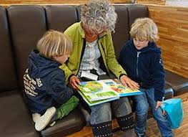
Do you have a special Nanny or Grandma?

Slide 7
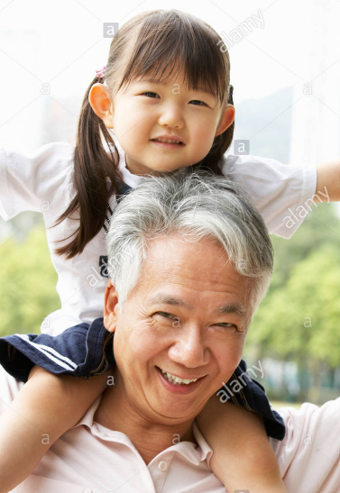
Do you have a special Poppa or Grandad?

Slide 8
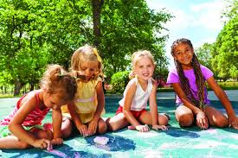
Do you have a special cousin?

Slide 9
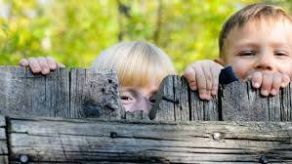
Do you have a special neighbour?

Slide 10
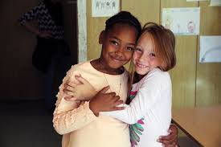
Do you have a special friend?

Slide 11

Draw your special person!
Write about this special person. Tell me who he or she is.
Write about their personality. Are they kind or funny?
Finally, tell me why they are special to you…

Slide 12
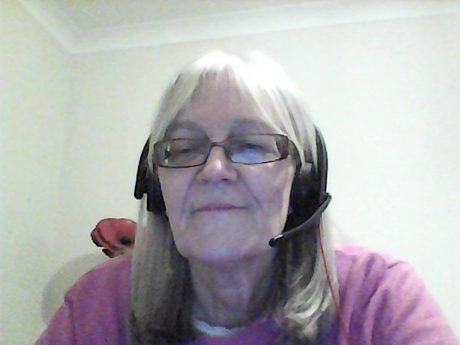
See you soon!

