Slide 1


Year 1 Phonics
air
are

Slide 2
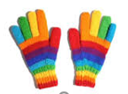
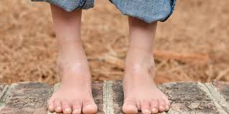
Let’s Think about trigraphs…
pair
bare

Slide 3
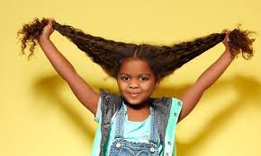
The sound ‘air’ is sometimes written with the letters ‘air’.
hair

Slide 4
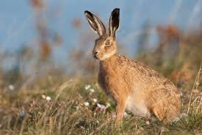
The sound ‘air’ is sometimes written with the letters ‘are’.
hare

Slide 5
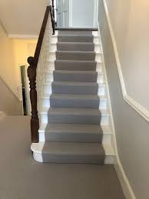
stairs

Slide 6
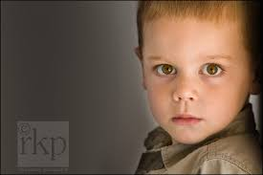
stare

Slide 7
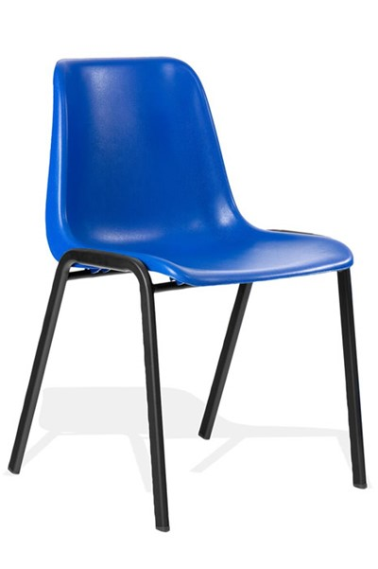
chair

Slide 8
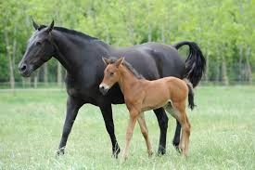
mare

Slide 9
square

Slide 10
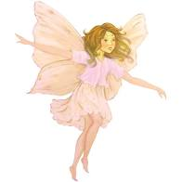
fairy

Slide 11
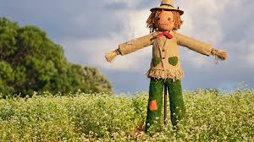
scarecrow

Slide 12
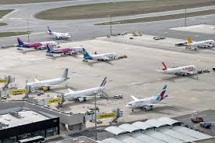
airport

Slide 13
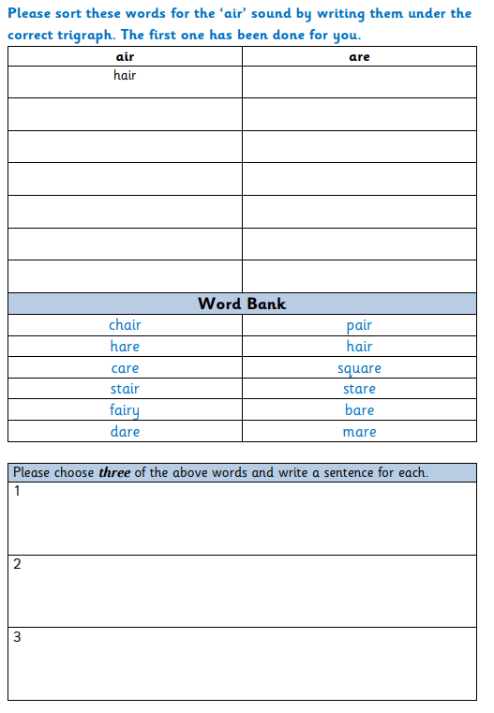
Task 1
Read the words in the word bank and sort them by writing them into the correct columns.
Choose three words and write a sentence for each word.

Slide 14
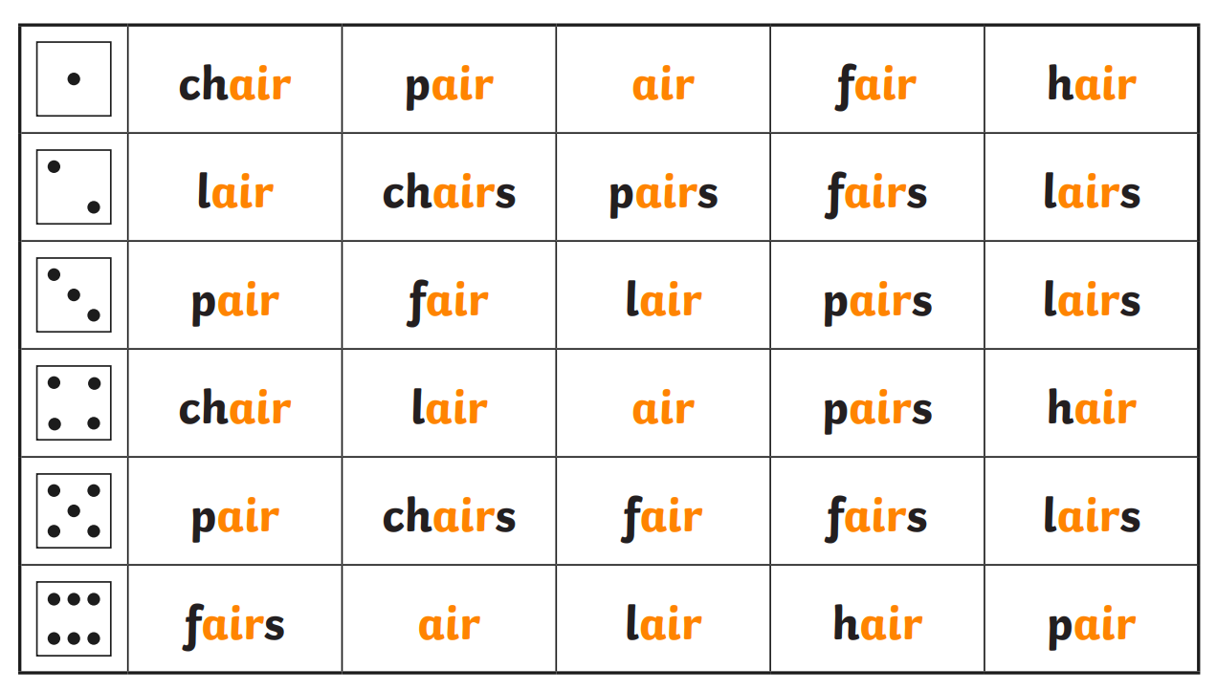
Task 2 – Roll and Read!

