Slide 1
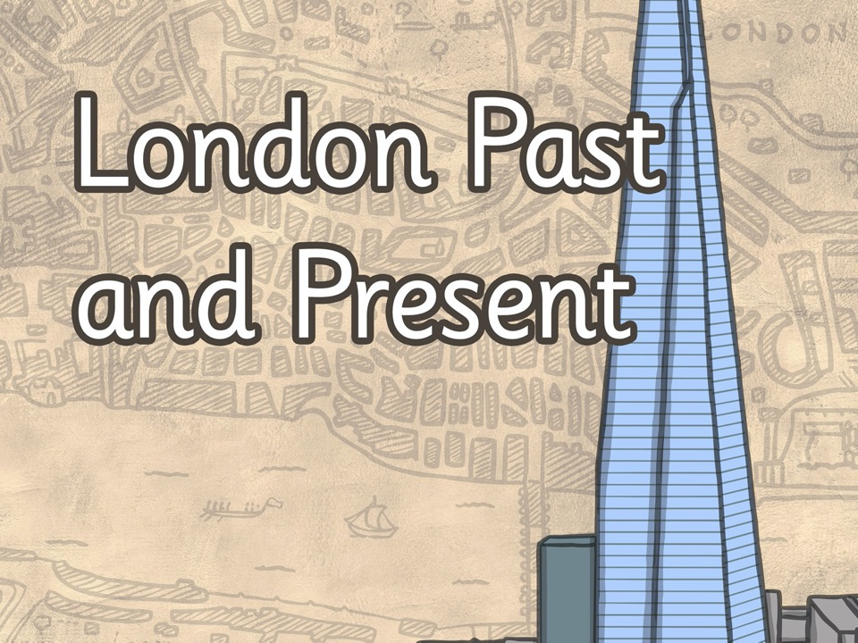

The Great Fire of London
Lesson 3

Slide 2
L.O: To compare London of 1666 to London today

Slide 3
London in 1666
We don’t have any photographs of what London was like in the past.

Slide 4
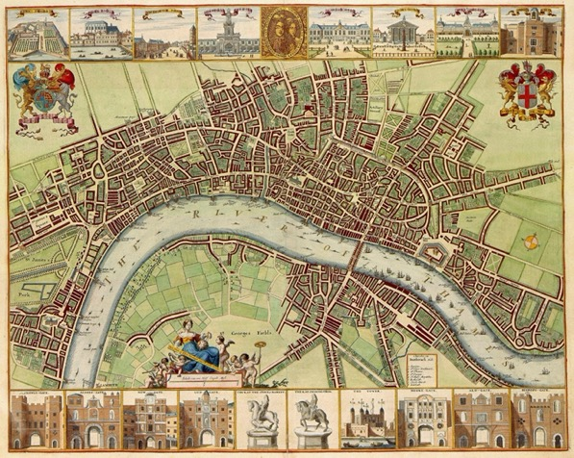
This is a 17th Century map of London- can you see the River Thames?
Photo courtesy of Felix Obholzer(@flickr.com) - - granted under creative commons licence - attribution

Slide 5
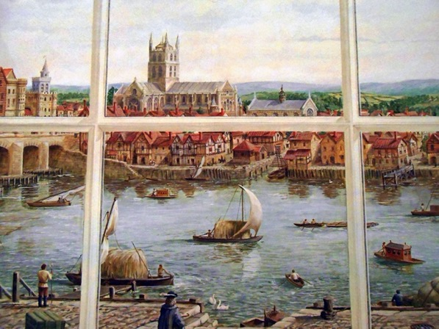
This is a painting of the Thames, London in the 17th Century
Photo courtesy of [Duncan](@flickr.com) - - granted under creative commons licence - attribution

Slide 6
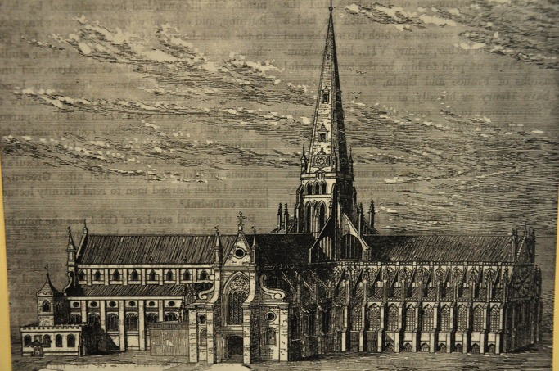
This is a drawing of St Pauls Cathedral (pre 1666)
Photo courtesy of Ben Sutherland(@flickr.com) - - granted under creative commons licence - attribution

Slide 7
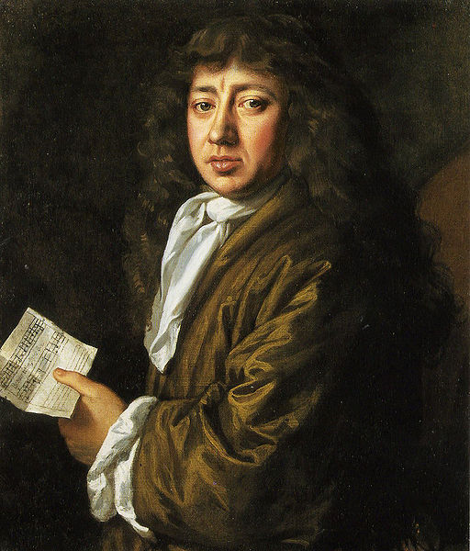
This is a painting of
Samuel Pepys (1633 – 1703).
He was a Member of Parliament and lived in London. He kept a very detailed diary from 1660 – 1669 and this diary became one of the most important sources of information about London during this time in history.
Photo courtesy of Robert Hoffstutter(@flickr.com) - - granted under creative commons licence - attribution

Slide 8
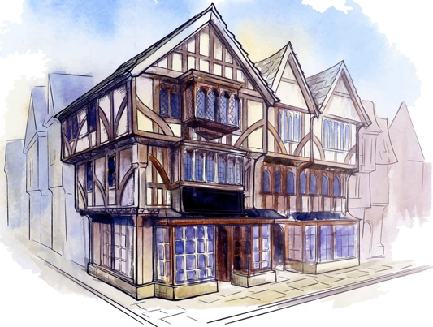
Houses and buildings
This is a painting of a Tudor house.

Slide 9
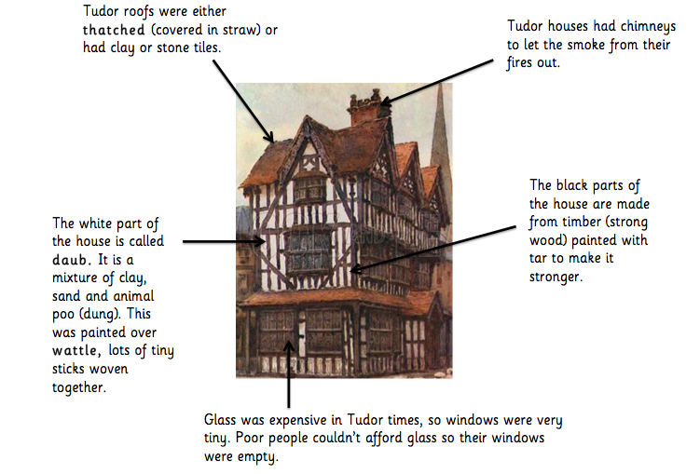
Houses and buildings

Slide 10
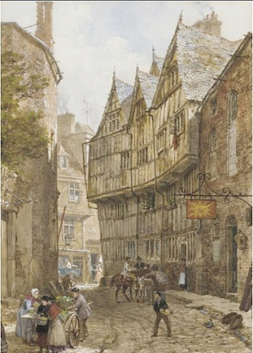
Houses and buildings
They were built very close together and the streets were narrow.
Lots of different families lived in the same house if they were not rich. Rich people owned their own houses and lived in the whole house by themselves.

Slide 11
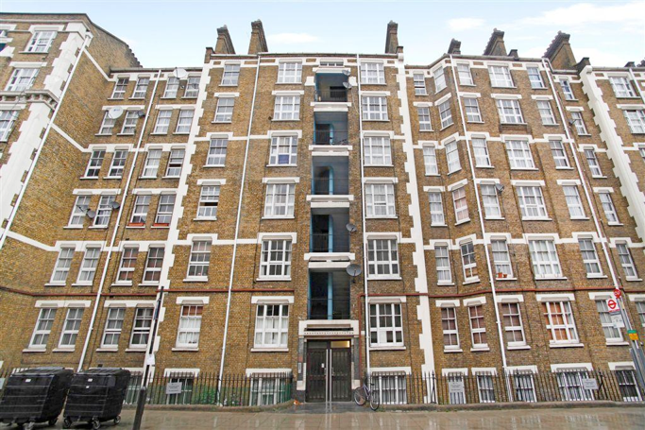
Houses and buildings
Most people in London today live in flats like these.

Slide 12
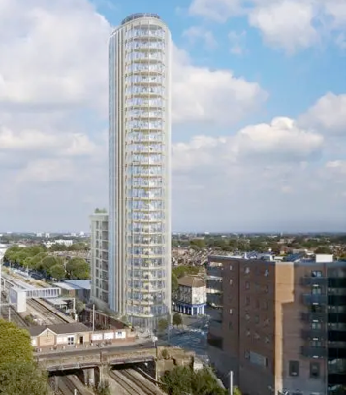
Houses and buildings
This is a photo of a tower block of flats.
Hundreds and hundreds of people can live in tower blocks because they are so tall.
Another name for these very tall buildings is skyscrapers.

Slide 13
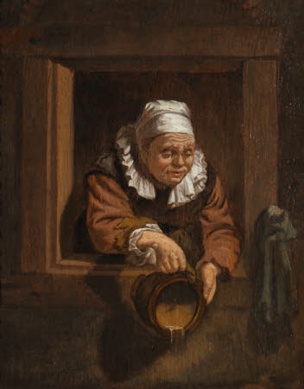
Houses and buildings
They had no toilets in 1666 so they would throw it out onto the street below.

Slide 14
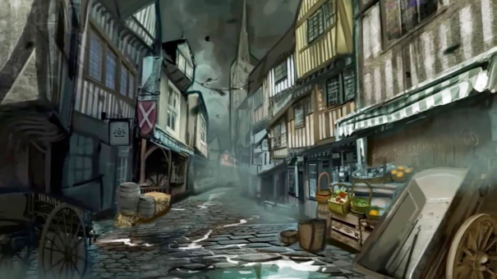
London at night
In 1666, London could be a very dark place at night.

Slide 15

London at night
There were hardly any street lamps.
The dark streets meant it was easy for thieves and robbers to pounce on people as they walked around. The streets of London in 1666 were not very safe because of this, and also because you could fall over on the bumpy roads in the dark.

Slide 16
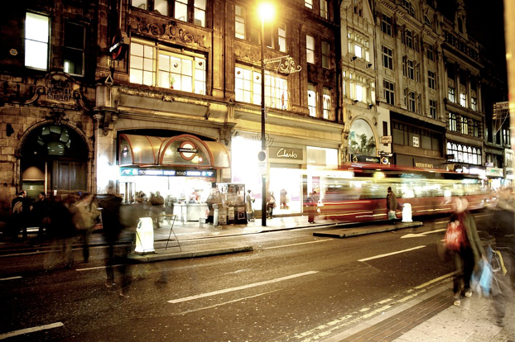
London at night
This is a picture of London at night.

Slide 17
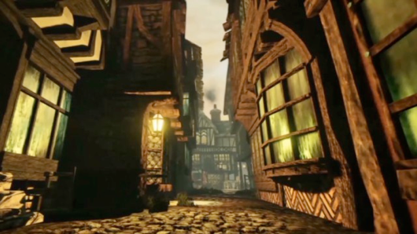
London at night
This street has one lamp hanging outside somebody’s house. That means they were responsible for making sure it was lit.
Can you see the dim lights coming from inside the houses? There was no electricity in 1666. Instead, people lit a fire in order to see. This is also how they kept warm.

Slide 18
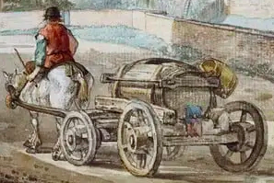
Transport
In 1666, people either walked or travelled by horse and cart.
If you could afford it, you would pay someone to take you in their cart.

Slide 19
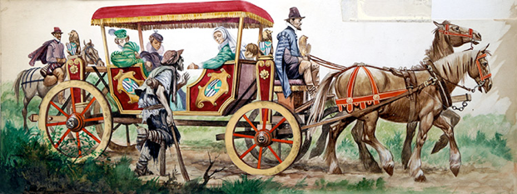
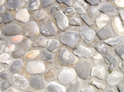
Transport
The more people were travelling, the more horses you needed.
The roads were not smooth like they are today. They were cobbled.
People and horses sometimes tripped on the uneven roads.

Slide 20
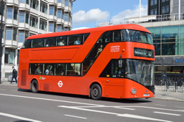
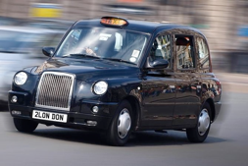
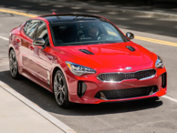
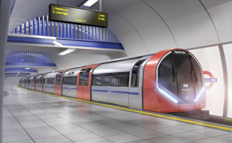

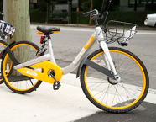
Transport
Do you think any of these modes of transport were around in 1666?

Slide 21
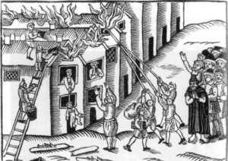
Fire engines
There were no fire engines in 1666.

Slide 22
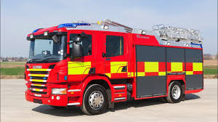
Fire engines
Today we have a trained Fire Brigade who we can contact of there is a fire.

Slide 23
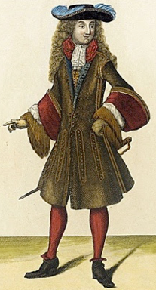
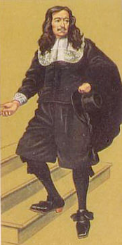
People
Most men wore thick tights
This man is not quite as rich. He doesn’t have a wig – instead, he has grown his own hair.
Rich people (both men and women) wore fabrics like silk, velvet and linen.

Slide 24
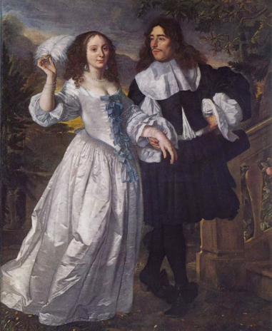
People
Women wore long dresses which were very tight around their chest and stomach.
They wore something called a corset, which sucked their stomachs in and made them look like they had tiny waists.
Rich women often wore feathers in their hair. They liked their hair to be in curly ringlets.

Slide 25
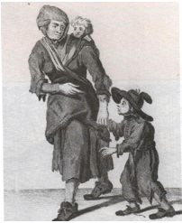
People
Poor people in 1666 wore clothes made out of simple wool and cloth.

Slide 26
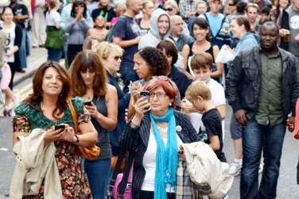
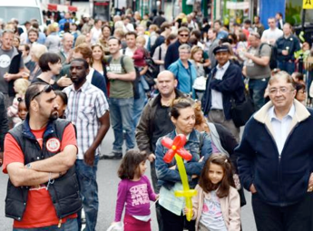
People
Nearly 9 million people live in London.

Slide 27
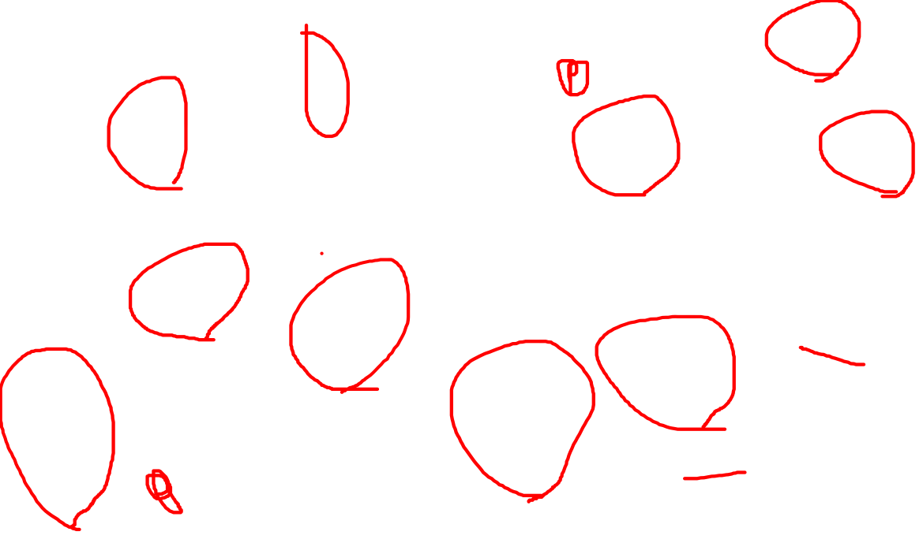
1666
Today

Slide 28
Task
In London in 1666 the houses were made from wood and close together. In London today people live in flats.

