Slide 1
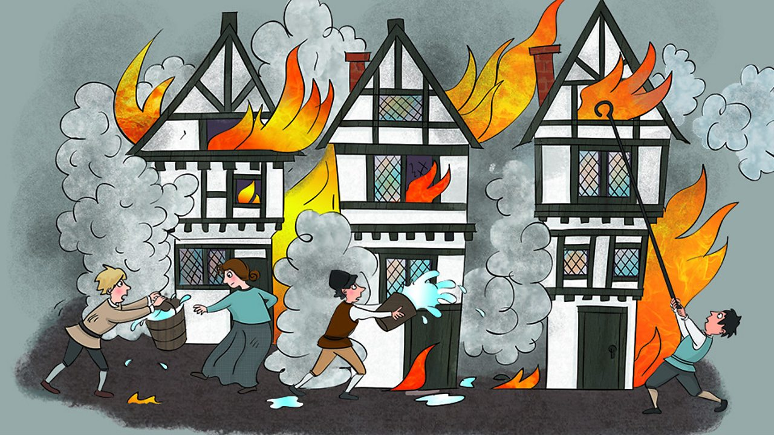

The Great Fire of London

Slide 2
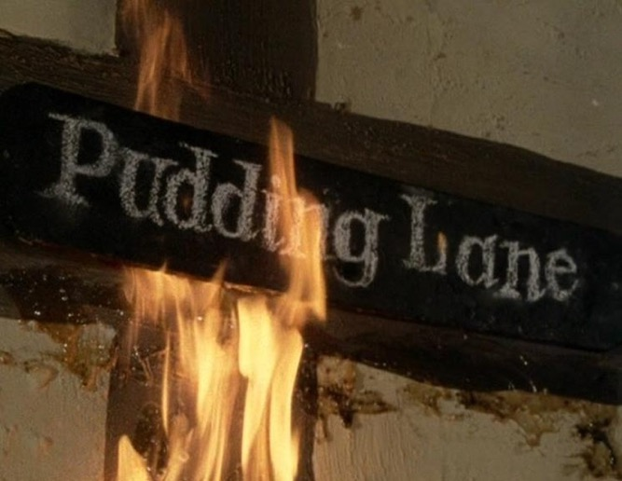
The fire started in the King’s bakery in Pudding Lane. The shop was owned by Thomas Farrinor.
It is believed that a spark from the bakers oven started the fire.
It is reported that the maid died because she was too scared to jump.

Slide 3
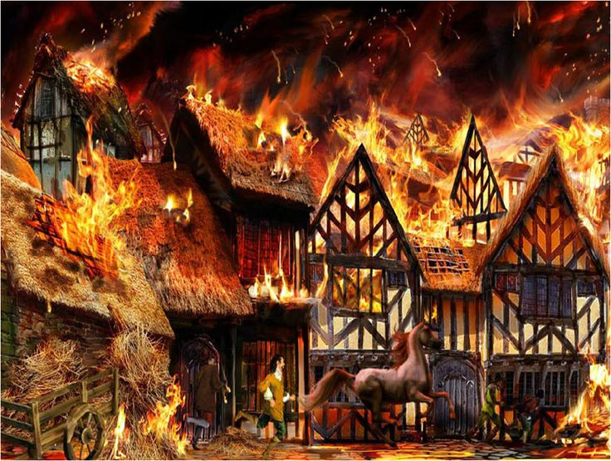
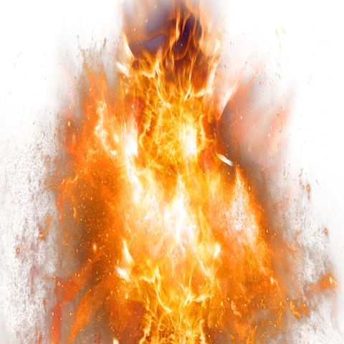
Fanned by the east wind, the fire burned fiercely spreading to buildings in the south, the east and in the west of London.
The heat was so intense that no one could get close enough to fight the flames!

Slide 4
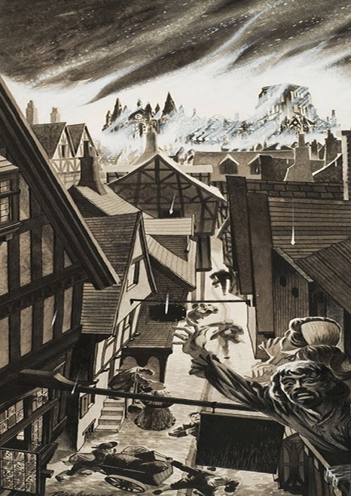
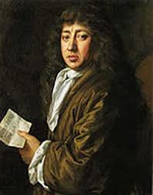
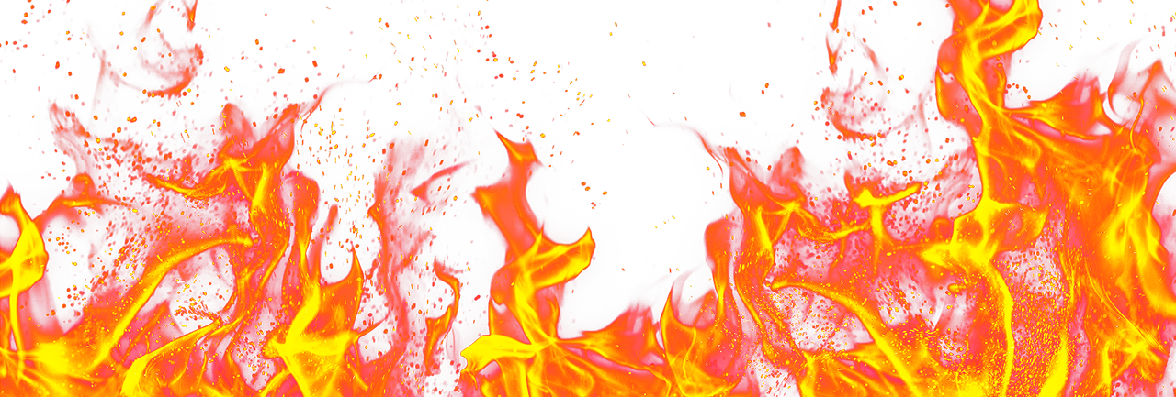

In 1666 the buildings were build very close together. They were made from wood and often had thatched roofs.
This meant that the fire spread quickly jumping from house to house.

Slide 5

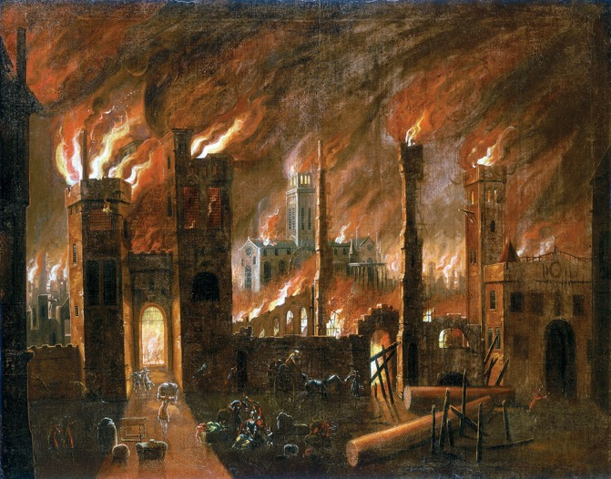
A strong wind was blowing which meant that the fire spread very quickly.

Slide 6
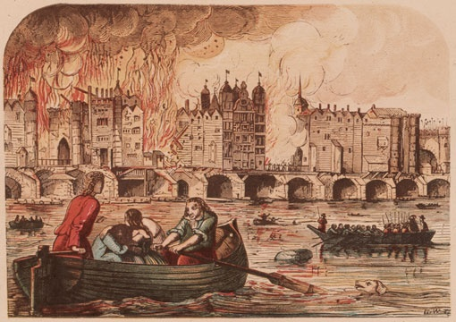
People were frightened as they did not know what had started the fire.
Families fled London, some escaped on boats on the River Thames.

Slide 7


People used bucket of water and fire squirts to try and put the fire out.
Houses were knocked down to stop the spread of the fire.

Slide 8

We know lots about the fire because Samuel Pepys kept a diary.
‘’ It made me weep to see it’’.

Slide 9
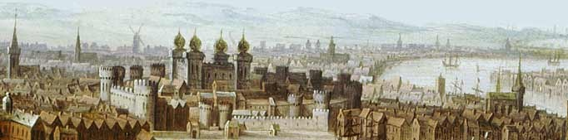
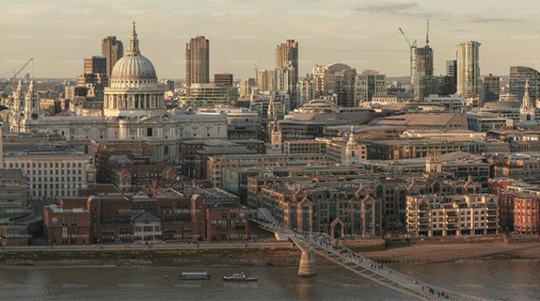
Life in Tudor London…
and London today.

Slide 10
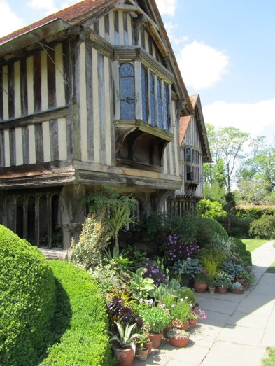
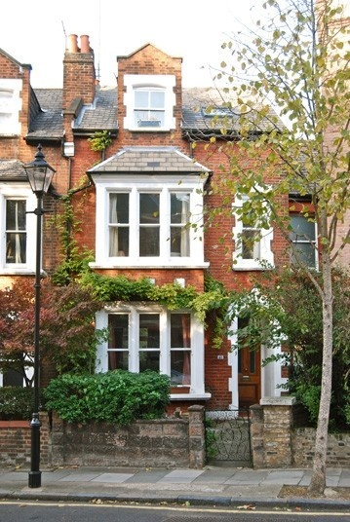
Tudor house
London house today

Slide 11
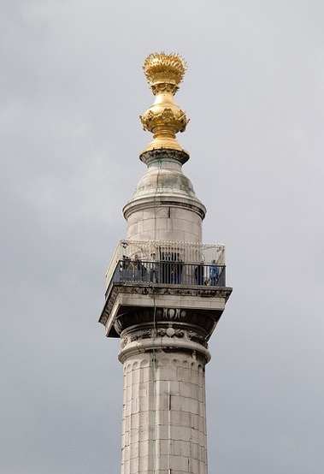
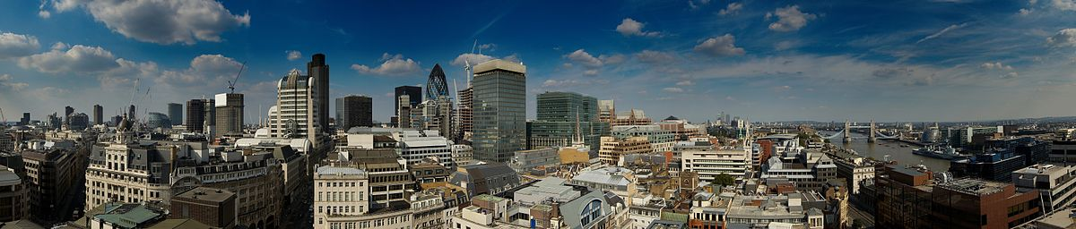
A monument was built to remember the Great Fire of London - 1666

Slide 12
Task

