Slide 1


Year 1 Phonics
wr
mb

Slide 2

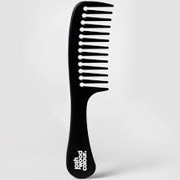
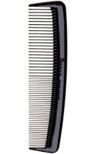
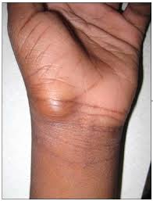
Let’s Think about Silent Letters…
wrist
comb

Slide 3

Words that end with the sound ‘m’ are
sometimes spelt with the digraph ‘mb’.
climb

Slide 4
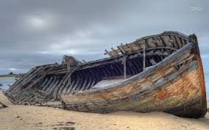
Words that start with the sound ‘r’ are
sometimes spelt with the digraph ‘wr’.
wreck

Slide 5

write

Slide 6

thumb

Slide 7

wrong

Slide 8
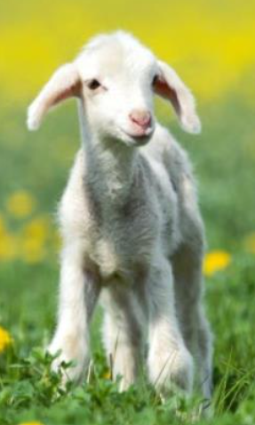
lamb

Slide 9
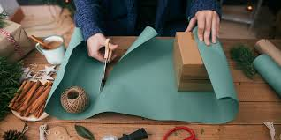
wrap

Slide 10

bomb

Slide 11
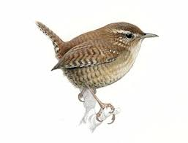
wren

Slide 12
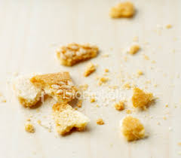
crumb

Slide 13
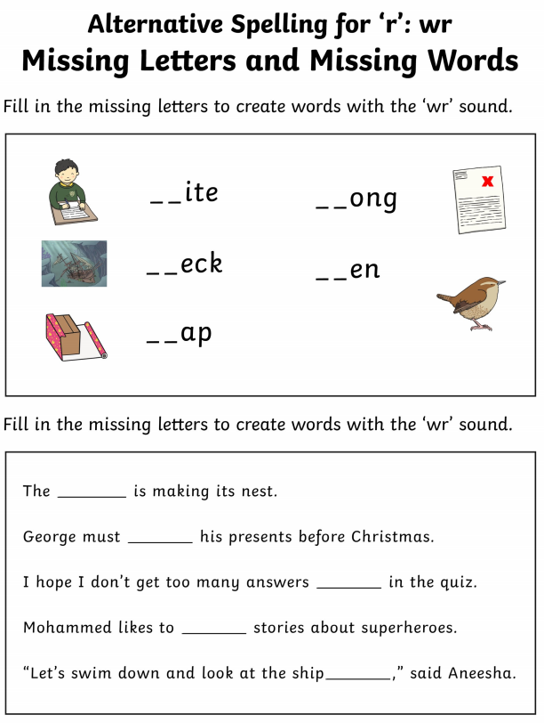
Task 1
Fill in the missing letters with the ‘wr’ digraph.
Use these words to complete the sentences. Read the sentences to check that they make sense.

Slide 14
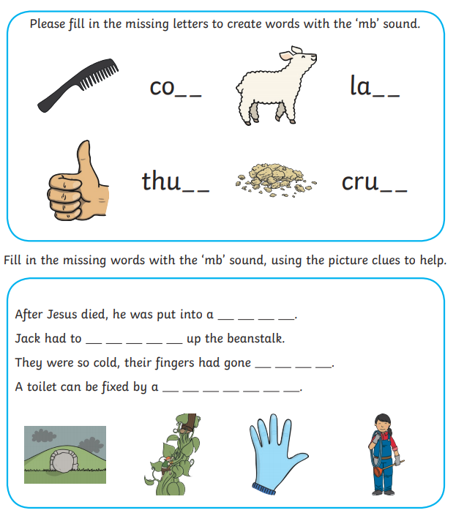
Task 2
Fill in the missing letters with the ‘mb’ digraph.
Use the pictures at the bottom to complete the sentences. Read the sentences to check that they make sense.

Slide 15
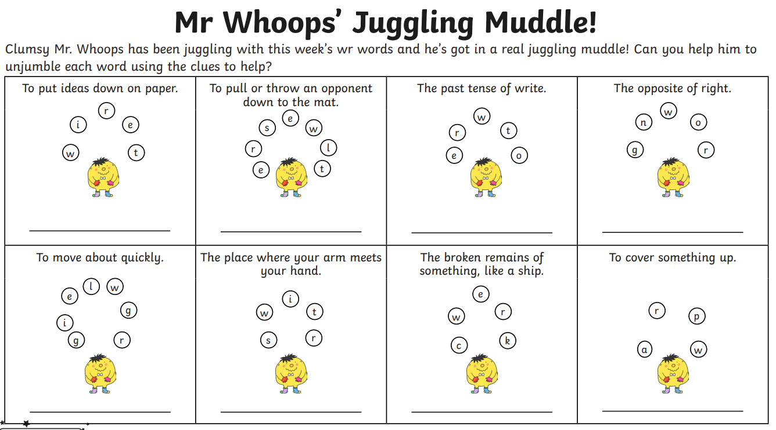
Task 3 – Just for Fun!

