Slide 1

Tuesday
2nd March 2021

Slide 2
L.O: To measure length and height.

Slide 3

Starter
https://www.youtube.com/watch?v=jshiAs9HGOE

Slide 4

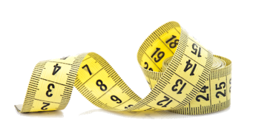
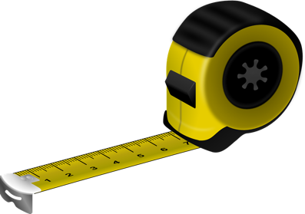
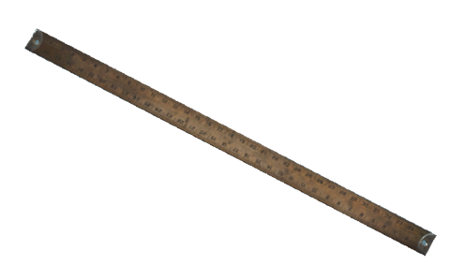
We use centimetres as a standard unit of measure
This Photo by Unknown Author is licensed under CC BY-SA

Slide 5

Remember to line up the item at 0 when measuring.
Each mark is 1cm

Slide 6
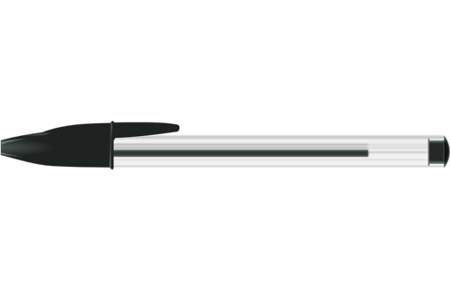
How long my special marking pen?
8
The pen is _______ cm long.

Slide 7
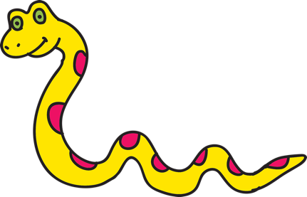
How long is the slithering snake?
14
The snake is ____ cm long.

Slide 8
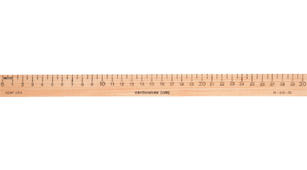


How do we measure with this ruler?
14
The snake is _______ cm long.

Slide 9

We use measure height and length.
Height
Length

Slide 10


Measuring Height
The toy knight is 5 cm tall

Slide 11
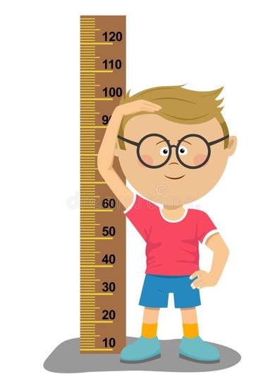



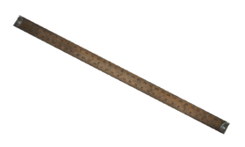
What would you use to measure how tall you are?
A. Ruler
B. Tape
C. Tape Measure
D. Meter stick
This Photo by Unknown Author is licensed under CC BY-SA

Slide 12
When we talk about height we use these words
Tall
Taller
Tallest
Short
Shorter
Shortest

Slide 13
Fill in the missing words

Slide 14

Measuring Length
The book is 4cm long

Slide 15
When we talk about length we use these words
Long
Longer
Longest
Short
Shorter
Shortest

Slide 16
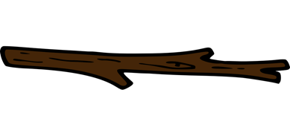
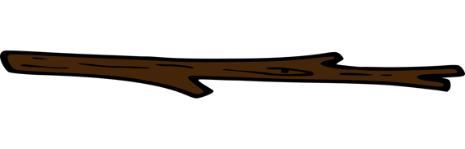
Which stick is the longest?
Stick A is 7cm long
A
Stick B is 10cm long
B
B

Slide 17
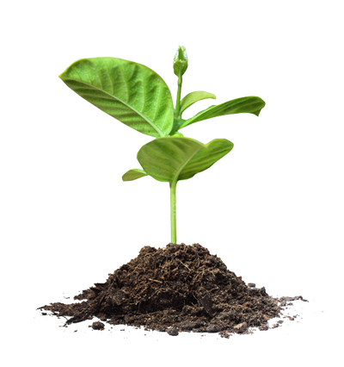
Have I measured the height or the length?
Height
22cm
The plant is 22cm tall.

Slide 18
Have I measured the height or the length?
Length
10cm
The leaf is 10cm long.

Slide 19
.
Task 1

Slide 20
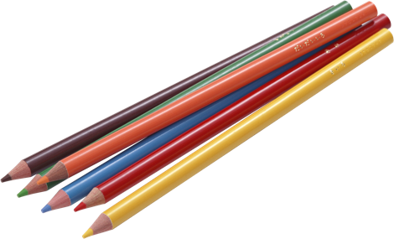
.
Task 2
Measure the length of your pencils.

Slide 21

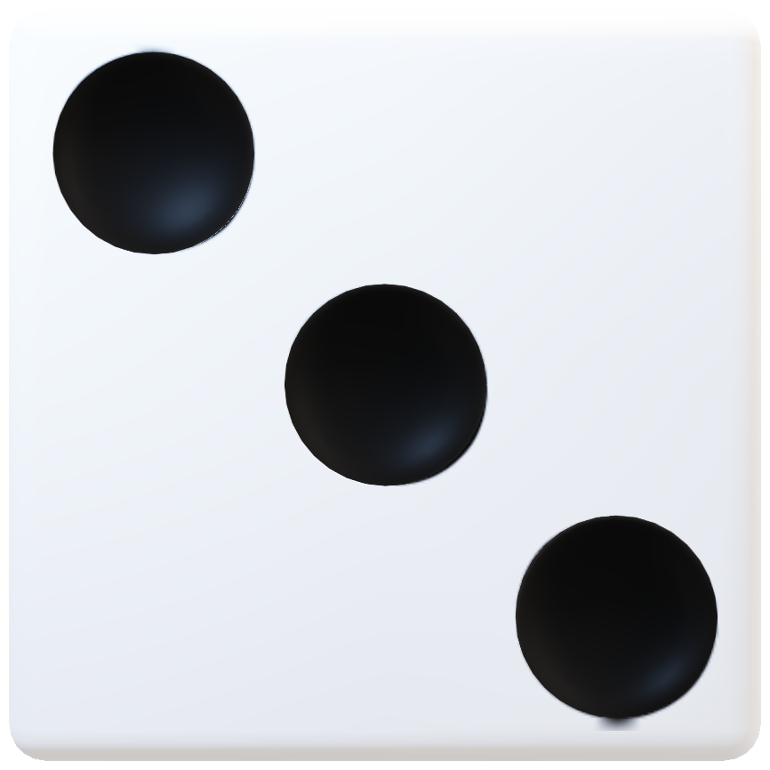
.
Extension Task
8cm + 2cm = 10cm

