Slide 1

Quiz!

Slide 2
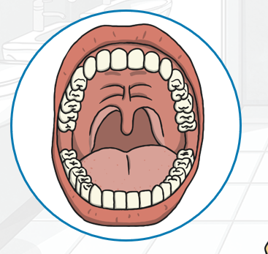
What are our teeth called and what are they used for?
canines are used to tear or rip food apart.
Incisors are used to cut food by biting.
Pre-molars are used to crush or squash food.
Molars are used to grind food.

Slide 3
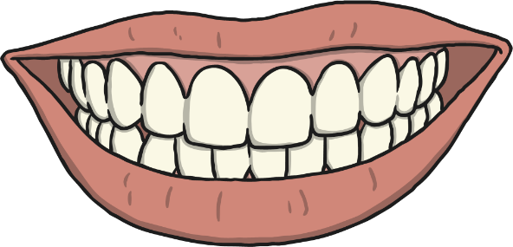
1
How many sets of teeth do we have throughout our lives?
a)
six
b)
two
c)
one

Slide 4
2
Do all animals have teeth?
a)
No, there are some animals such as birds that don’t have teeth
b)
Yes, every single animal has teeth
c)
Don’t be silly! Have you ever heard of a fish with teeth?

Slide 5
3
Why do we have teeth?
a)
So that we can show them off when we smile
b)
To taste food.
c)
To cut, tear and crush food in our mouths before we swallow

Slide 6
4
Tigers and leopards are carnivores. What food do carnivores eat?
a)
Just plants
b)
Just meat
c)
Both meat and plants

Slide 7
5
Which types of teeth are used to rip and tear food?
a)
Molars
b)
Incisors
c)
Canines

Slide 8
6
Cows and rabbits are herbivores. What food do they eat?
a)
Both plants and meat
b)
Just meat
c)
Just plants

Slide 9
7
Humans are omnivores. What should we eat in order to stay healthy?
a)
A varied diet with lots of different types of food
b)
Only meat
c)
Only vegetables

Slide 10
8
Which teeth are used for crushing and grinding food?
a)
Incisors
b)
Molars
c)
Canines

Slide 11
9
What is the job of the incisor teeth?
a)
Cutting off pieces of food so that they are bite-sized
b)
Tearing food
c)
Crushing and chewing food

Slide 12
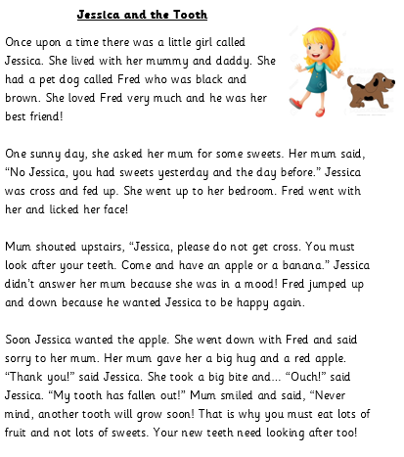
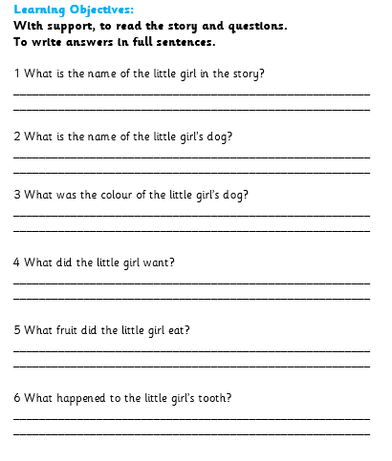
Reading Comprehension

